Slide 1
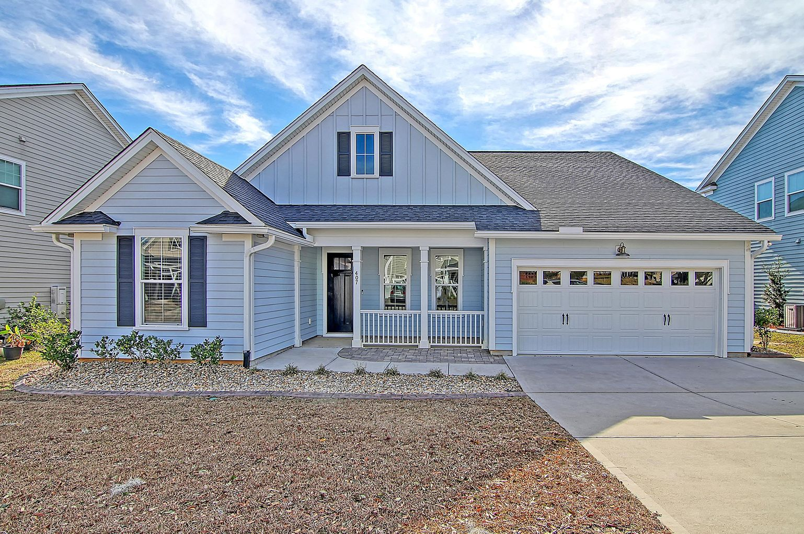
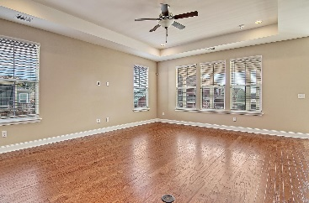
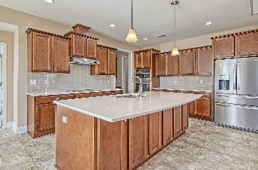
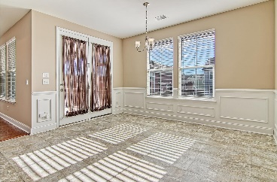
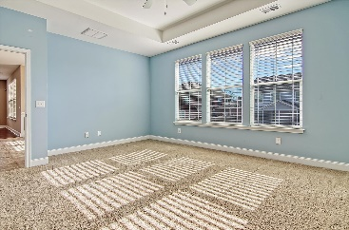
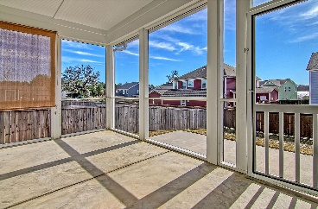
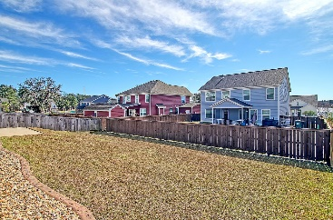
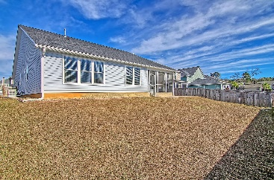
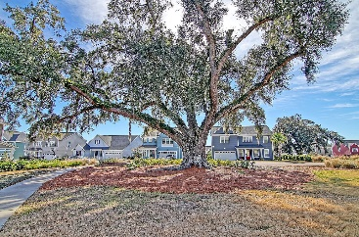

407 Ambergate Lane
Foxbank Plantation · Moncks Corner, SC 29461
MLS# 22000654 · $420,000
New Listing! Loaded With Upgrades!
Gorgeous, like new, one story living home with stunning curb appeal in desirable Foxbank Plantation! Upon entering the home you are greeted with handsome hardwood flooring, open floor plan and an abundance of natural light. The foyer is large and welcoming, and to the left are two nicely sized bedrooms that share a full bath. Continuing in is the oversized family room that is open to the chef inspired kitchen with HUGE island, quartz countertops, 42'' custom cabinets with drawer pullouts, stainless steel appliances, GIGANTIC pantry, butler's pantry, and an eat-in area! The master bedroom suite is large, has a tray ceiling, wall of windows and spectacular walk-in closet with custom shelving that opens directly to the laundry room. The ensuite master bath has an oversized shower with dual shower heads, glass shower door, and dual sink vanity-this is the perfect relaxing spa-like master bathroom! There is a mudroom area by the two plus car garage with a big walk-in storage closet. The wonderful screened-in porch is off the kitchen and leads to a large patio idea for grilling and a fenced backyard. Finally, the home is equipped with a Generac Generator! Foxbank Plantation in Moncks Corner is a wonderfully landscaped community with schools, an exercise area, walking jogging trails, and community pools! The neighborhood is close to local shopping and grocery stores and is a short drive to downtown Charleston with 5-star restaurants, world class shopping and iconic history as well as a short drive to the beaches, the airport, Boeing and Daniel Island. Come take a look because you will not find another home that offers as much as this one.
Take a video tour: https://vimeo.com/663480974
Stan Huff
843-670-2835
stan.huff@agentowned.com
Jill Marcacci
843-297-5590
jill@agentowned.com
www.agentownedrealty.com
AgentOwned Realty Co. Preferred Group, Inc. | 824 Johnnie Dodds Blvd | Mt Pleasant, SC 29464

