Slide 1
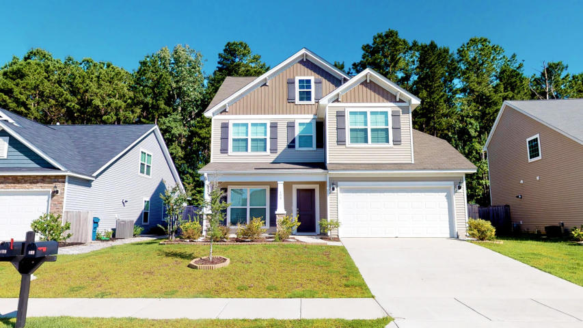
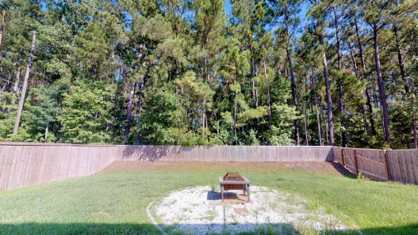
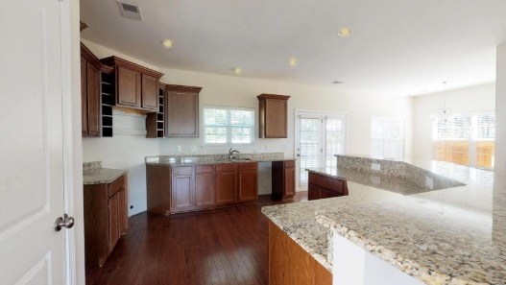
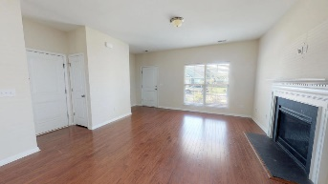
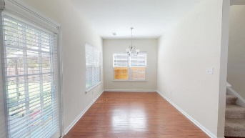
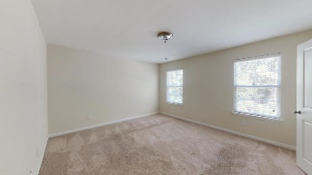
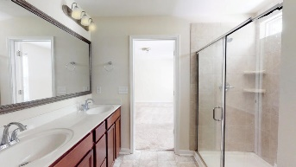
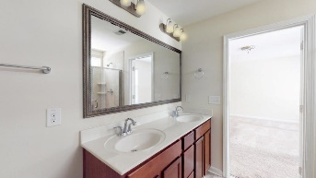


Like-new Construction | 4 Beds & 2.5 Bath Home Private yard & Energy-Saving Home!
This Home Has Been Detitled, Set On Permanent Foundation And Is Taxed With The Land As ONE Piece Of Real Property.
408 Allamby Ridge Road Spring Grove Plantation ~ Moncks Corner, SC 29461 ~ MLS# 19017682 ~ $259,900
Now's your chance to own this LIKE-NEW CONSTRUCTION in the desirable Spring Grove Plantation subdivision! Built in 2016, this 4 bedroom, 2 and a half bath HERS Rated and LEED Certified energy-saving home has tons to offer! Hardwood floors, Granite Countertops, gas fireplace, 9+ foot ceilings, endless amounts of cabinet space and storage, crown molding, home music port with speakers, Tankless Hot Water Heater, newer HVAC/roof, full-sized front porch, private fenced backyard that backs up to woods - this home has it ALL! On the second floor there's oversized guest bedrooms with walk-in closets and the master suite that features a 5' nicely crafted tile shower with dual vanities and HUGE closet. On the third floor, this room can be your 4th bedroom or also makes a GREAT movie/game room - wonderful for family time! Thinking about hosting an outdoor event or family get-together? Look no further! This home boasts a vast backyard with a privacy fence that backs up to the woods! Spring Grove Plantation offers a neighborhood pool, children's play park, wonderful disc golf course and walking trails! Come see this home today! Practically new construction!
Come see 408 Allamby Ridge Road TODAY!
Nick Mazzilli (843) 640-5575
nick@nickmcharleston.com www.nickmcharleston.com
Reside Real Estate LLC
155 Wingo Way Unit 421 Mt. Pleasant, SC 29464

