Slide 1
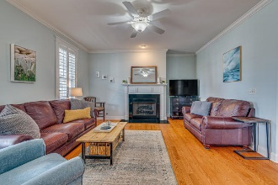
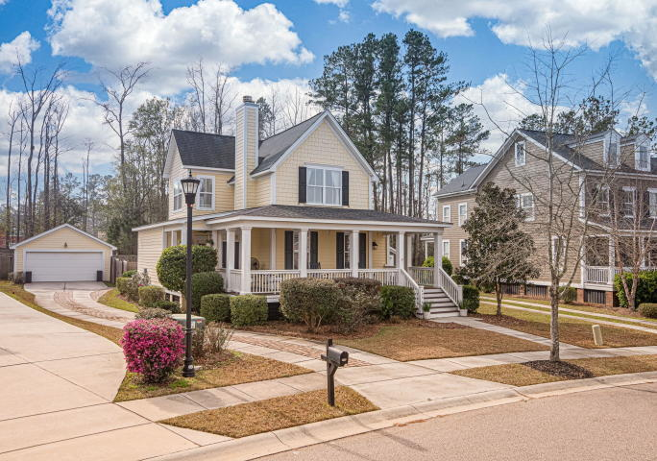
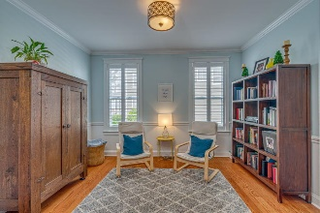
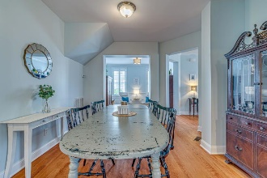
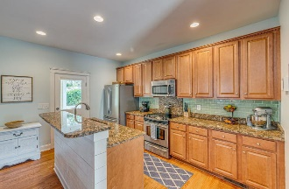
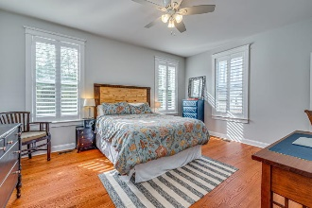
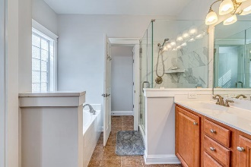
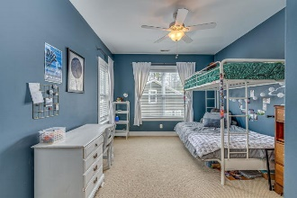
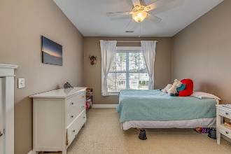
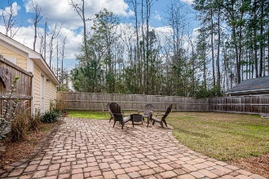
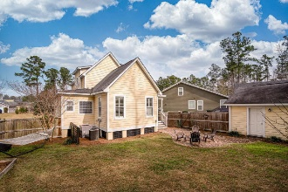


End Unit Townhome on Golf Course w/ Screened Porch
Starbucks card to first 10 agents
408 Brick Kiln Drive
Branch Creek ~ Summerville, SC 29483
MLS# 20001831 ~ $287,000
Fantastic home in pristine condition located within the desirable Dorchester II School District at a hot price point under $290k! This Lowcountry style home has a full wrap around front porch that exemplifies the Charleston Lifestyle and is ideal for just relaxing or entertaining. Gleaming hardwood floors encompass the entire first floor and greet you upon entering. The main level offers a traditional floor plan with a family room, gas fireplace and a wall of windows providing abundant natural sunlight. This room leads into the dining room and kitchen. The kitchen features stainless steel appliances, granite countertops, wood cabinets, glass tile backsplash, kitchen island with bar seating, and overlooks the dining room and adjacent room which can be used as a home office, playroom, or sitting area. First floor master suite offers a stand alone upgraded tiled shower, separate bathtub, dual sinks, and walk in closet. Upstairs are two large bedrooms separated by a full bathroom each with a large closet and extra storage. Upgraded plantation shutters on the first floor. The back porch opens up to a very desirable and highly sought after large private wooded lot, complete with hardscape patio pavers, fenced in yard, and detached two car garage that could also be used as a workshop.
Jerod Coulter, ABR, REALTOR
(843) 513-3741
jerod@realtor.com | www.HomesOfMountPleasant.com
The Boulevard Company, LLC | 35 Broad Street | Charleston, SC 29401

