Slide 1
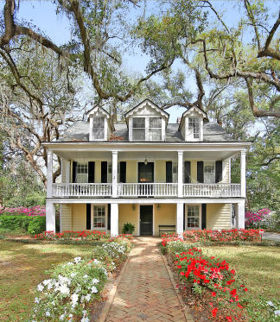
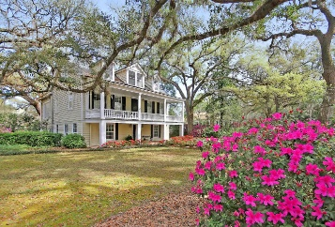
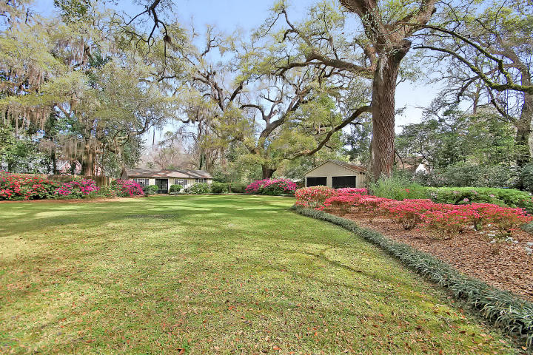
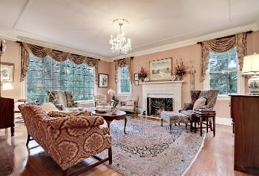
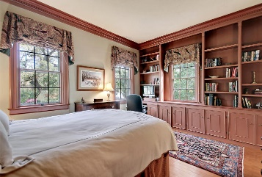
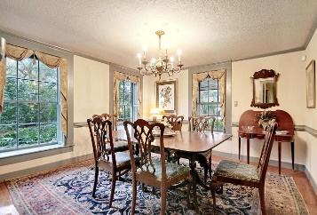
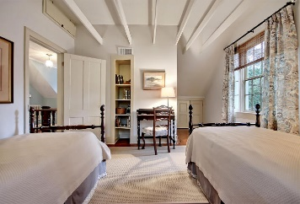
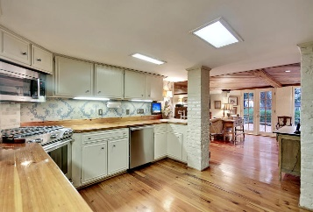
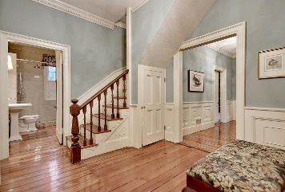
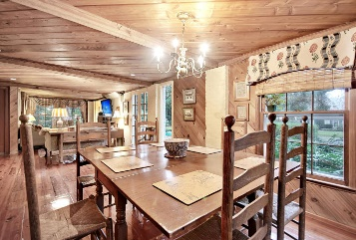
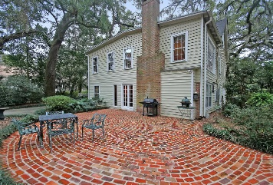
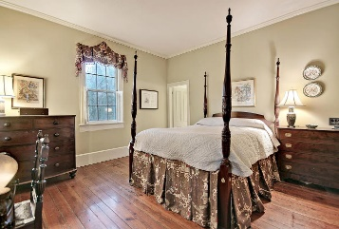
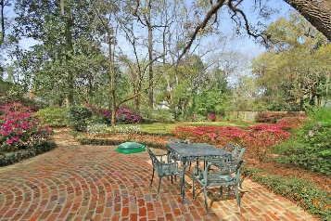
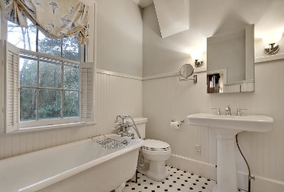
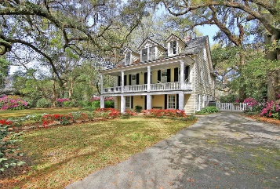

Nothing could be finer than Springtime in the Flowertown
408 Sumter Avenue
Historic District ~ Summerville, SC 29483 ~ MLS# 16002843 ~ $699,999
Located on one of the most desired streets in Summerville’s historic district, the “Brailsford-Browning House,” is a highlight of Summerville’s Walking Tour of Homes and Flowers and one of Summerville’s 29 oldest homes. Lovingly preserved and tastefully updated, this elegant home features old heart pine flooring, exquisite millwork and molding, 4 fireplaces, 2 clawfoot tubs, built-in cabinets and bookcases, and stainless appliances. Enjoy outdoor living at its finest in a spacious, private yard filled with 7 live oaks, over 100 azaleas, and dozens of camellias and hydrangeas. The grounds also boast a lovely brick patio, a 683 sq. ft. carriage house, and a 2-car detached garage. The carriage house offers additional storage or the opportunity to refinish and use as a guest or rental cottage.
Other features include:
* Stainless steel appliances in the kitchen, including a top-quality Miele dishwasher, a built-in Bosch microwave, and a brand new Kitchen-Aid gas over/range
* High-quality, custom shutters and window treatments throughout
* Ample storage space
* New roof in 2014 and new HVAC in 2012
* Rinnai Tankless Hot Water Heater
* Sonitrol Security System
* Located in the Dorchester District II school district
Don't miss this rare opportunity to own a piece of Summerville history that is minutes away from Summerville's historic downtown and convenient to everything else Summerville has to offer. Book your viewing today!
***Please note that this property is subject to an exterior preservation easement with the Charleston Historical Society.***
Julie Nims julie@mattoneillteam.com 843-580-6310

