Slide 1
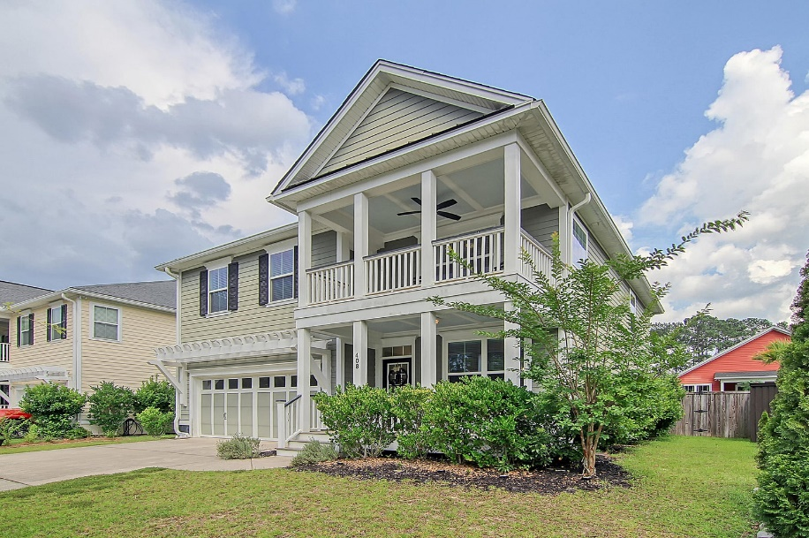
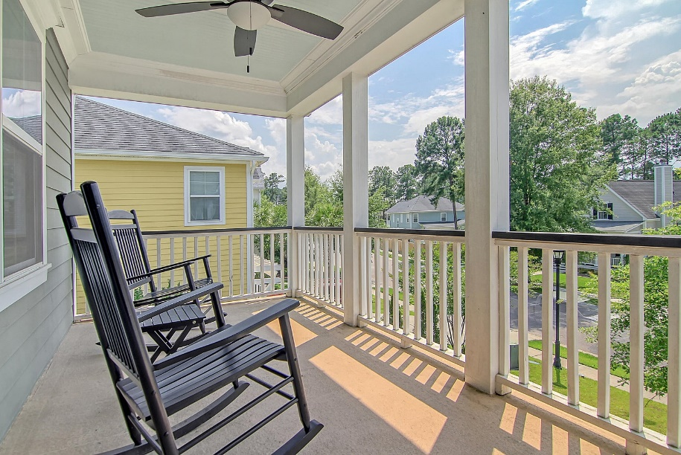
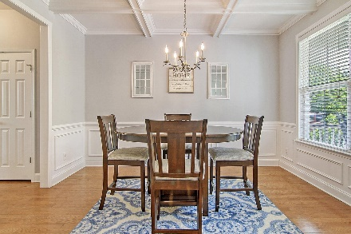
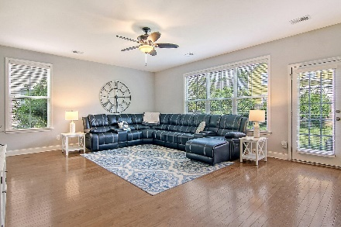
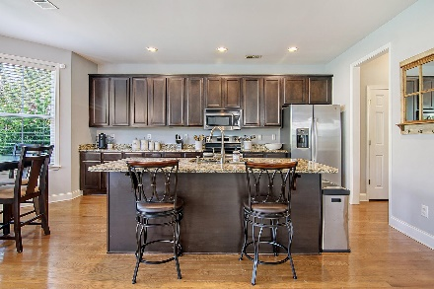
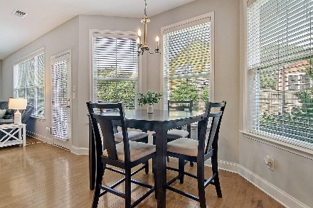
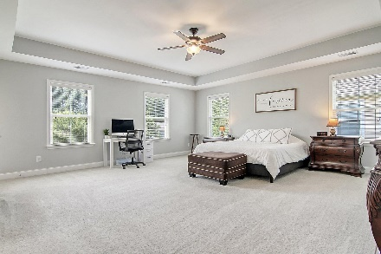
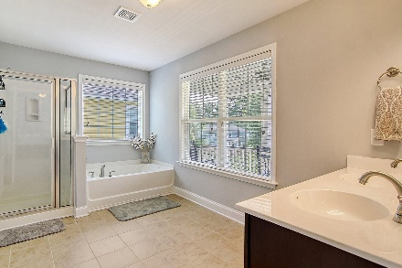
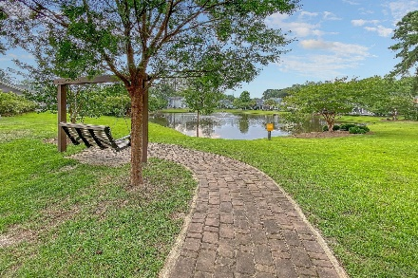
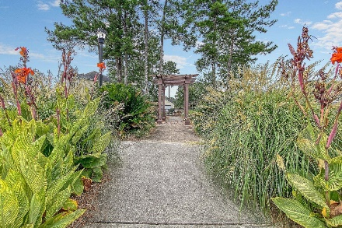



408 Branch Creek Trail Branch Creek | Summerville, SC 29483 MLS# 23015201 | $417,700
Now The Lowest Price
Per Sq Ft In The Area!
Welcome to Branch Creek, a charming neighborhood nestled in highly-desirable Summerville, SC. Featuring three bedrooms plus a loft, two and a half baths, and a two-car garage, this home is priced to sell! As you approach, the covered front porch beckons you inside, setting the tone for the warm and inviting atmosphere within. Upon entering, you'll be greeted by a spacious foyer and gleaming hardwood floors that guide you into the expansive living room. Natural light floods the open-concept layout, seamlessly connecting the living area to the eat-in kitchen. The kitchen boasts a bay window, perfect for enjoying your morning coffee, as well as a center island with breakfast bar seating, stainless steel appliances, and elegant granite countertops. A separate formal dining room awaits with a beautiful coffered ceiling, providing a perfect space for hosting parties or gatherings with loved ones.
The sheer size of the primary bedroom will leave you in awe. Complete with a tray ceiling, this luxurious haven offers two walk-in closets with custom built-in shelving, providing ample storage space. You also have access to your own private balcony. The en-suite bath features a dual vanity, a garden tub, and a convenient walk-in shower. The versatile loft area serves as a flexible space that can adapt to your unique needs, whether it be a home office, media room, or play area. The second level includes two more comfortable bedrooms, a full bath, and a conveniently located laundry room.
Perfect for entertaining guests or simply unwinding after a long day, step outside into your own private, fully-fenced-in backyard with a patio area and fire pit.
Additional notable upgrades include: a new HVAC system installed in 2022; a tankless water heater; and a water purification system, enhancing both comfort and peace of mind.
Residents of Branch Creek enjoy an array of community amenities, including a playground, pavilion area, and picturesque walking trails that lead to the serene ponds, providing endless opportunities for relaxation and outdoor recreation.
Don't miss your chance to make this gorgeous home in Branch Creek your own. Schedule a showing today and experience the epitome of comfortable and stylish living in Summerville, SC.
Click here for interactive floorplan and virtual tour
Katie Wishneff
843-870-8784
katie.richterco@gmail.com
Brand Name Real Estate
4 Carriage Lane Suite 106
Charleston, SC 29407

