Slide 1
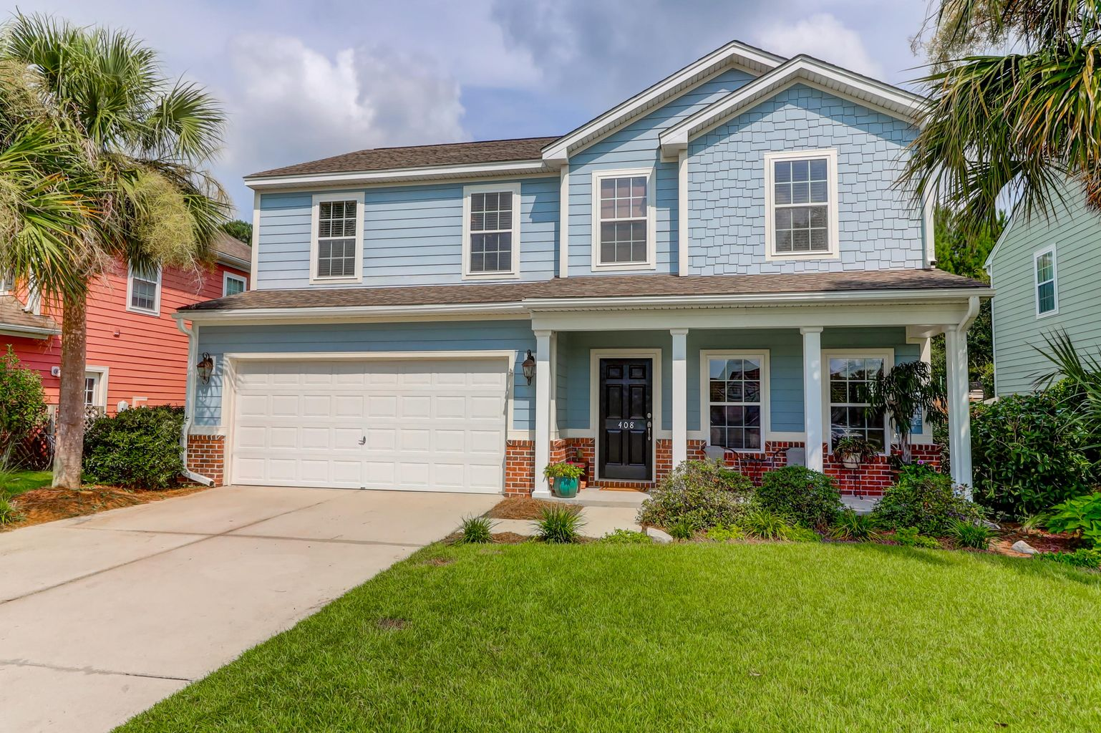
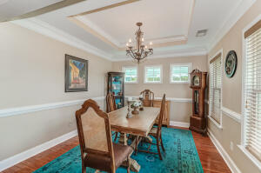
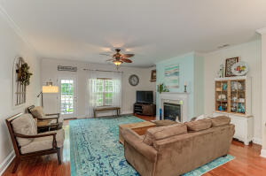
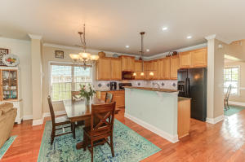
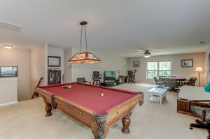
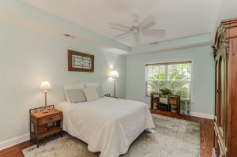
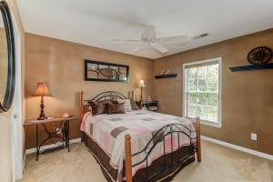
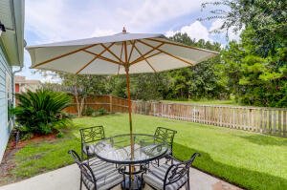



Just Listed!
408 Nelliefield Trail
Nelliefield Plantation | Wando, SC 29492 | MLS# 21021824 | $499,950
Beautiful and Spacious 2 story home in the highly sought after Nelliefield Plantation. Almost 3,000sf of living space highlighted by an enormous second floor bonus room! Upon entering the home you will be greeted by a fabulous foyer, separate dining area, spacious kitchen with new dishwasher, a large living area highlighted by a gas fireplace, wood flooring and crown molding throughout. The Master Bedroom is located on the first floor with walk-in closet and bath. The first floor also includes a powder room and large laundry room. The second floor has 3 additional bedrooms and the bonus room! The exterior of the home features a covered front porch along with a fully fenced-in back yard with pond and green space, irrigation system front and back. Amenities include neighborhood pool & park.
Elaine Nugent
(843) 330-7044
enugent@carolinaone.com
John Nugent
(843) 304-2061
john.nugent@carolinaone.com
nugentknowsrealestate.com
Carolina One Real Estate | 628 Long Point Rd | Mt Pleasant, SC 29464

