Slide 1
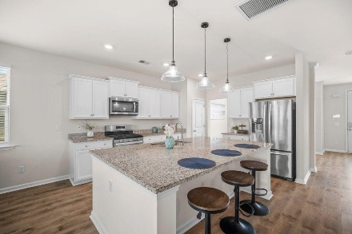
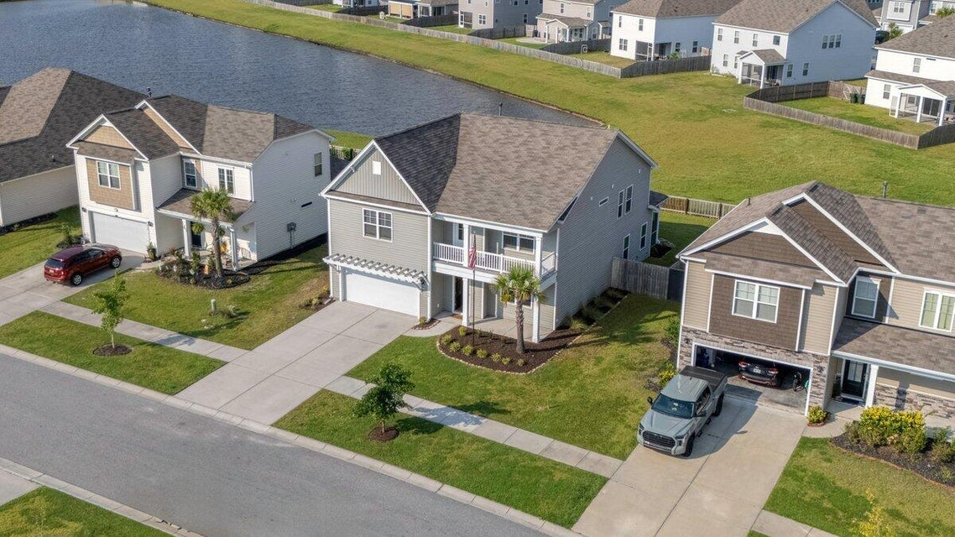
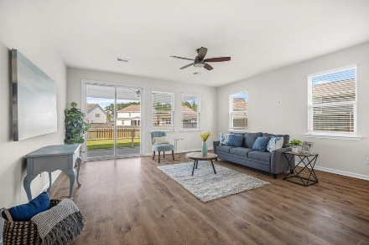
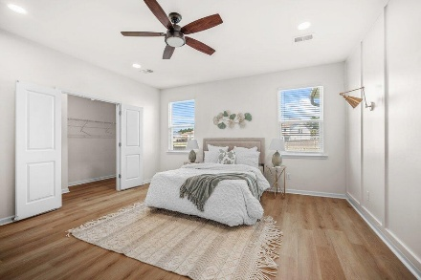
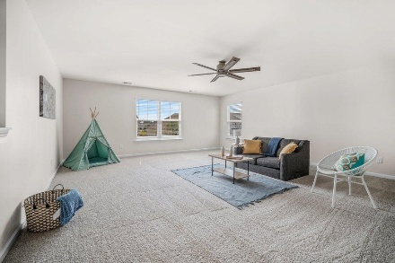

408 Ribiero Drive Meridian @ Cane Bay Plantation | Summerville, SC 29486 MLS# 25023061 | $439,000
JUST LISTED! 2.75% ASSUMABLE RATE!
LOWEST PRICE PER SF IN MERIDIAN
OPEN HOUSE SATURDAY 8/23 FORM 12-2PM
Co-hosting with Lisa Wood from Crown Home Mortgage
Offering $2500
Lender Credit
Welcome Home to 408 Ribiero Drive in The Meridian at The Lakes of Cane Bay! If it's space and serenity you're searching for, this 5-bedroom, 3.5-bath, 3,212 sq. ft. home is ready to impress. Situated on a private pond-view lot, this Charleston-style beauty combines classic Lowcountry charm with modern comfort. As you approach, you're greeted by iconic double front porches, perfect for rocking chairs and sweet tea evenings. Step inside, and the bright foyer and luxury vinyl plank floors throughout the entire first level—no carpet downstairs—set the tone for the thoughtful updates throughout. To your right is a formal dining room that could easily serve as a home office or study. The open-concept floor plan unfolds into a chef's kitchen with a massive island and freshly painted cabinets, seamlessly flowing into a light-filled living area, an entertainer's dream.
The primary suite on the main floor is truly extraordinary, large enough for a private sitting area and boasting pond views, custom board-and-batten detailing, a spa-like bath, and a huge walk-in closet. Upstairs, all bedrooms now feature upgraded luxury vinyl plank flooring for durability and style, while the loft and hallway have brand-new carpet for a soft, cozy feel underfoot. The spacious loft offers endless possibilities, playroom, media room, or additional lounge space. The four generously sized bedrooms provide room for everyone, including one with its own balcony that could serve as a second master suite. Two full baths and a large laundry room complete the second floor. Step outside to enjoy a screened porch and extended patio with firepit, the perfect setting to watch waterfowl glide across the pond. The fully fenced yard adds convenience and peace of mind.
Living in The Meridian at The Lakes of Cane Bay is about more than just owning a beautiful home, it's about embracing an exceptional lifestyle. The neighborhood features a sparkling resort-style pool overlooking the lake and dock, where you can fish for hours or launch your kayak or canoe to spend a day on the water. You'll also enjoy an indoor pickleball court, a playground, picnic pavilion, horseshoes, bocce ball courts, and regular food-truck nights that make it easy to connect with neighbors and friends. As part of one of America's top master-planned communities, Cane Bay offers a YMCA, a full shopping center, and its own elementary, middle, and high schools, all accessible by more than 12 miles of golf-cart and walking trails that weave throughout the community. This home is a rare find, priced below market value for its size, setting, and amenities. 408 Ribiero Drive offers unmatched space, stunning views, and a community second to none, schedule your tour today before this gem is gone!
House Tour | Amenities Tour
Elissa Campbell
843-853-1433 | elissa.campbell@agentownedrealty.com
AgentOwned Realty Preferred Group | 824 Johnnie Dodds Blvd | Mt Pleasant, SC 29464

