Slide 1
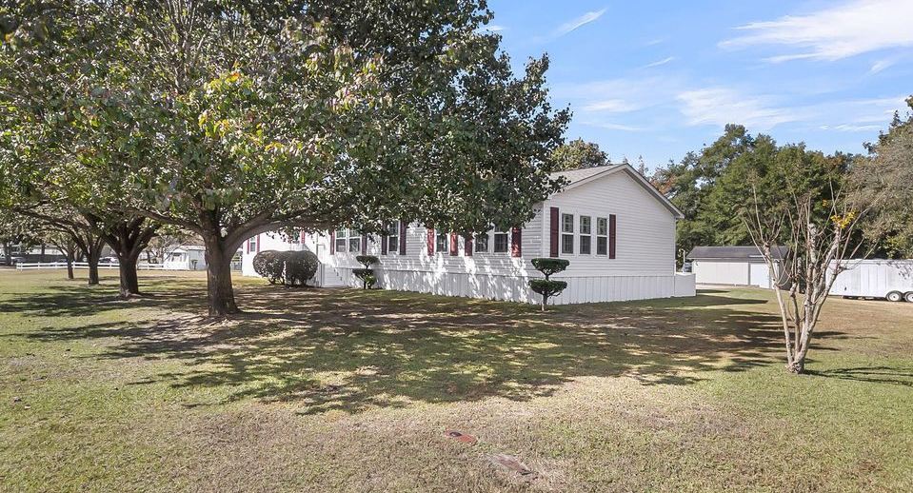
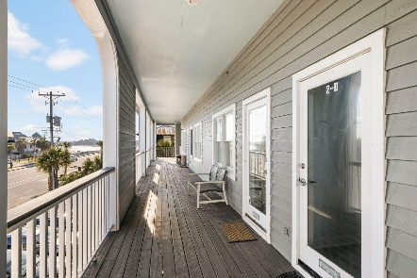
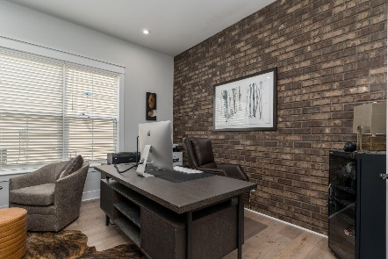
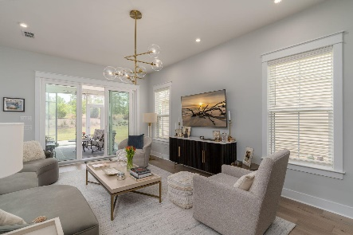

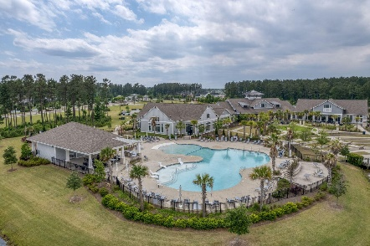
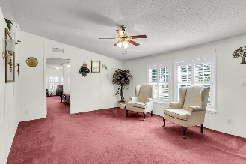
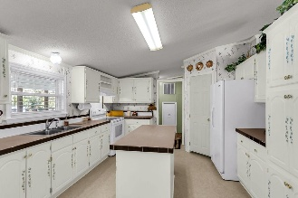
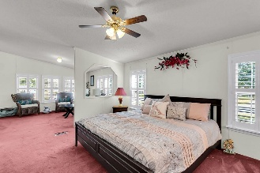
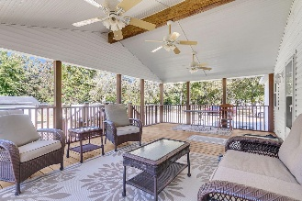
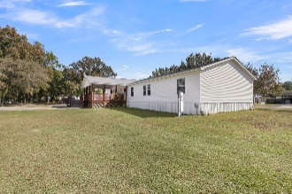
408 Treeline Drive Springhill | Moncks Corner, SC 29461 | MLS# 25029718 | $298,800
Darrell Creek Elevated Home With Elevator & Salt Pool
Country Living in Town
Co-sponsored by
Nestled on a generous, lot of almost half an acre with the sought-after benefit of NO HOA, this four-bedroom, two-and-a-half-bath manufactured home offers remarkable space and functional design. The heart of the home features an open, flowing layout, anchored by both a comfortable Family Room and an expansive Great Room, ensuring plenty of room for gatherings large and small. Convenience is addressed with a half bath perfectly situated off the kitchen and a nice size Laundry Room providing essential utility space. However, the true retreat is the oversized Master Suite, a luxurious escape featuring a dedicated sitting room and an attached private bath that is designed to feel like a true spa. The three additional nice size bedrooms are comfortably appointed, and outdoor enjoyment is made easy on the peaceful covered back porch, overlooking the ample yard.
Offering $3000
Lender Credit
Rochelle Rennert
843-847-9694 | rochellesellscharleston@gmail.com | www.theunlockingdreamsteam.com
AgentOwned Premiere Group, Inc. | 219 N Highway 52 Ste A | Moncks Corner, SC 29461-3926

