Slide 1
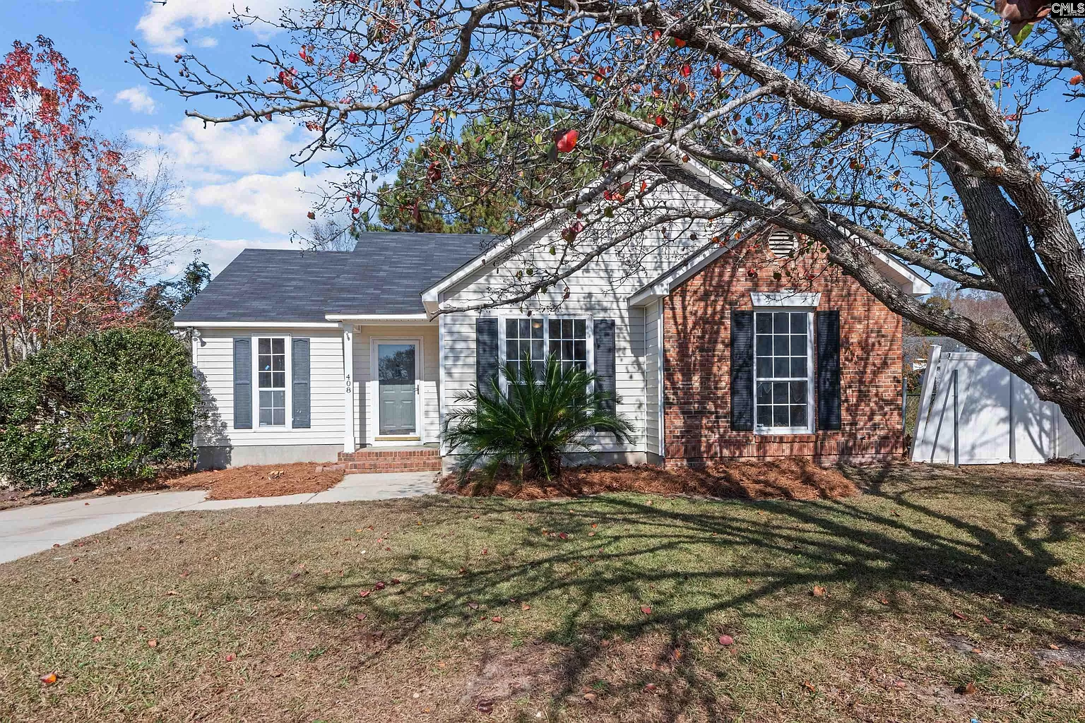
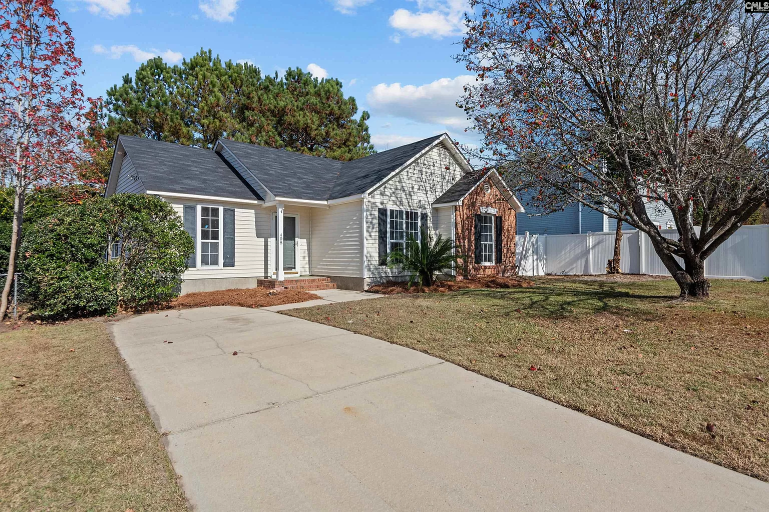
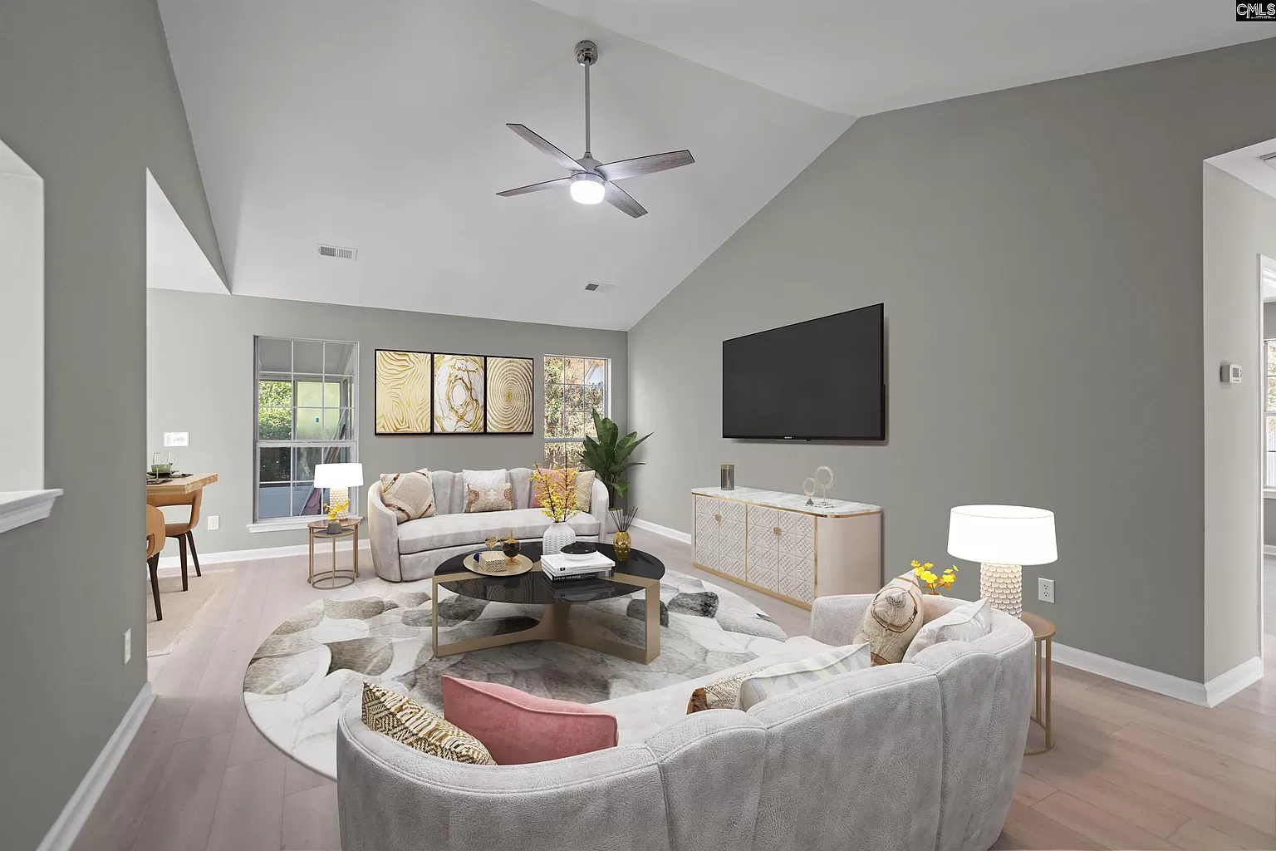
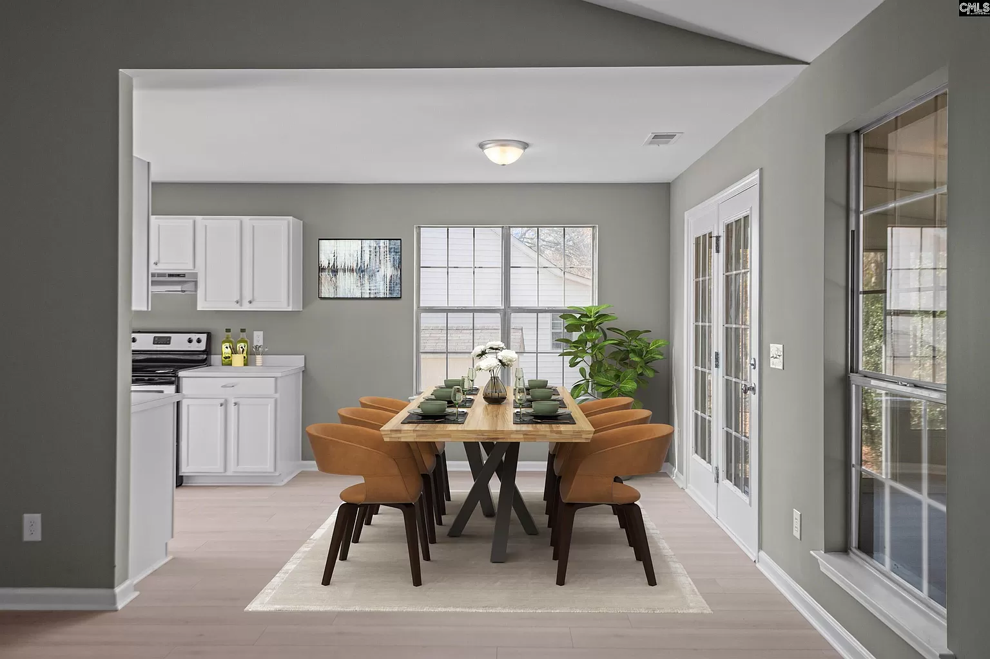
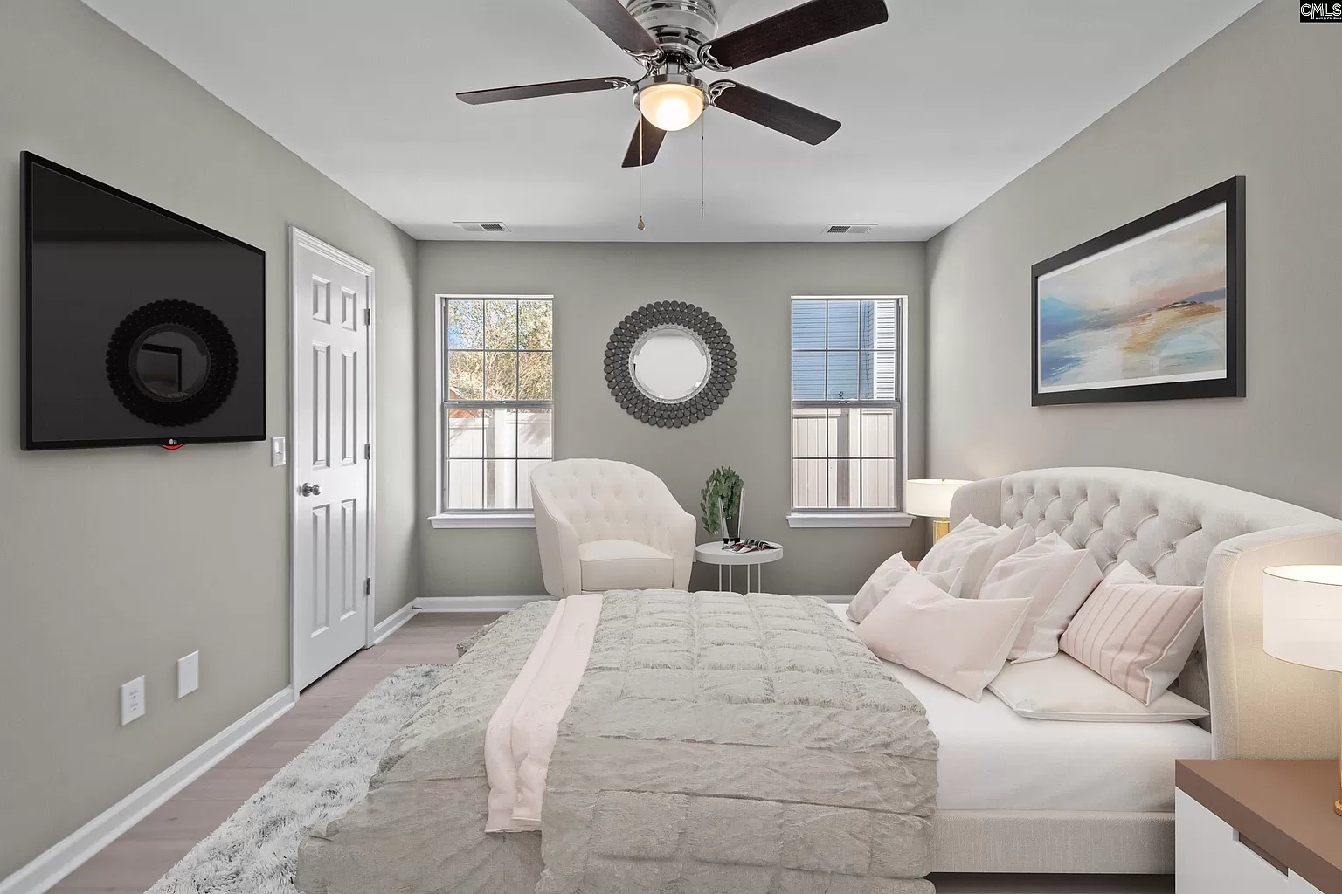




WHY RENT WHEN YOU
CAN EASILY OWN?
408 Willow Tree Ct
Garden Pond | Lexington, SC 29073
MLS# 574619 | $225,000
Susan Stanley
843-323-5573
susancstanley@gmail.com
1,202 SF
3 BEDS
2 BATH

