Slide 1
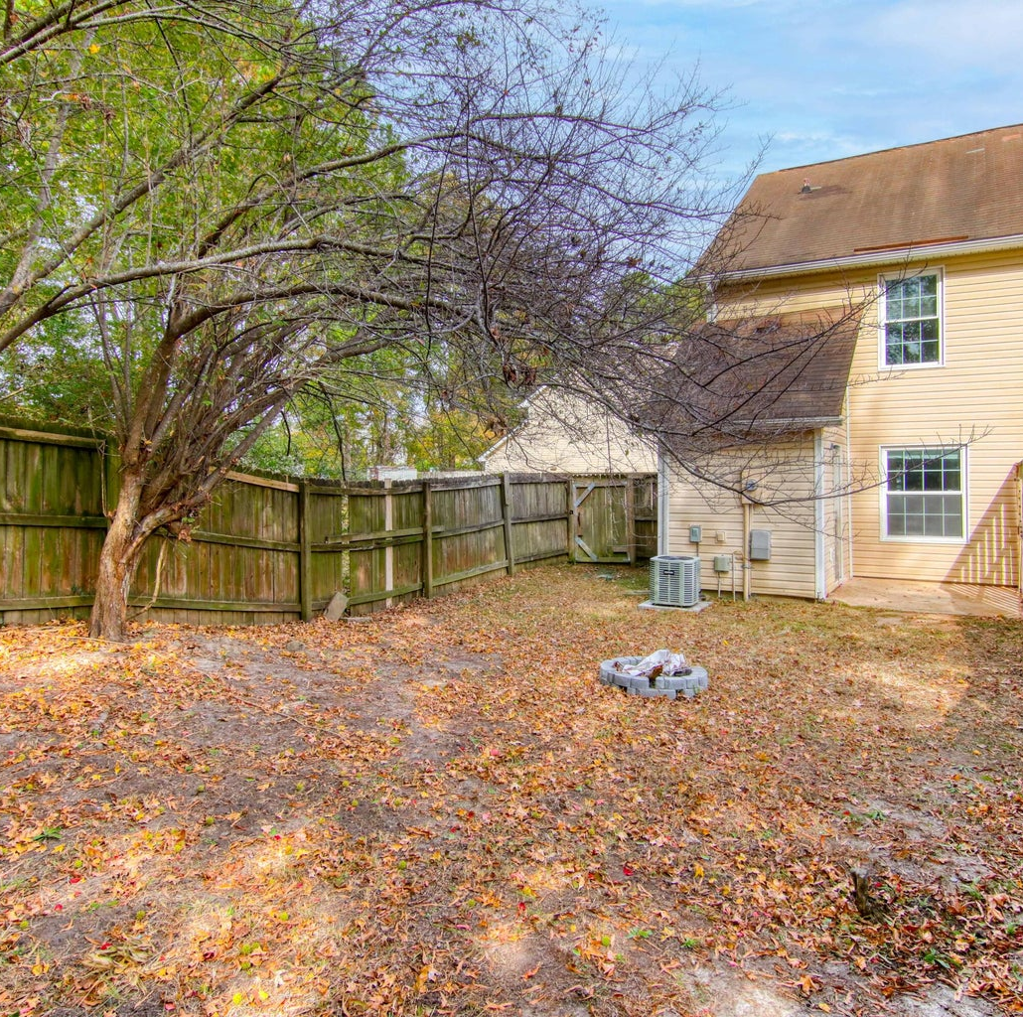
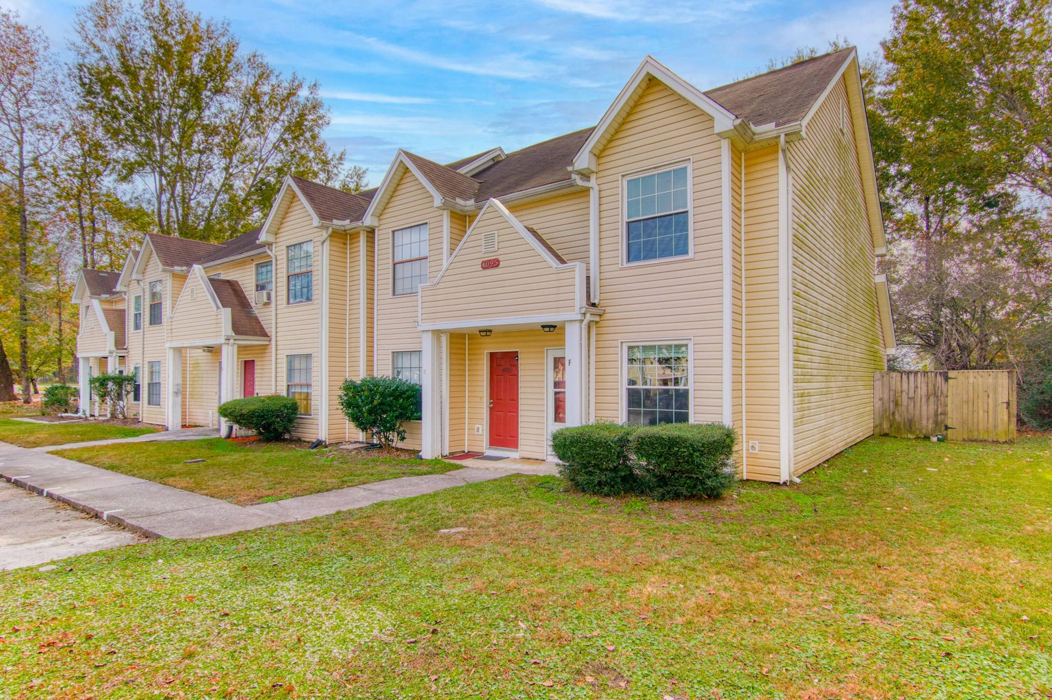
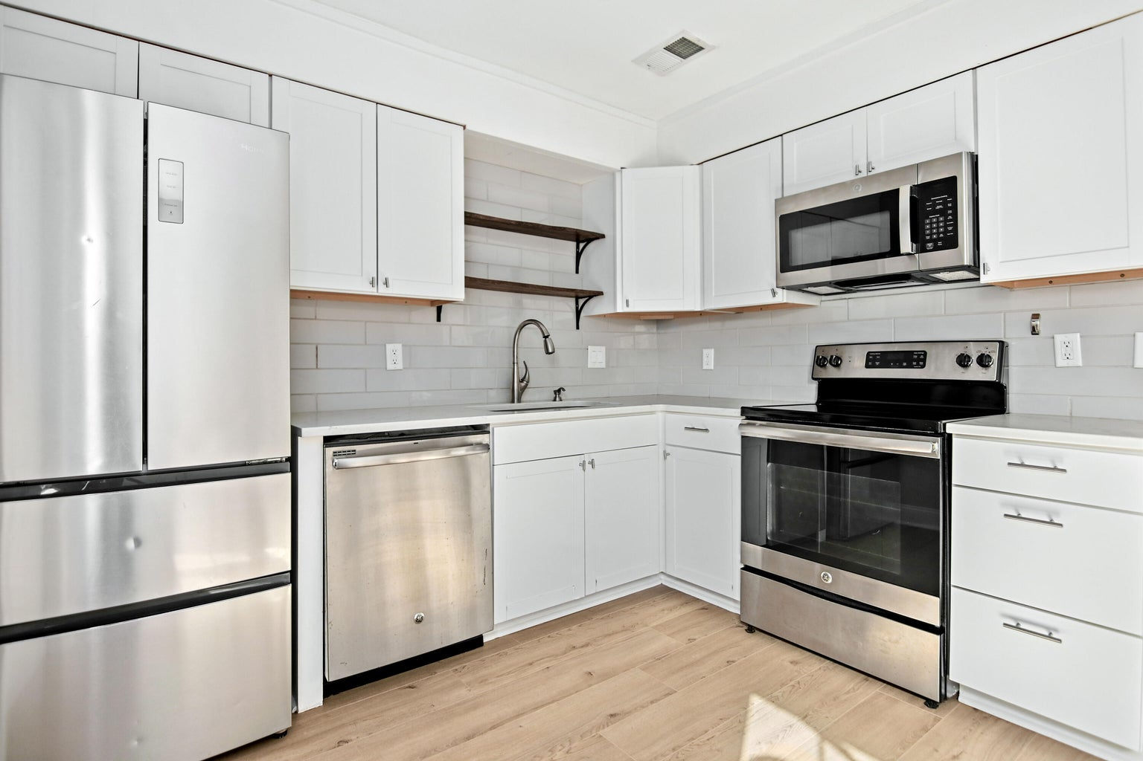

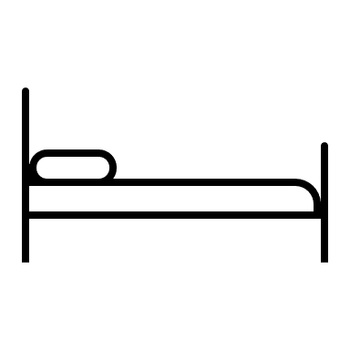

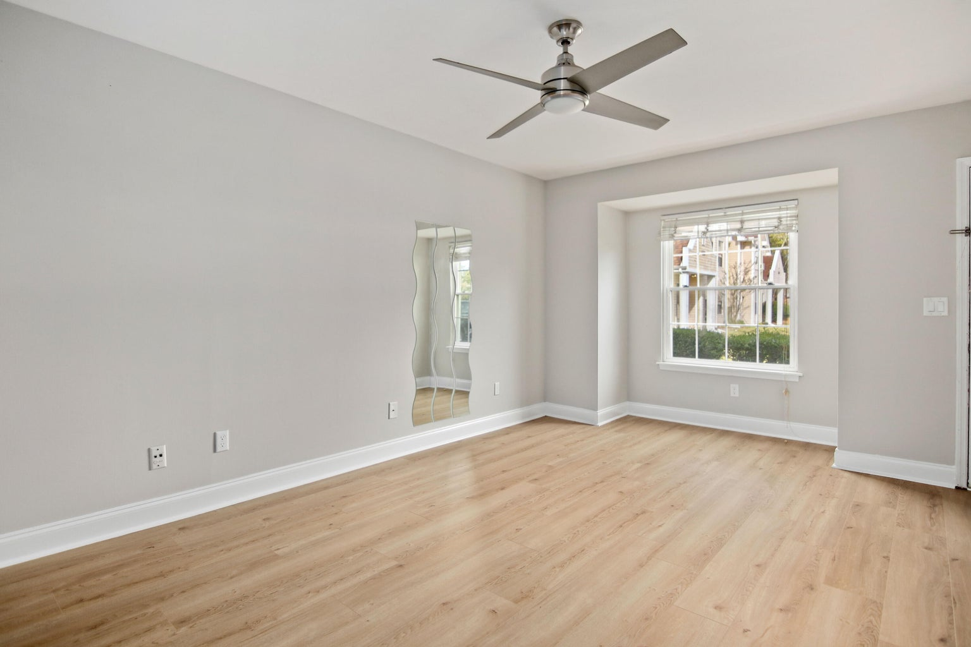
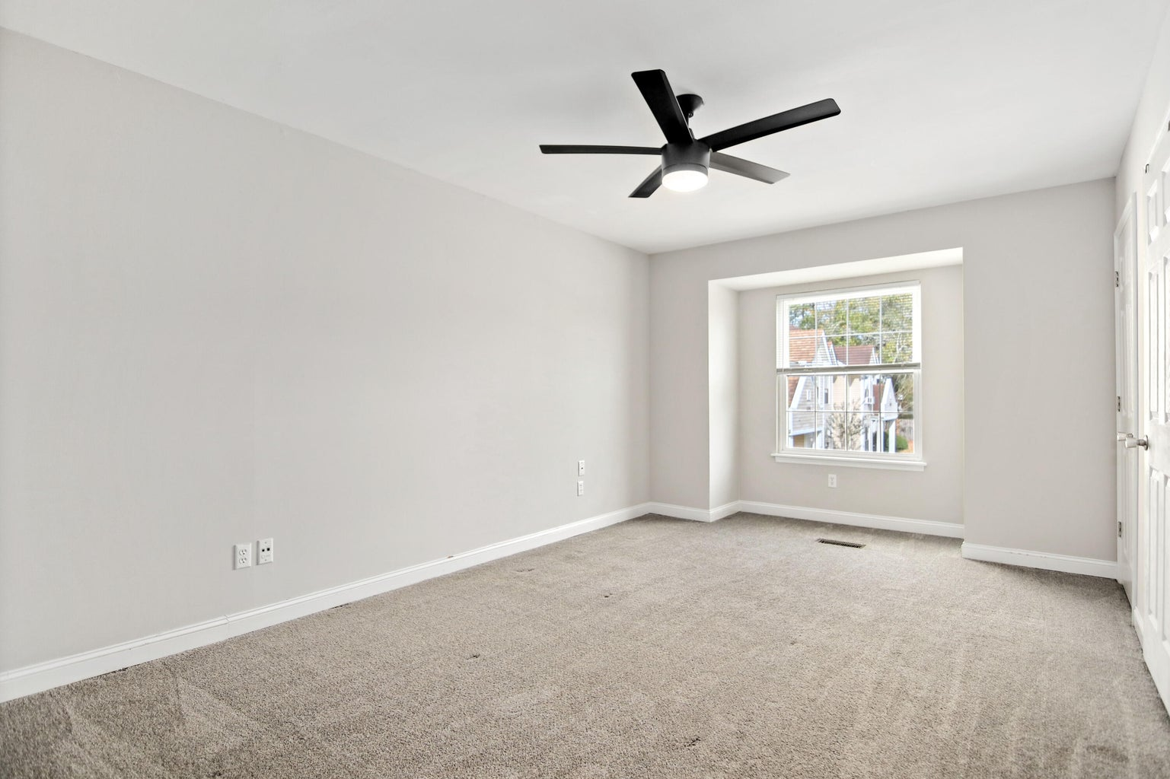

WHY RENT WHEN YOU CAN EASILY OWN UNDER 200K!
4095 Cedars Parkway F
The Cedars
North Charleston, SC 29420
MLS# 23026403 | $194,000
1,023 SF
2 BEDS
1½ BATH
Susan Stanley
843-323-5573
susancstanley@gmail.com

