Slide 1
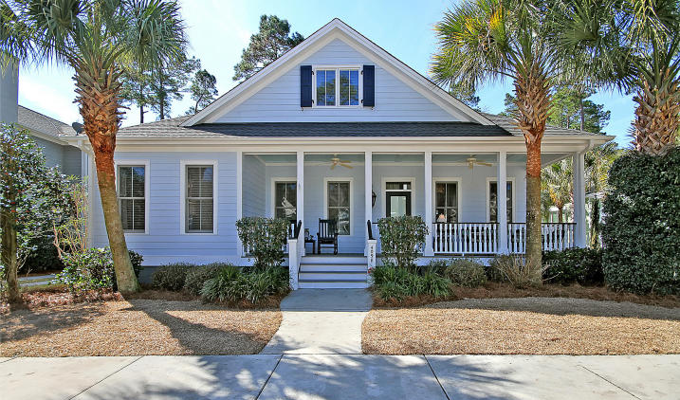

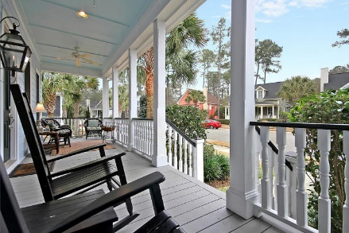
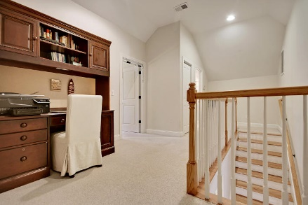
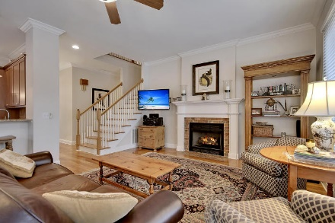
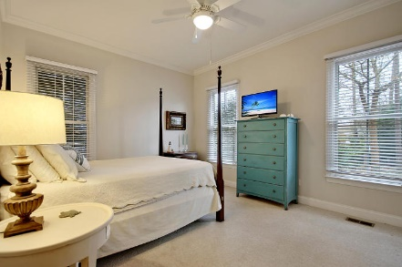
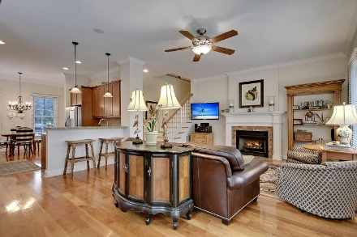
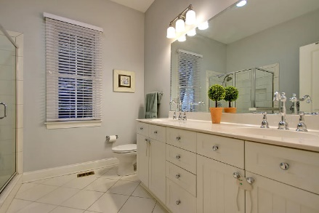
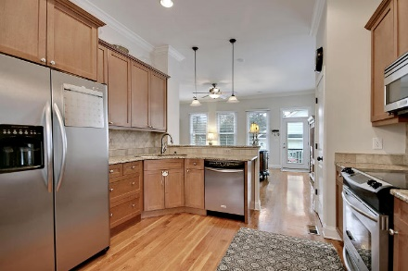
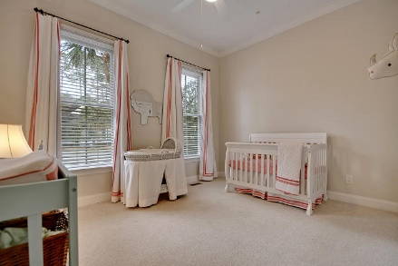
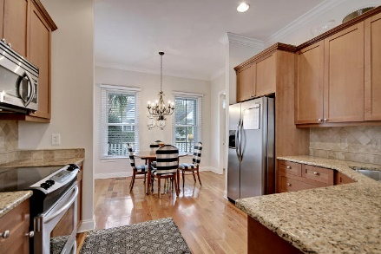
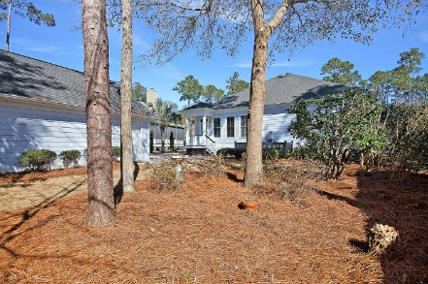

Parkshore Marshfront
Great Home in The Villages In St Johns Woods
4098 E Amy Lane ~ Johns Island ~ MLS# 16004165 ~ $429,000
Beautifully appointed and move-in ready, this 3BR, 3BA, 2CG home is just what you’ve been waiting for! A spacious front porch with a gas lantern and room for rocking chairs greets you.
Step inside to find stunning hardwood floors, high ceilings, crown molding, built-in surround sound, a whole home water filtration system, a cozy fireplace in the living room and a sunlit open concept floor plan. The dining area opens to the granite kitchen with its SS appliances and breakfast bar.
French doors lead to the office on the first level. The first floor master boasts dual walk-in closets and a gorgeous en-suite bath with a dual vanity, jacuzzi tub and walk-in shower. The second level has a bedroom, full bath, loft area and tons of storage space in the unfinished portion of the attic.
View Today!
Call or email for details: (843) 654-7777 or Ben@MattOneillTeam.com

