Slide 1

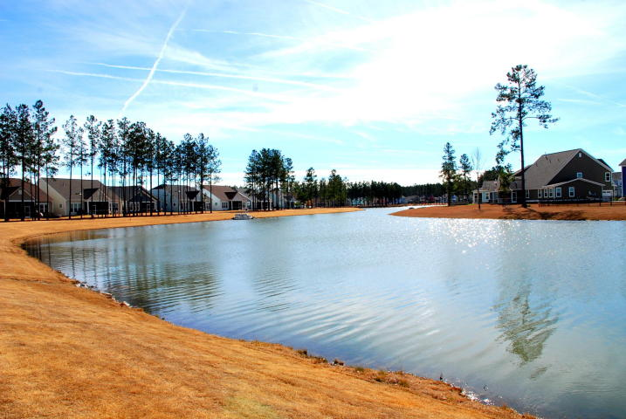
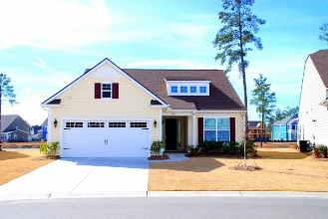
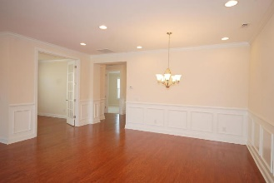
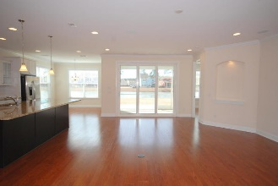
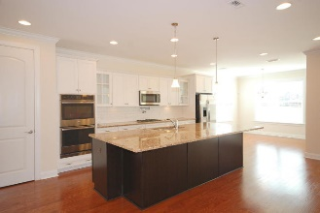
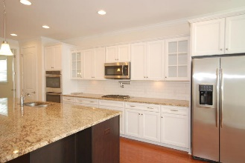
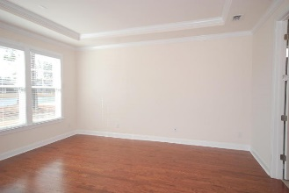
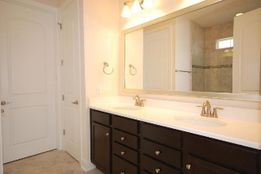
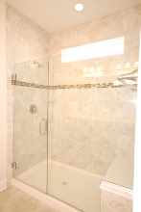
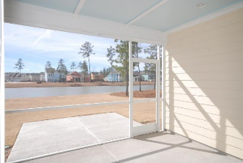
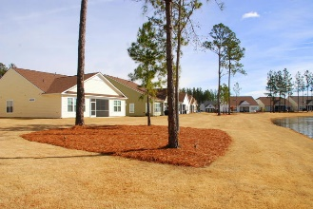

Debbie Cromer
ABR, RSPS, REALTOR, CRS
(843) 437-6342
debbie@debbiecromer.com
www.mylowcountryhomes.com
Lakefront Opportunity
In 55+ Community
409 Four Seasons Boulevard
Cane Bay Plantation | Summerville | MLS# 18005522 | $375,000
ONLY LAKEFRONT OPPORTUNITY!
This beautiful Ibiza model one story home is ready now. Backing up to the lake on an unusually large lot, this one story home is immaculate! Featuring a very open floor plan, gleaming hardwoods and a very impressive trim package, there is plenty of room in the open kitchen equipped with upgraded cabinets, granite countertops, gas cooktop, built in microwave, double ovens flowing into the formal and informal eating areas, a great room and screen porch. All with a beautiful lake view. The master bedroom features a tray ceiling and wood floors as well as a luxury ensuite bath with a tiled shower and double sinks. A guest bedroom and bath, home office, mechanical room, laundry room and 2 car garage with finished but unconditioned space completes this property.
Century 21 Properties Plus | 3301 Salterbeck St Suite 100 | Mt. Pleasant, SC 29466

