Slide 1
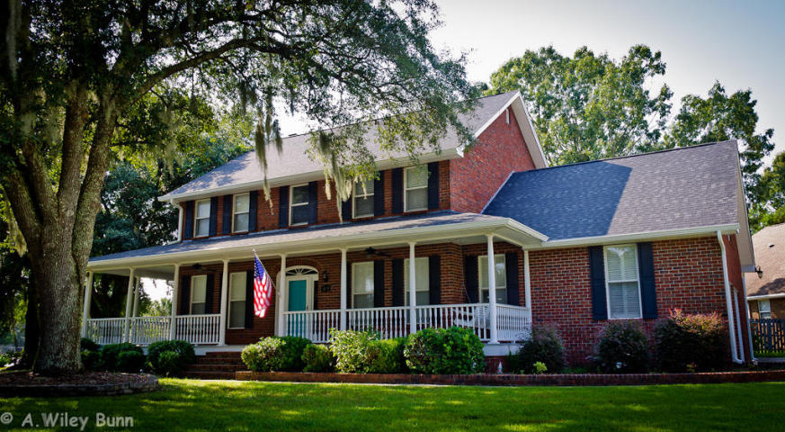
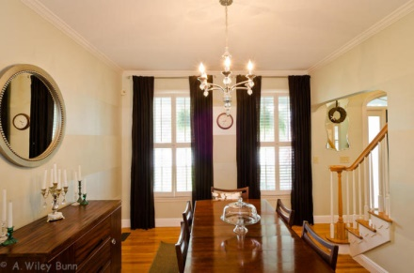
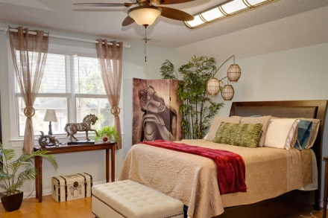
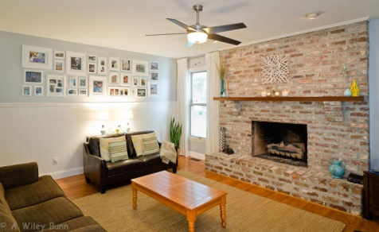
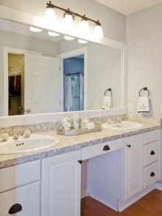
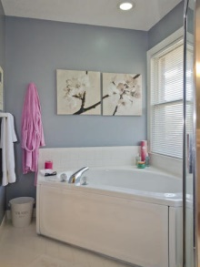
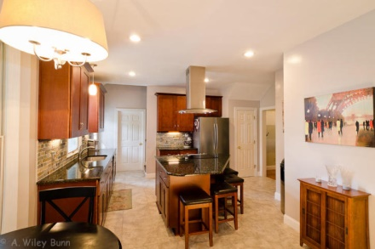
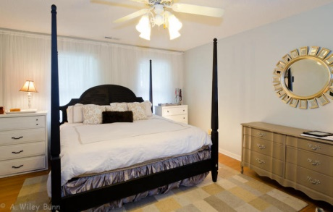


409 Meadow Breeze Lane
Sylvan Shores - Charleston - MLS# 15006598 - $435,000
Priced To Sell!
This beautifully maintained traditional brick home in desirable Sylvan Shores offers 4 bedrooms, 3 1/2 baths, downstairs office, large sun room, duel staircases, hardwood floors throughout and renovated dream kitchen just to name a few.
The full front porch wraps around overlooking the 3 large oak trees in the front yard with attached two car garage that has extra room for a work area.
* * Community dock and tennis courts**
This convenient location is a straight shot into downtown and easy access to 526.
This home will not last long!
JERICHA A. MCGEE
Mobile - (843) 568-1767
jdelia@mycharlestonproperty.com
www.mycharlestonproperty.com

