Slide 1

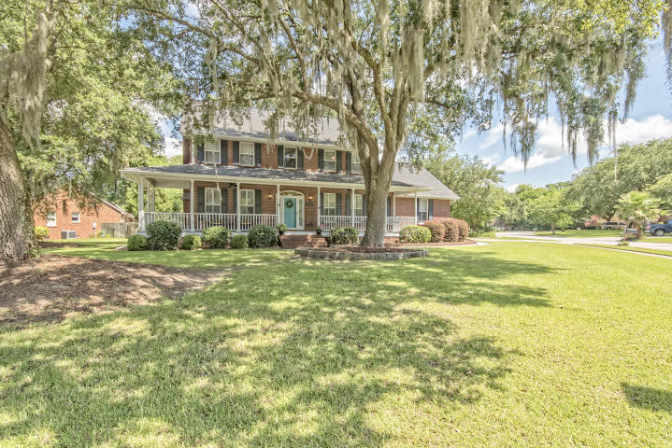
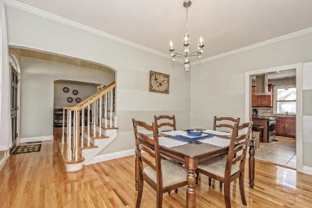
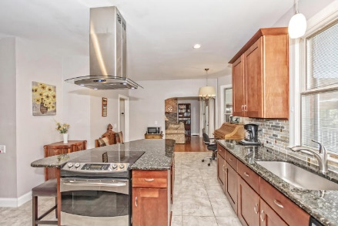
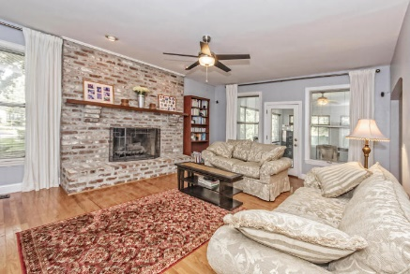
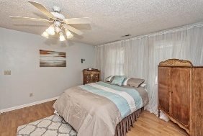
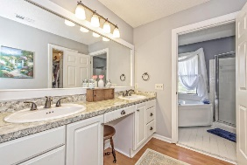
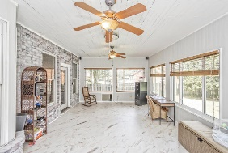
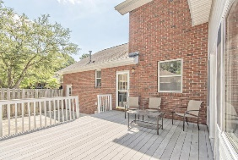
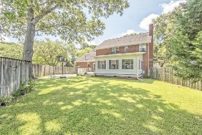
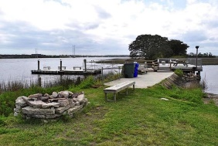

Great Family Home
Just Reduced
Pam Bass Realtor
M 843-259-4926 | O 843-871-2121
www.pambassproperties.com
pbass@century21properties.com
409 Meadow Breeze Ln | Sylvan Shores | Charleston | MLS# 16017944 | $475,000
Beautiful brick traditional home sitting on a large corner lot with gorgeous mature oak trees. As you enter the home there is an office on the left with lighted built in book shelves. To the right is a formal dining room with gleaming hardwood floors. The spacious family room has a gas fireplace and opens to a large sunroom with tongue and groove walls and new cork floors. The kitchen boast lots of cabinet space, granite counter tops, island with electric cook top and range and a stainless hood. There is a laundry room off the kitchen and a 2nd staircase leading to upstairs. Upstairs is 3 bedrooms with a large room over the garage with a full bathroom that is the 4th bedroom. The master bedroom has dual closets, master bath with double sinks and a Jacuzzi tub. The backyard has a privacy fence and a maintenance free deck built with composite board. There is also a concrete slab for parking a boat or RV. The 2 car attached garage has lots of storage and a utility sink. There is also a lawn irrigation system and an security system. **The neighborhood has an optional HOA which allows you access to the boat ramp, dock, tennis courts and bird sanctuary. This neighborhood is close to shopping, schools, restaurants and Interstate 526 and is only a short drive to downtown Charleston. It also is next to the West Ashley Greenway which is an 8.25 mile hiking and biking trail.

