Slide 1
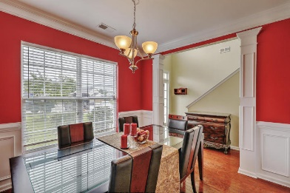
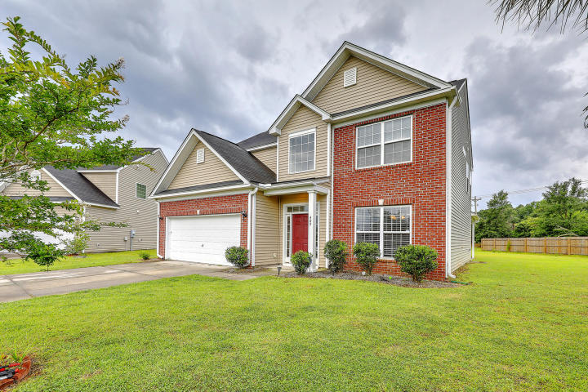
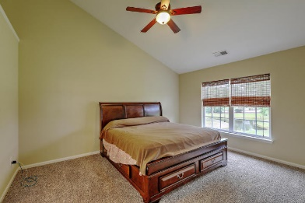
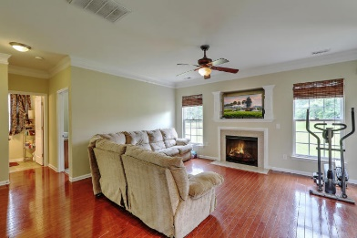
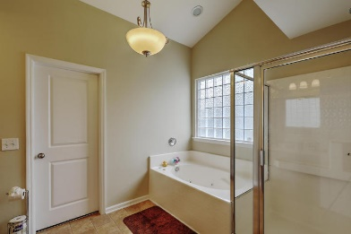
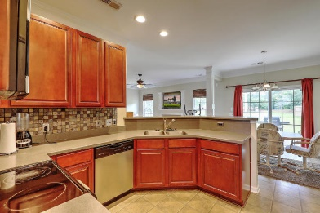

Beautiful Home in Paddock Point
3.5% Buyer’s Agent Commission
409 Pin Oak Drive Oakley Pointe ~ Moncks Corner, SC 29461
MLS# 17017523 ~ $210,000
4 bedrooms upstairs plus bonus room downstairs which would make a great office, guest room, or play room, etc. Hardwood floors .New carpet & paint throughout Gas FP with TV nook. Upgraded kitchen with Corian countertops, tile backsplash, & stainless steel appliances…including side by side refrigerator a Formal dining with upgraded wainscoting ,Covered patio with great views of pond & fountain Large master bath with separate shower & jetted tub, Beautiful trim work & crown molding Come See This Home!
Eric McFadden
emcfadden90@gmail.com | Cell (843) 408-9235 | Office (843) 225-8830
Brand Name Real Estate | 4 Carriage Lane Suite 106 | Charleston, SC 29407

