Slide 1
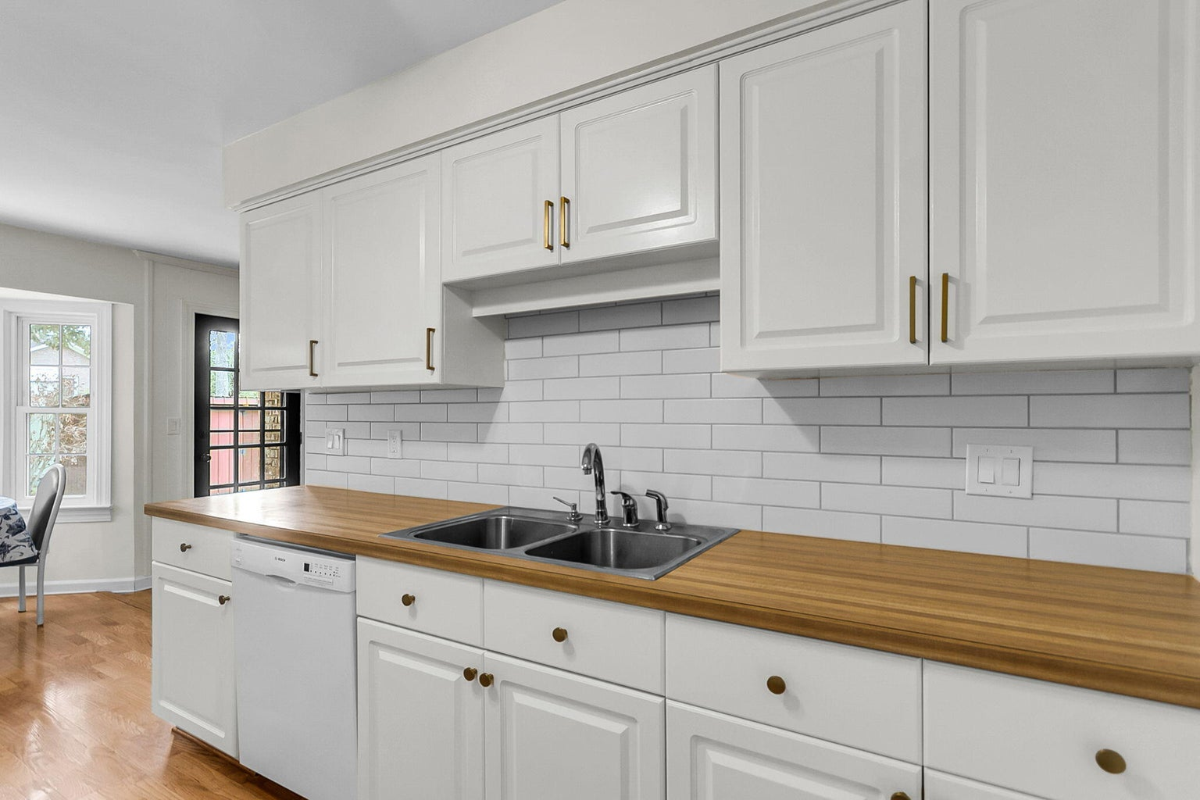
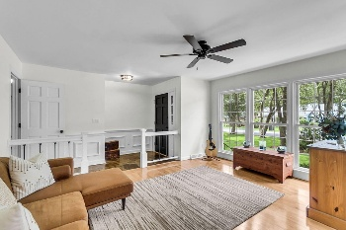
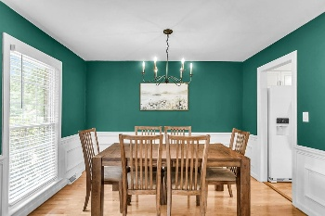
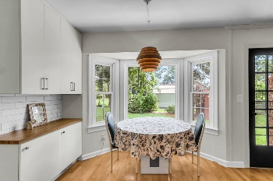
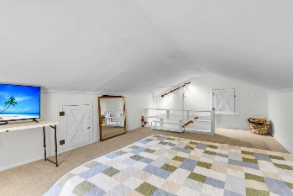
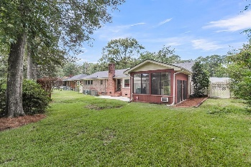

409 Red Fox Run
Quail Arbor · Summerville, SC 29485 · MLS# 25022936 · $385,000
One Level Living-Stunning Kitchen and Baths!
Welcome to this charming, beautifully updated 3-bedroom, 2-bath brick ranch that combines classic charm with modern updates. Featuring a spacious loft, large screened porch, 2-car garage, whole-home generator, private fenced backyard, and stunning curb appeal with lush green grass and mature landscaping, this home is a true gem. Step inside to find an abundance of natural light, stylish fixtures, and the warmth of handsome flooring throughout. The inviting foyer flows into a versatile living/flex room with a wall of windows, seamlessly connected to the dining room—large enough for a full dining set. The bright white kitchen offers an eat-in area, pantry, and plenty of cabinet and counter space, making it both functional and elegant. Sq footage is from appraisal.
The family room is the heart of the home, complete with a cozy fireplace, a ceiling fan, and ample space for a large TV. The primary suite boasts a newly renovated ensuite with a stunning tiled shower, dual-sink vanity, tiled floors, and a walk-in closet. Two additional bedrooms share an updated full bath with modern finishes. Upstairs, the finished FROG provides endless possibilities-ideal as a guest room, home office, or media space (not included in square footage). The home also includes a convenient laundry/mud room, adding extra storage and functionality. Outside, the screened porch/four-season room overlooks a spacious private backyard, perfect for entertaining, play, or even an outdoor kitchen or art studio. For leisure outdoor activities, this home is conveniently located close to Sawmill Branch Trail and Ashley River Park. For entertainment, it is near shopping and restaurants. Finally, with the Berlin G Meyers overpass now complete, it is easy to get everywhere quickly! There is an optional HOA available to join, Quail Arbor Civic Club, with amenities including a pool, tennis courts, and a park with a slide.With so many features and perfect location this home will not last!
Stan Huff
843-670-2835
stan.huff@agentowned.com
Jill Marcacci
843-297-5590
jill@agentowned.com
www.agentownedrealty.com
AgentOwned Realty Co. Preferred Group, Inc. | 824 Johnnie Dodds Blvd | Mt Pleasant, SC 29464

