Slide 1
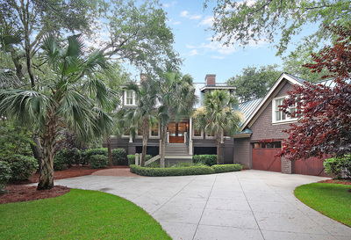
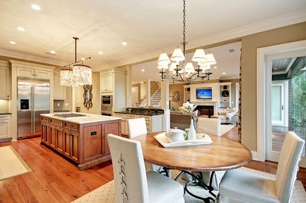
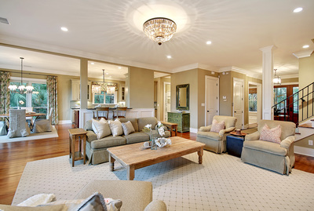


Extraordinary Kiawah Island Home
Located In the Settlement
One of the Kiawah’s Private Club Communities
* A Very Motivated Seller *
40 Kiawah Island Club Drive
Take A Video Tour
More Details
Nestled in the Settlement, one of Kiawah Island's most exclusive communities, this home is being offered furnished with a Kiawah Island Club Social Membership. The Settlement is a quiet neighborhood with manicured landscapes, serene lagoons, and abundant wildlife. The mahogany and beveled glass double entry doors open to a large foyer with a study to one side and a formal dining room to the other. Beyond that is an expansive living area with a grand fireplace and French patio doors which open to a deck and views of the lagoon and the 11th hole of The River Course. The open floor plan allows the living area to seamlessly flow to the gourmet kitchen and casual dining area. This 4,450 sf home has 5-bedroom, 5.5 baths, Heart pine flooring, custom cabinetry, granite counters, stainless steel appliances, cooking island, wet bar, butler's pantry, laundry room, several living areas, screened porch, built-in BBQ and a fenced yard.
Lagoon & Golf Views
5 bedrooms
5 full, 1 half baths
4,550 sq. ft;: 0.42 acres
KIC Social Membership
Offered at $2,395,000
MLS® #18020885
Toula DiGiovanni
843.469.7555
toulad@nvrealtygroup.com
toula.nvrealtygroup.com

