Slide 1
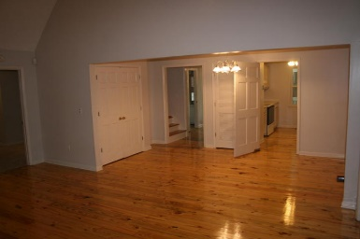
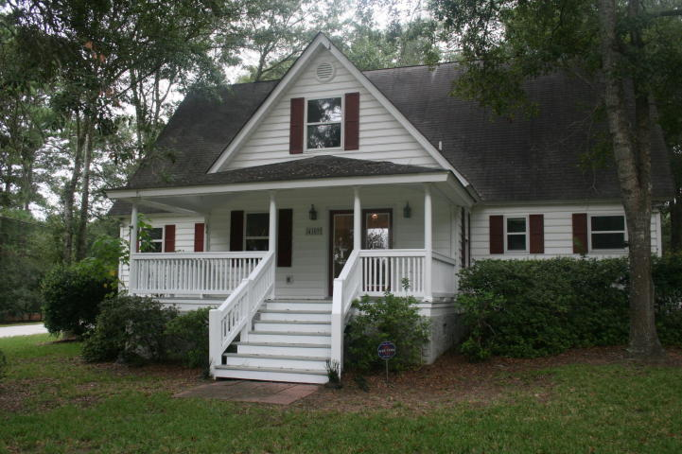
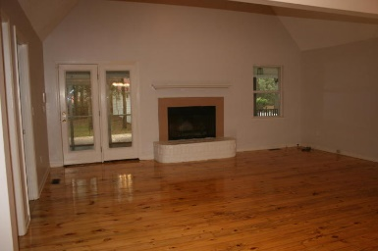
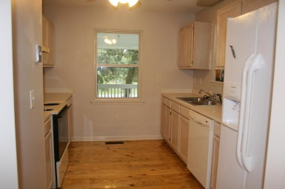
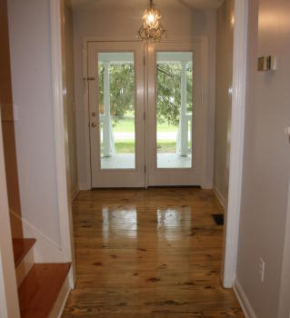
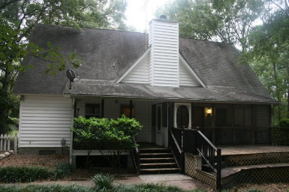
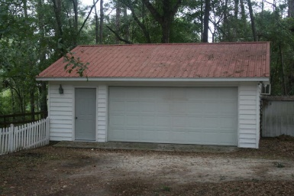
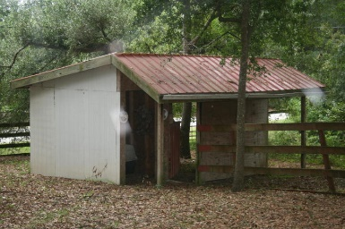
Quiet country living in Meggett.
3 Bedroom
3½ Bath
2,259 Sq Ft
4107 Legacy Lane
Meggett, SC 29449
MLS# 15024883
$315,000
This home sits on just under one acre of land and is across the street from the water in a beautiful rural setting. The home features dual downstairs master bedrooms and is currently being used as a three bedroom home, however one room does not have a closet. Additionally there is a finished bedroom and bath upstairs that could serve as an additional bedroom, just add heat and air.
This home has the ability to easily serve as a large two bedroom, three, or four bedroom home. There is still additional attic space that could be finished.
The rear of the home features a screened porch and deck. A large air conditioned and insulated garage and small stable complete the backyard.
Melanie Thornhill, Realtor®
(843) 270-8997
melaniethornhill1@gmail.com
Frank Thornhill Realtor®
(843) 224-7997
frank@thornhillpropertiesllc.com
Places LLC
400 Hibben St., Suite 200
Mt Pleasant, SC 29464
www.scplaces.com

