Slide 1
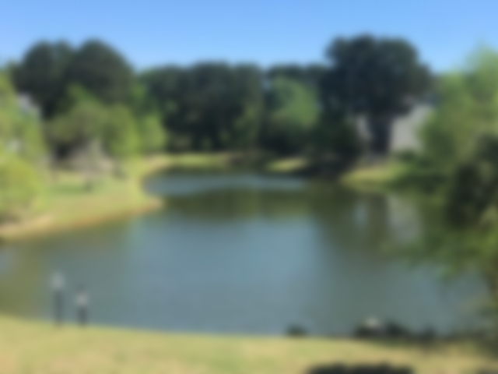
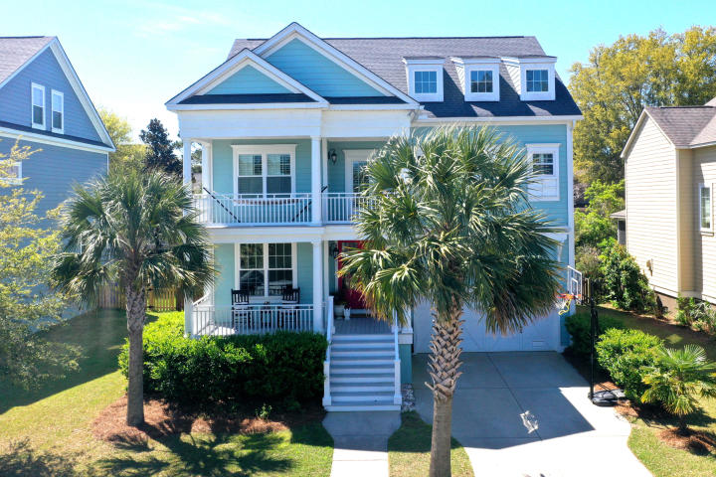
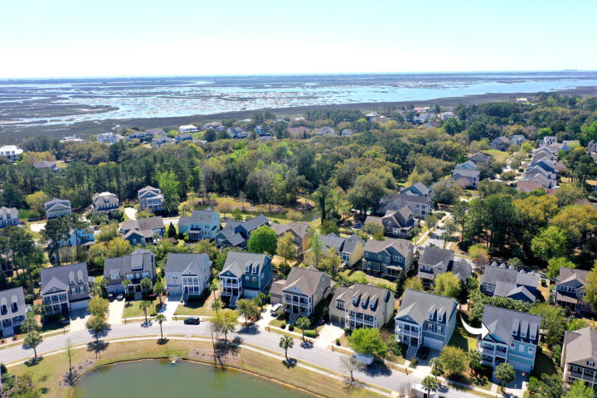
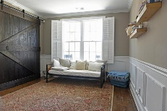

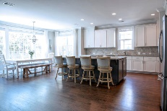

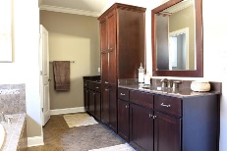

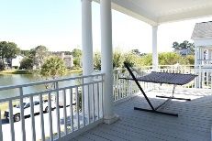

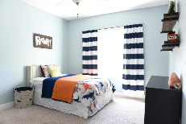
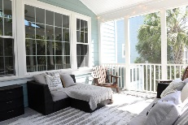
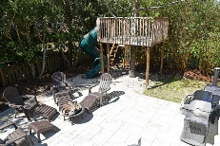




Lowest Price/Sq. Ft SFD in Hamlin Plantation!
1138 Waterfront Dr
Hidden Lakes ~ Mt Pleasant ~ MLS# 16000069 ~ $765,000
4108 Whiting Street
Hamlin Plantation ~ Mount Pleasant ~ MLS# 19011096 ~ $749,947
Imagine relaxing on your front porch, waving to neighbors and watching wildlife in the pond. You don't have to imagine anymore! You can have this and so much more with this spacious home in incredible Hamlin Plantation. From the moment you walk through the double glass doors, this home shines! On the bright, open main floor you'll find a large office/bedroom, dining room, and huge open kitchen/family room. Upstairs are four spacious bedrooms including a fantastic Master suite complete with a huge bathroom and two walk-in closets. Up another flight of stairs you'll find a huge bonus room complete with separate bedroom and bathroom. The cozy backyard is surrounded by lush foliage, has an awesome screened porch and patio, and an outdoor shower for rinsing off when you get home from the beach!
Mark Macpherson
mark@beachbreak-properties.com
843.367.5640 Mobile

