Slide 1
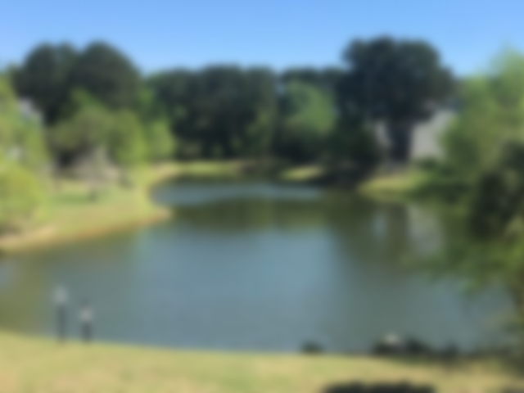
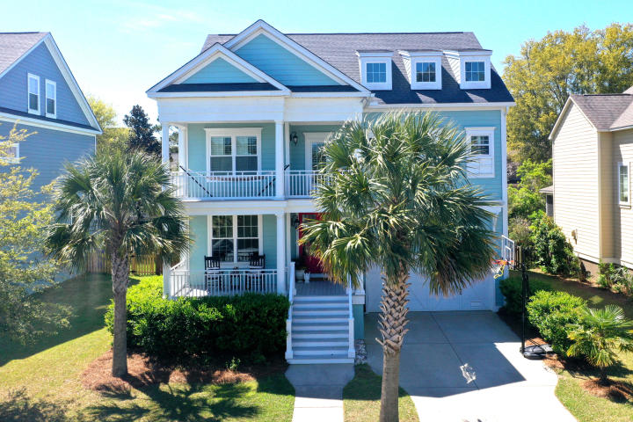
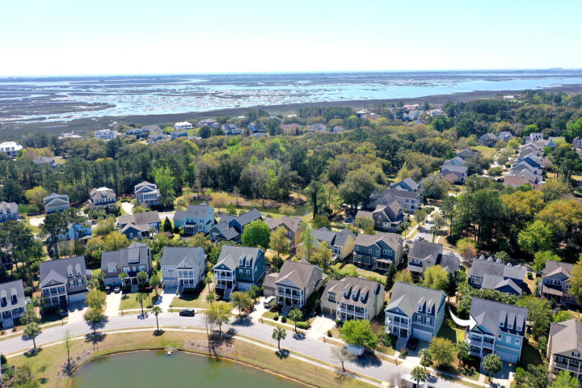
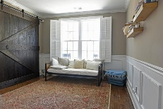
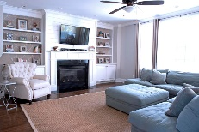
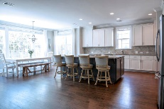
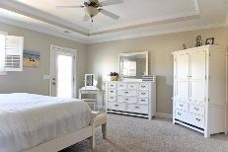
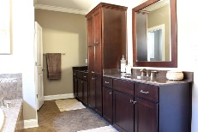

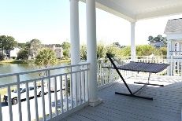

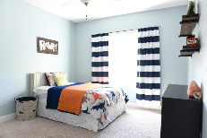
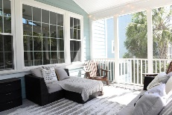
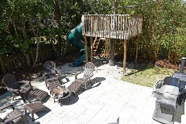




Lowest Price/Sq. Ft SFD in Hamlin Plantation!
1138 Waterfront Dr
Hidden Lakes ~ Mt Pleasant ~ MLS# 16000069 ~ $765,000
4108 Whiting Street
Hamlin Plantation ~ Mount Pleasant ~ MLS# 19011096 ~ $684,986
R.I.D.I.C.U.L.O.U.S VALUE!!
Now listed at an UNBELIEVABLE $168/sq. ft!! Help us make this the next home to sell in Hamlin Planation! From the moment you walk through the double glass doors, this home shines! On the bright, open main floor you'll find a large office/bedroom, dining room, and huge open kitchen/family room. Upstairs are four spacious bedrooms including a fantastic Master suite complete with a huge bathroom and two walk-in closets. Up another flight of stairs you'll find a huge bonus room complete with separate bedroom and bathroom. Heaps of outdoor space including two spacious front porches overlooking a pond, a comfy-living backyard surrounded by lush foliage, an awesome screened porch and back patio, and even an outdoor shower!
Mark Macpherson
mark@beachbreak-properties.com
843.367.5640 Mobile

