Slide 1
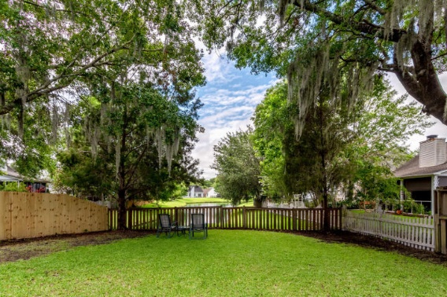
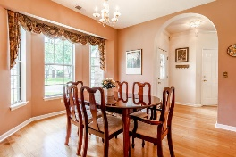
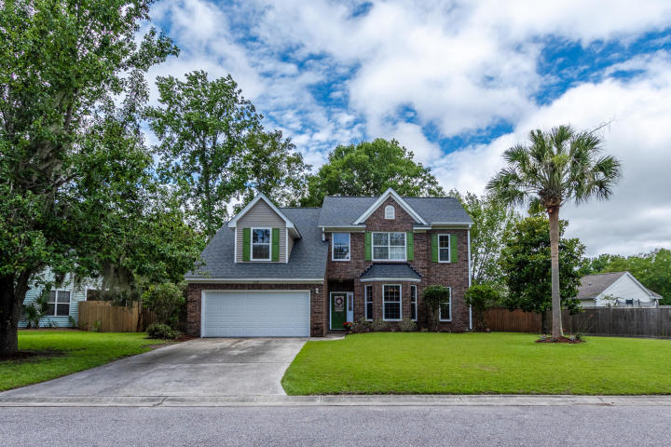
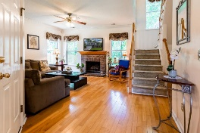
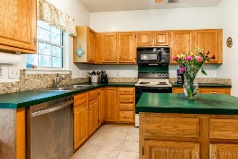

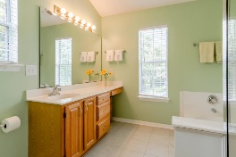
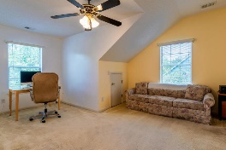
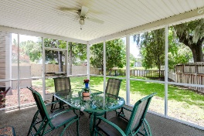
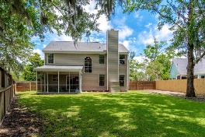
Beautiful Home in Paddock Point
LOVELY HOME ON POND
4109 Westerly Lane Village Green | Charleston, SC 29414 | MLS# 20016400 | $307,500
Welcome to 4109 Westerly Lane in sought after Village Green at River Oaks. When you arrive at this lovely brick front home you will notice its awesome curb appeal, from its manicured yard to its awesome Palm Tree. As you walk towards this lovely home you will notice the Brick Front of the house which adds to its attractiveness. As you enter you will notice the beautiful wood floors and to the right you will find a good size separate dining area. The spacious living room has a gas log fireplace and has a great view of the pond in back. The kitchen has new ceramic tile floors which were just installed and you have new ceramic tile floors in the bathrooms. Brand new samsung, self cleaning range installed on 7/15. Just off the kitchen you have a large screen porch which is a great place to relax after a long day of work and a great place to entertain guest with a great pond view as well. As you walk back into the home going upstairs you will find all the bedrooms with the two full baths the half bath is downstairs. The seller is also offering a $7000.00 credit for carpet and counter top upgrades or however you want to use it with an acceptable offer. So come view this lovely home this area sells very quickly. The community has a swimming pool. Membership required also the architectural shingles on the roof have a lifetime transferable warranty seller has the documents.
Bruce Miller
charlestownehomes@comcast.net | (843) 813-4591 | www.charlestonlifestyle.com
Brand Name Real Estate | 4 Carriage Lane, Suite 106 | Charleston, SC 29407

