Slide 1
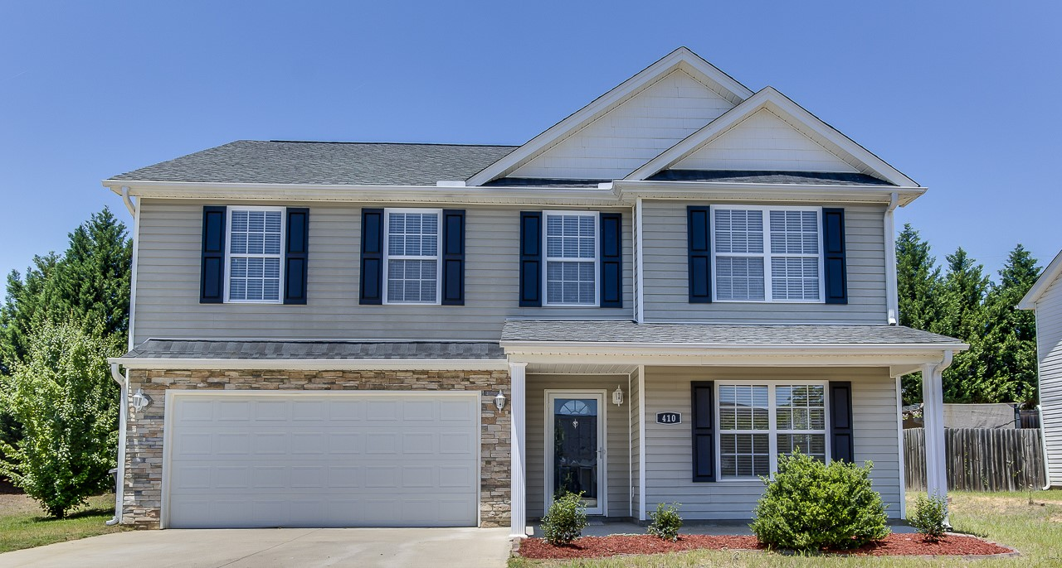
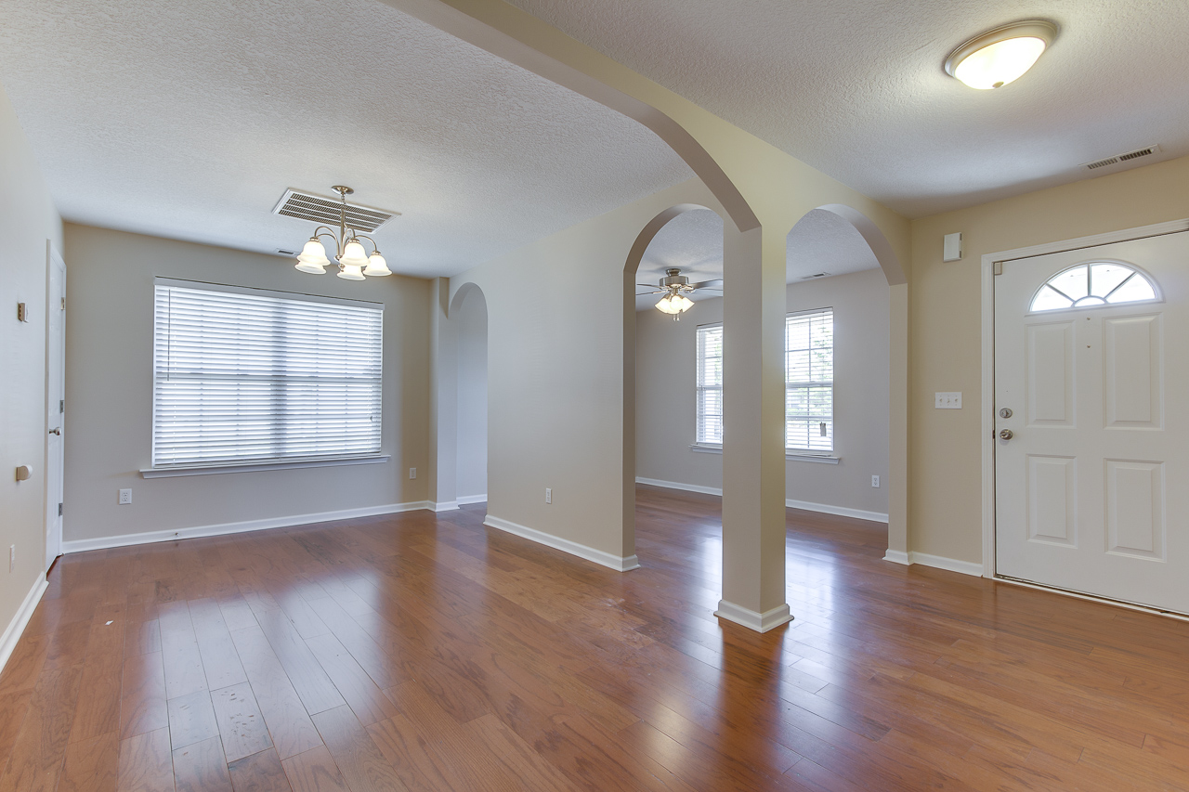
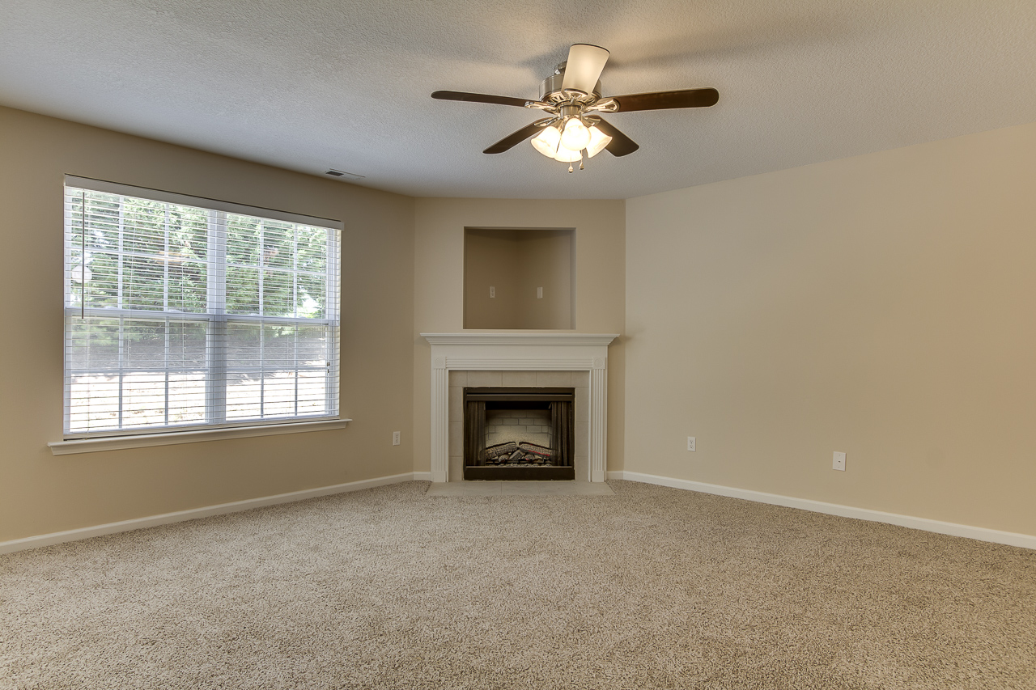
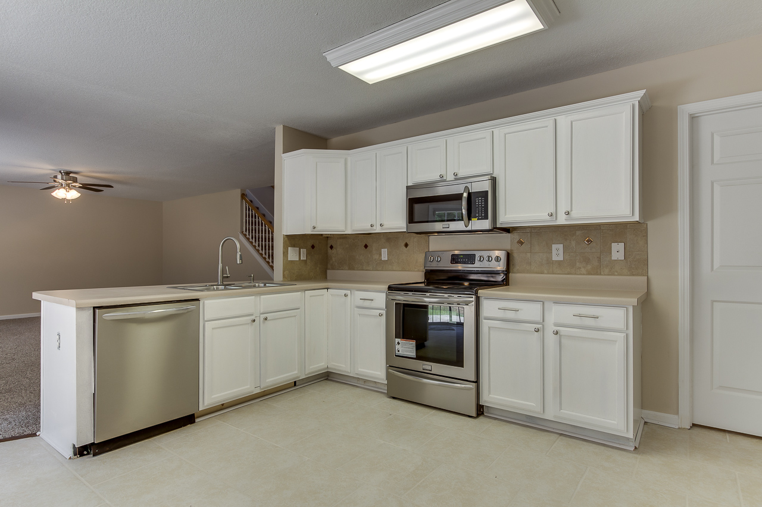
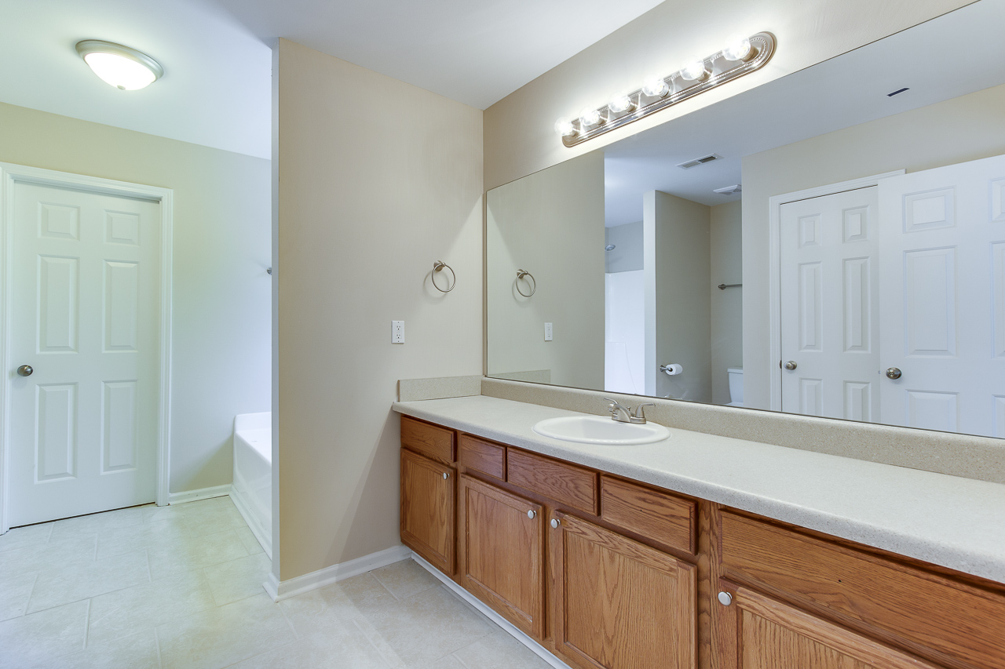
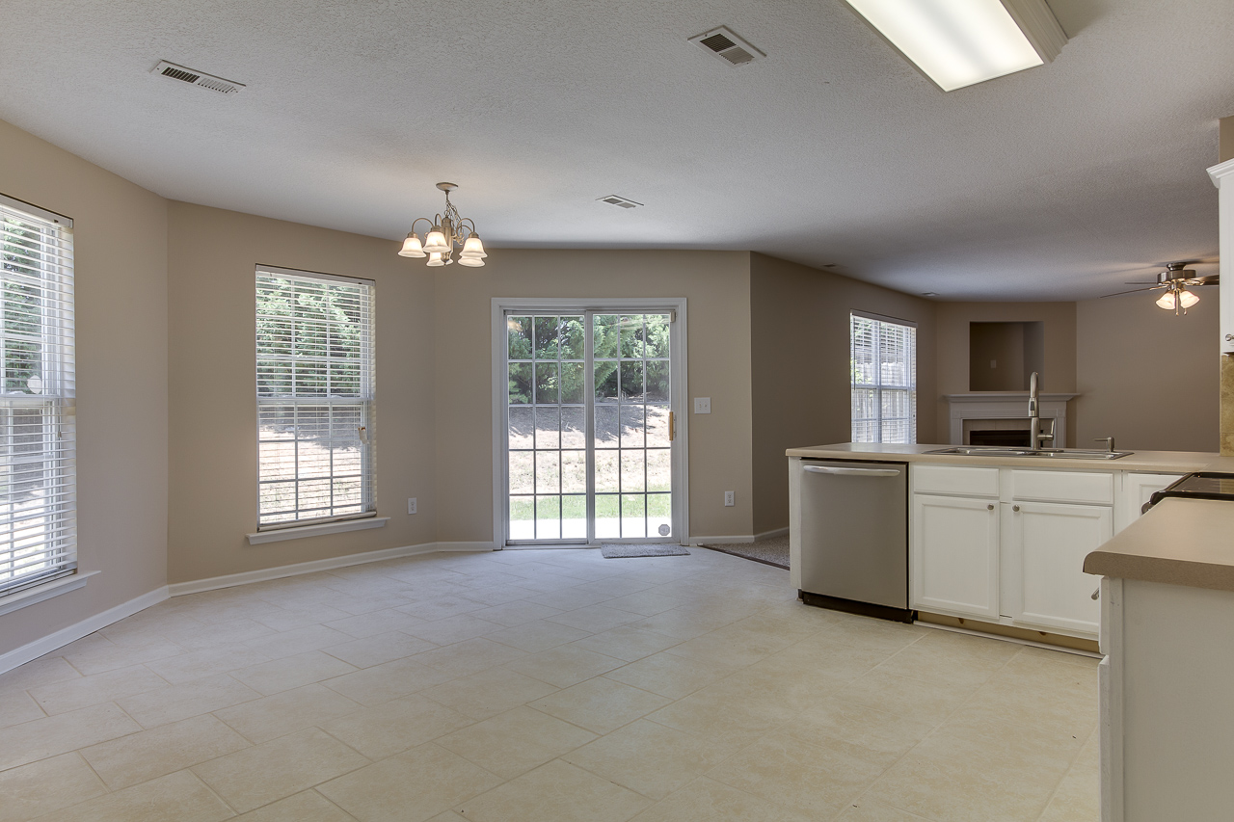
410 Dellwater Way ~ Spartanburg
$159,900
This true 4-Bedroom, 2.5 Bath home w/ Loft & 2-Car Garage has just undergone a very nice renovation! NEW HVAC units (inside & out); professionally-painted interior (walls, ceilings, doors & trim); NEW premium 16” tile floors in Kitchen, Bathrooms, & Laundry; NEW premium wood floors in Living Room, Dining Room & Foyer; NEW frieze carpet in Bedrooms, Halls & Den; NEW brushed nickel ceiling fans & lights, NEW brushed nickel hardware & 2” blinds throughout. Enormous Master En Suite offers tray ceilings, large vanity, NEW commode, oval soaker tub & separate walk-in shower. Laundry room is complete with full-size utility sink.
Bedrooms:
Bathrooms:
Fireplace:
Garage:
Home Sq Ft:
HOA:
4
2.5
YES
2-Car Attached
2522
None
Year Built:
New Central Air :
New Heat:
New Wood Floors:
New Tile:
New Carpet:
2004
2016
2016
2016
2016
2016
Greg Cook
Anchor One Realty, LLC
843-343-3030
gcook@anchorpropertiesofsc.com

