Slide 1
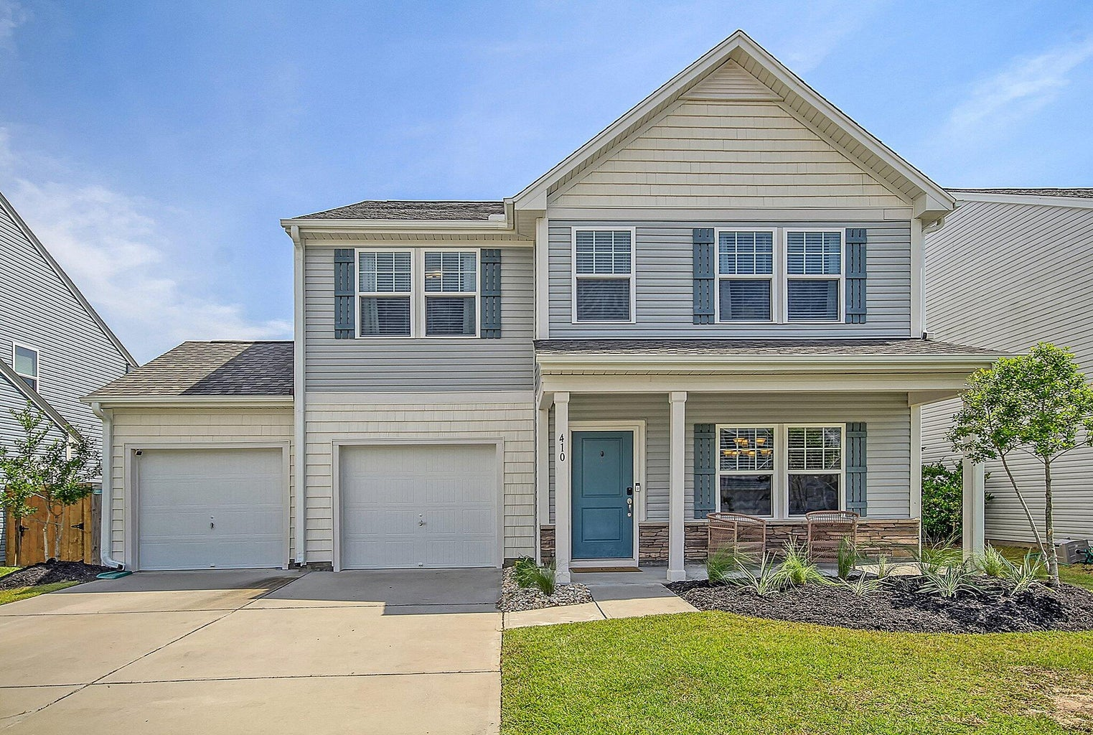
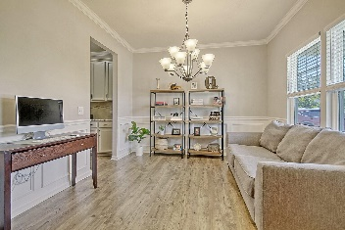
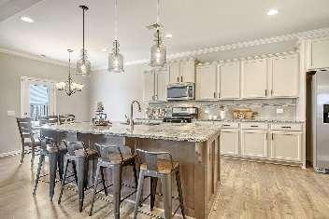
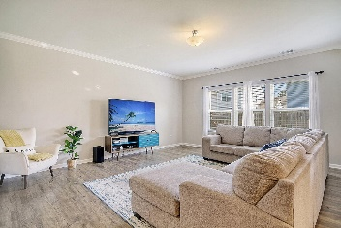
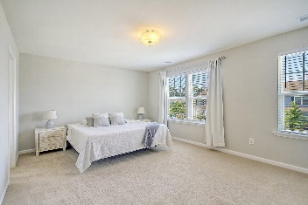
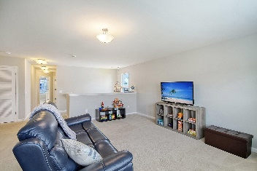
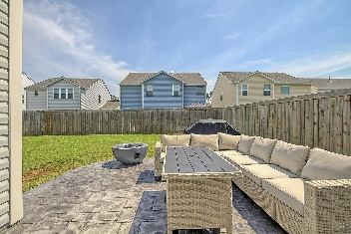
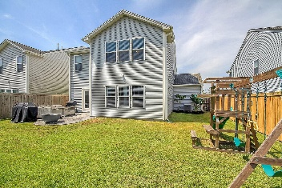
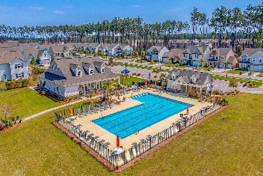

410 Snowy Plover Lane Nexton · Summerville, SC 29486 MLS# 23021449 · $410,000
Nexton-Shows Beautifully!
New Low Price
GORGEOUS meticulously maintained home with wonderful curb appeal! Upon entering the home you are greeted with handsome luxury vinyl plank floors, an open floor-plan, and an abundance of natural light. To the right is the dining/flex room that leads to a butler's pantry that acts as a drop zone and coffee bar. Continuing in is the chef-inspired gourmet kitchen-A MUST SEE! The kitchen features a HUGE island with seating for four and stunning pendant lights, granite countertops, stainless steel appliances, beautiful light cream cabinets, tiled backsplash, walk-in pantry, and eat-in area. Next is the fantastic family room that has a wall of windows and is large enough for an oversized sectional couch. The spacious primary bedroom is on the second floor has a relaxing spa-like ensuite bath featuring an upgraded LUXURY frameless glass shower with an amazing rainfall shower head, and walk-in closet. There are 2 additional nicely sized bedrooms that share a bath on the second floor and a very large loft that is perfect as a second living space, playroom, exercise area, office or media room! The awesome fenced backyard has a patio and and lots of green area for play, BBQing, or entertaining. The home is walking distance to the resort style community pool. North Creek Village in Nexton is a wonderfully landscaped community with a park, club house, and community pool! The neighborhood is close to local shopping and grocery stores and is a short drive to downtown Charleston with 5-star restaurants, world class shopping and iconic history as well as a short drive to the beaches, the airport, Boeing and Daniel Island.
Stan Huff
843-670-2835 stan.huff@agentowned.com
Jill Marcacci
843-297-5590 jill@agentowned.com
www.agentownedrealty.com
AgentOwned Realty Co. Preferred Group, Inc. | 824 Johnnie Dodds Blvd | Mt Pleasant, SC 29464

