Slide 1
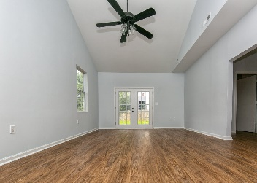
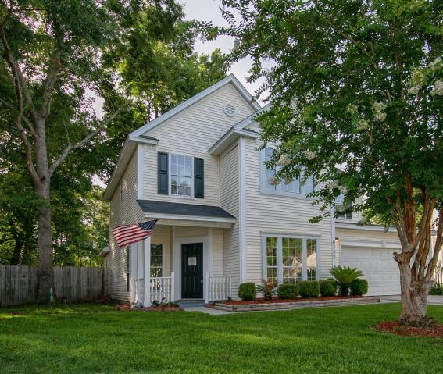
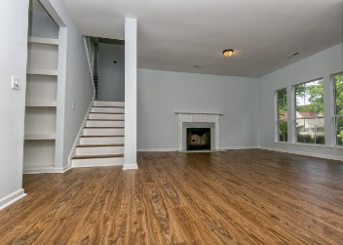
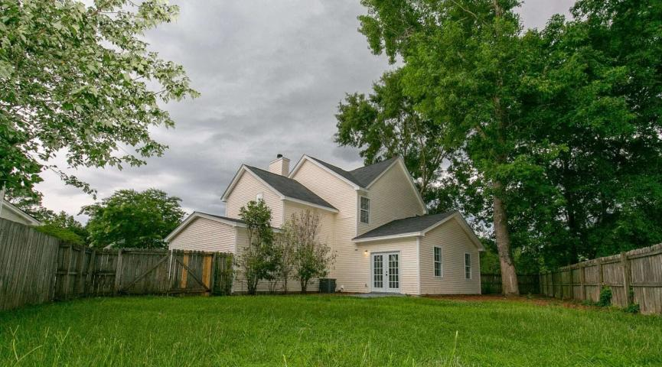
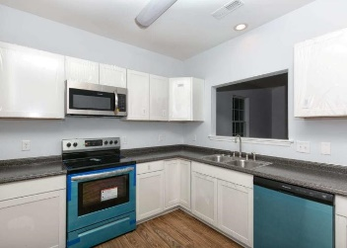
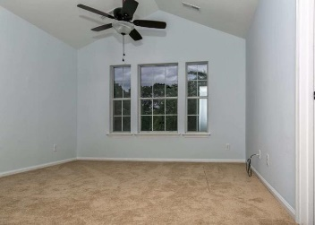
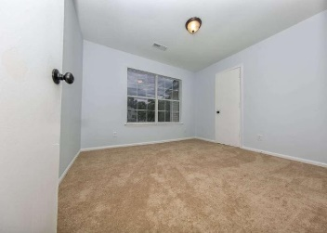


Open House Sunday 2-5PM ~ Seller Bonanza 6%
4117 Eastbury Court Indigo Ridge · North Charleston, SC 29420 MLS# 19018902 · $235,000
-NEW-NEW-NEW-NEW!
New Roof, New Flooring, New Contemporary Kitchen with New White Cabinetry & Stainless Appliances, New French Door of Bonus Room, Newly Treated Hardwood Stair Treads, New Vanities, New Lighting-You Name it & More..........
Cul-de-Sac home with fenced backyard in Sought After Dorchester II School District! Great neighborhood located in the wonderful Windsor Hill Community close to Boeing, Joint Base Charleston, minutes from Historic Downtown Charleston and the Beaches. Vacant and Ready-to-Show! Let’s Go and Make this Elite Home Yours Today!!!
YES-6% Buyer Commission with Reasonable Offer by 6PM on 7.14
Mattie Nesmith, ABR
Broker-in-Charge
Mobile - (843) 452-3779
mattie@ergroupofsc.com
The Elite Realty Group of SC, LLC
8310-A Rivers Ave
North Charleston, SC 29406

