Slide 1
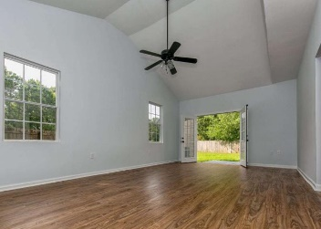
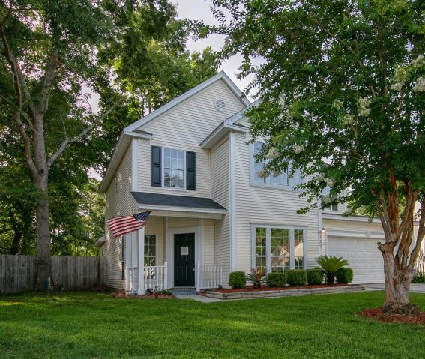
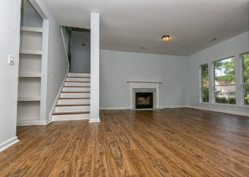
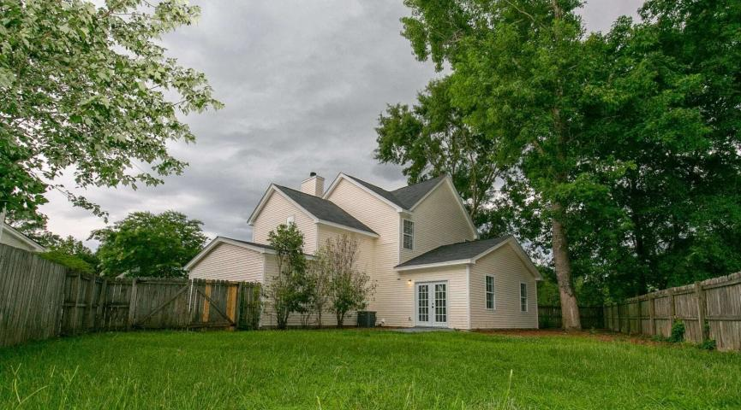
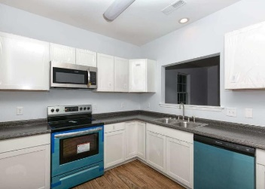
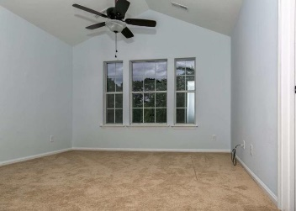
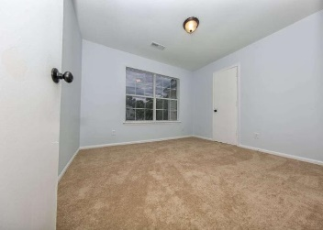

Contemporary - Sleek Remodeled DDII Dream
4117 Eastbury Court
Indigo Ridge · North Charleston, SC 29420
MLS# 19018902 · $235,000
$1500 Agent Bonus with Ratified Contract by 7/17
An OUTSTANDING opportunity to own in Dorchester II Schools with a contemporary-sleek remodeled 2-Story home waiting for the perfect family! New Roof, New White Cabinets, Stainless Appliances & Counters, New Flooring (Carpet & LVP), New Vanities & Toilets, New Paint, Double Car Garage with an AWESOME backyard. Welcoming cul-de-sac house with an entrance leading into a formal living with a fireplace and dining room combo. Great home for entertaining with a dream kitchen leads into a HUGE bonus room at the rear of the home. Upstairs leads to 4 spacious bedrooms with a newly stained split staircase to the Master and 2 bedrooms to the left and to the right the perfect space for an office, bedroom for the mother-in-law, or older child and a huge closet for storage. Close to Boeing & Joint Base Charleston
Mattie Nesmith, ABR
Broker-in-Charge
Mobile - (843) 452-3779
mattie@ergroupofsc.com
The Elite Realty Group of SC, LLC
8310-A Rivers Ave
North Charleston, SC 29406

