Slide 1
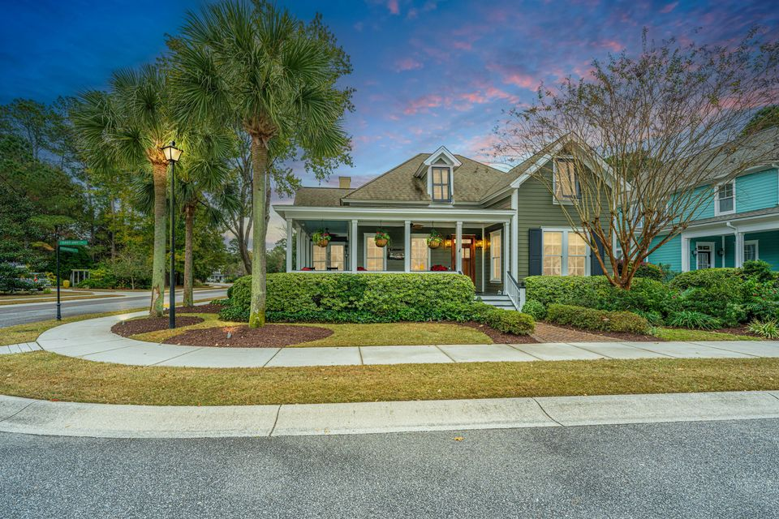
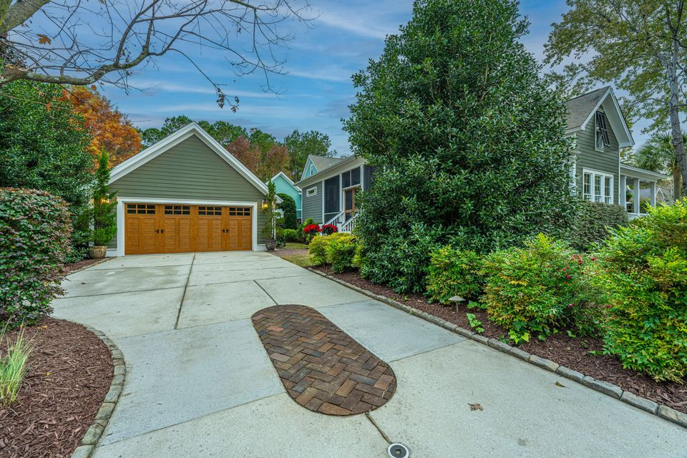
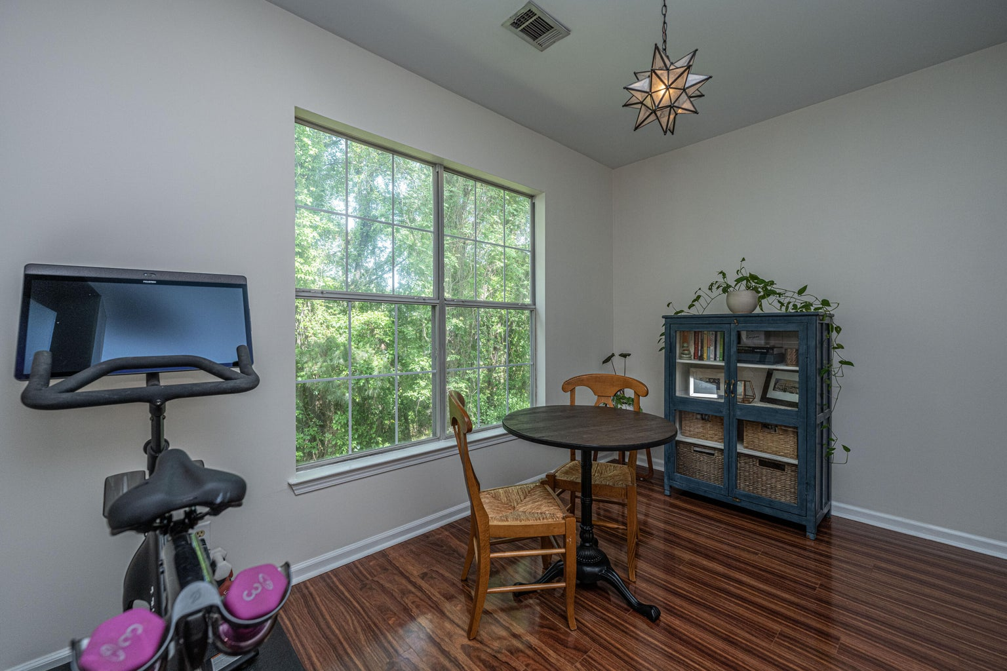
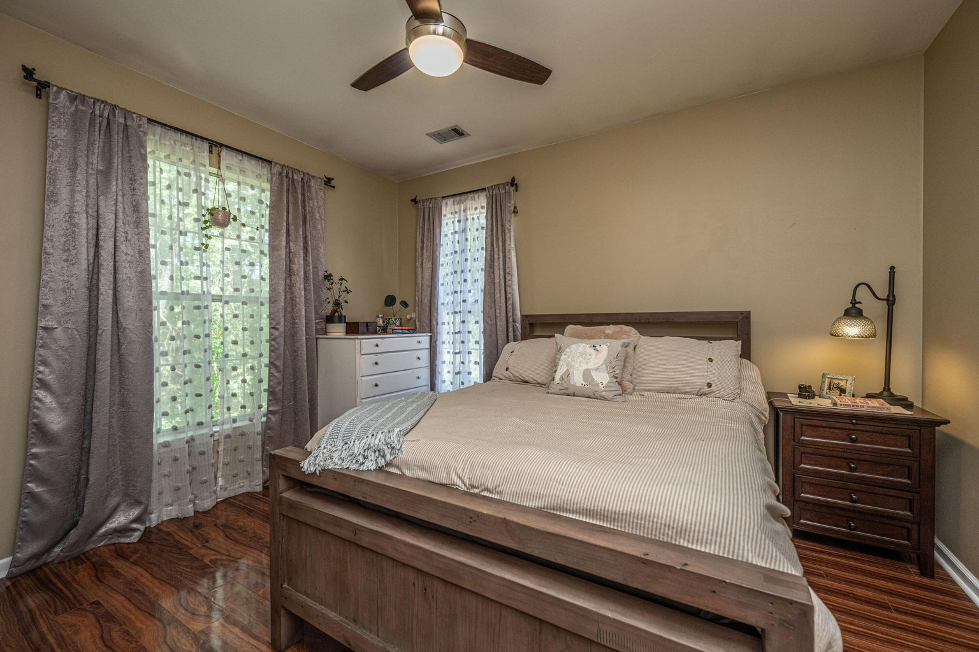



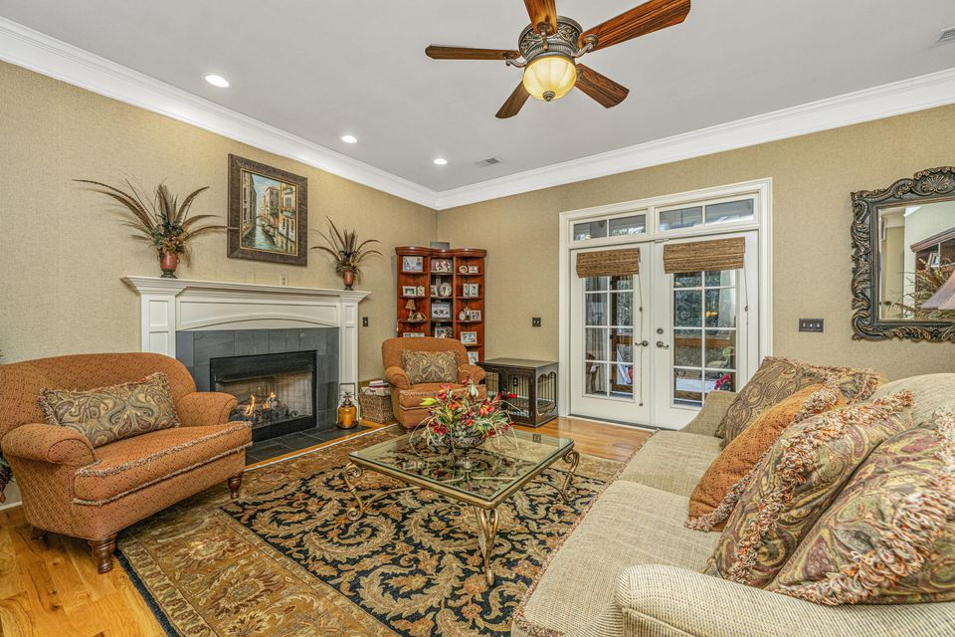
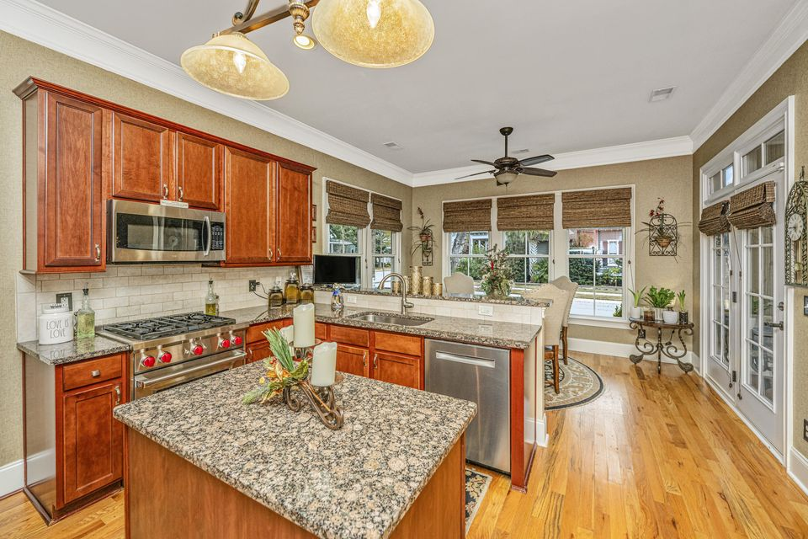
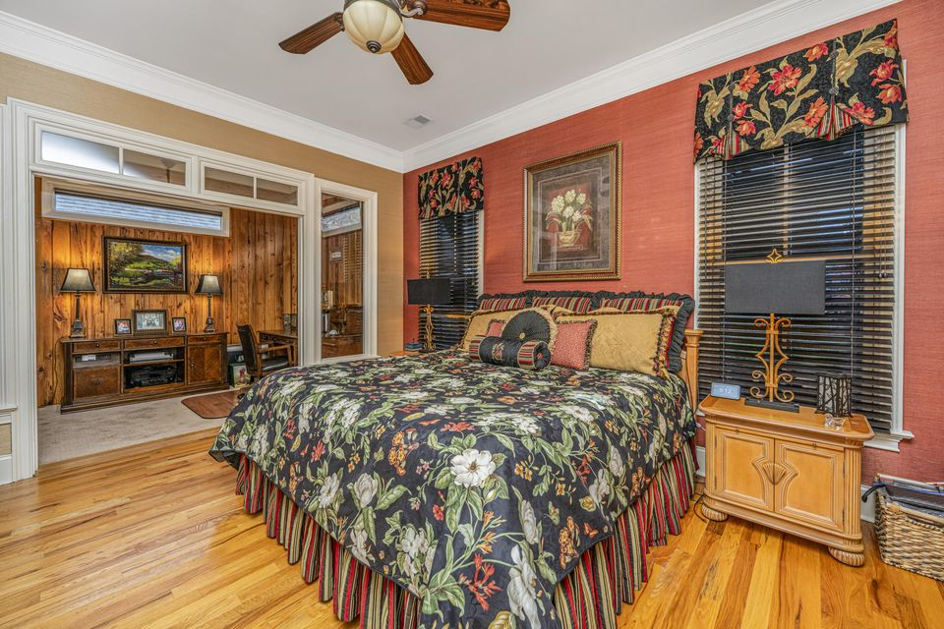
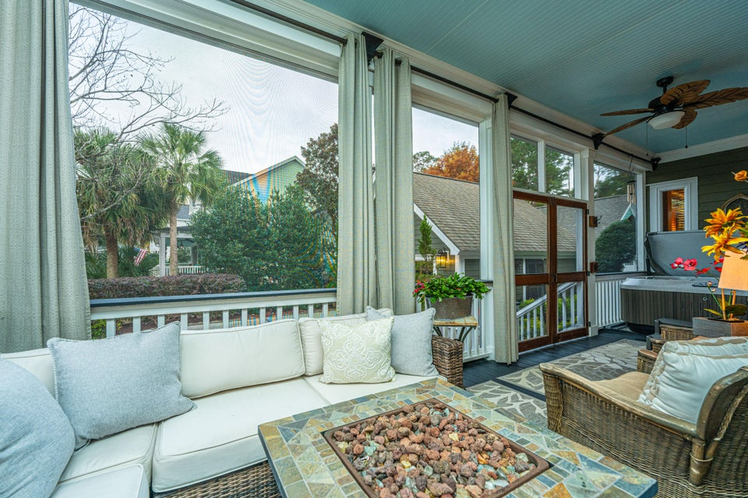

The Villages in St Johns Woods!!!
This stunning 5br, 4.5ba low country custom built home by Simonini Home Builders has been meticulously cared for situated on a .60 acre heavily treed lot on large pond in private gated community of Popular Grove. This spacious , two story, 4721 square foot home features master bedroom suite on the first level, full front porch, beautiful heart pine wood flooring, large entry foyer which separates the private study from formal dining room, open gourmet kitchen with Wolf 6 burner gas stove, built in SubZero refrigerator/freezer, dishwasher, microwave oven and large pantry. Half bath/Powder room under stairway and large utility room for washer and dryer and deep sink and built in cabinets off hallway. The smaller den with gas log fireplace opens to kitchen and breakfast room. The larger fireplace opens to kitchen and breakfast room and offers expansive views of the water year-round. The living room with its second gas log fireplace is great for entertaining away from dining areas. The large master bedroom suite is located on the first level and has travertine tile flooring in the master bath, his and hers walk in closets, separate vanities, soaking tub, and a large separate shower. There is a game room with separate stairs over the two-car garage large enough for a pool table. The second level boasts 4 spacious bedrooms and three bathrooms. On the rear of home is a large screened in porch and open deck overlooking firepit and pond. To reduce maintenance the exposed wood decking has been replaced with Trex decking and exposed rail caps with PVC. Yard has irrigation system and 120-gallon buried propane tank. Sellers just replaced roof with 50 year architectural shingles with transferable warranty. The two electric water heaters have been converted to a single LP gas fired tankless water heater. New epoxy coating on floors and newly finished walls now in two car garage. Neighborhood amenities include Privacy gate, Boat Ramp, Dock facilities, Exercise area, Pool, RV/boat storage and walking/jogging trails. Don't forget the fantastic equestrian center for your horses!
4118 E Amy Lane
Johns Island, SC 29455 | MLS# 24029887 | $898,500
LOCATION! This beautiful home on a nice corner lot in the sought-after Villages in St. Johns Woods neighborhood. This stunning residence Just Recently Painted boasts a wrap-around porch and is filled with exquisite upgrades, including crafted woodwork, travertine tile, and grass wallpaper throughout—truly a home that must be seen to be appreciated! As you enter the main floor, To the Right is the den or study, featuring gorgeous Pecky Cypress woodwork and a custom-built bookcase. Adjacent is the formal dining room, flowing into the gourmet kitchen, equipped with top-of-the-line Wolf and JennAir appliances. The kitchen opens into the grand great room, centered around a gas fireplace, and leads to a tranquil outdoor porch and freshly landscaped yard, providing a private and serene setting.
The primary bedroom suite on the main floor is both spacious and versatile, with additional flex space, an en-suite bathroom complete with a jetted tub, walk-in shower, and a custom mahogany walk-in closet.
Upstairs, you'll find the most recent addition to the home: a state-of-the-art theater room with intricate Pecky Cypress wood detail---a must-see! There's also ample storage space. A second bedroom, and a den or potential third bedroom, along with a full bathroom. The theater room addition adds approximately 277 sq. ft., bringing the home to around 2,692 Total sq. ft. (please measure if square footage is important). Be sure to see the finished 2 car garage. Also, there's an invisible fence for your pet!
Also, Most of the home's furniture and furnishings are available and being sold separately!
A separate water meter has been installed by the St. Johns Water Company exclusively for the outdoor irrigation system, a cost-saving feature! Residents of The Villages at St. Johns Woods enjoy outstanding amenities, including a saltwater resort-style pool, an outdoor clubhouse, a playground, and scenic walking trails. This home offers luxurious living in a vibrant community setting!
Close to restaurants and shopping and only 9 miles to downtown Charleston!
TAKE A VIDEO TOUR
4
3
1,844
Robyn Lane
843-222-5599
robynlane01@icloud.com
Jenny Siggelkow
843-901-3494
jcsiggelkow@gmail.com
ERA Wilder Realty | 537 Folly Road | Charleston, SC 29412

