Slide 1
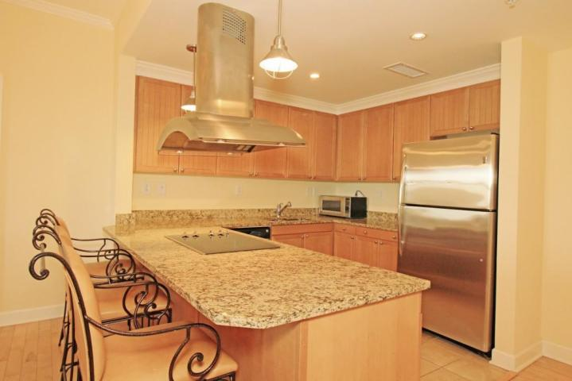
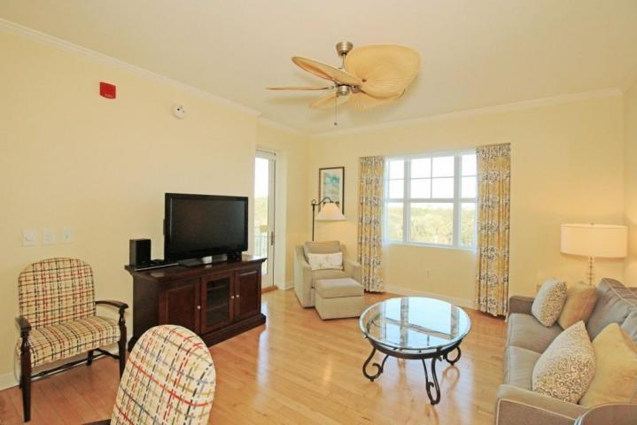
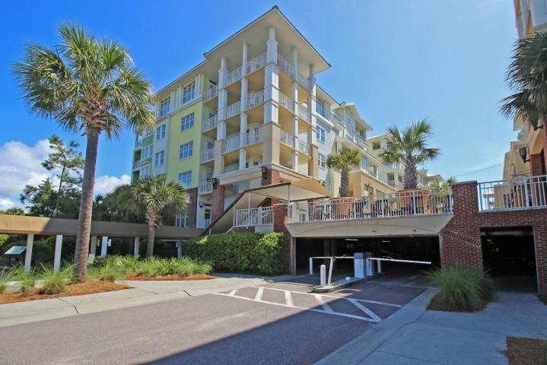
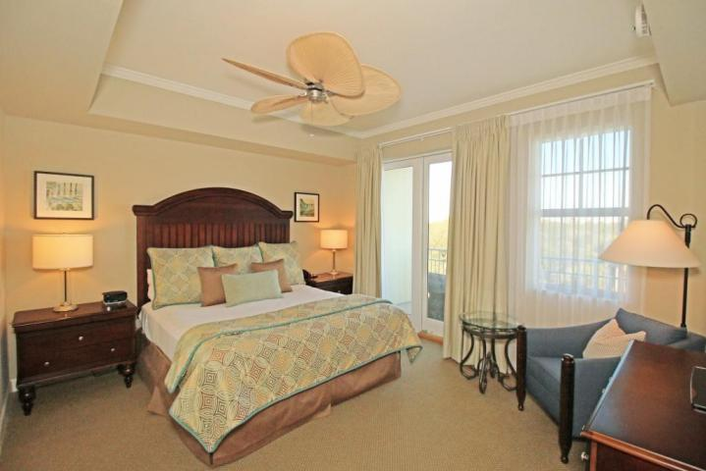
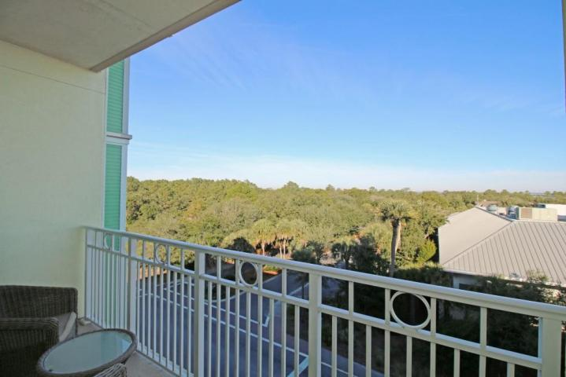
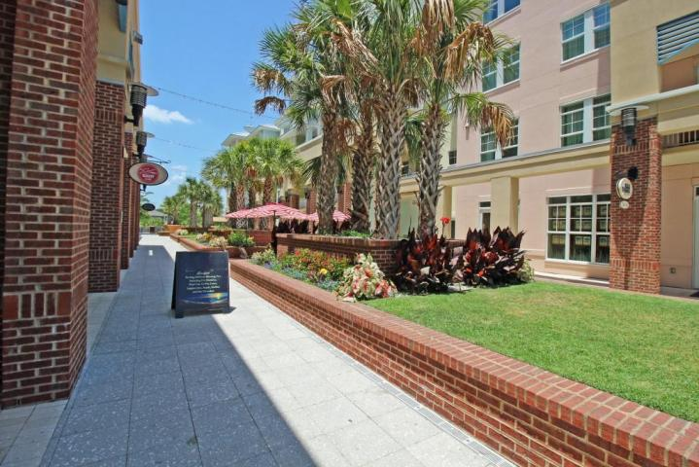
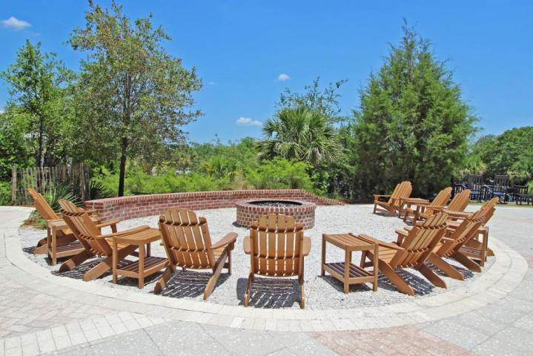


411-A Village At Wild Dunes Isle of Palms, SC 29451 MLS# 16000708 $599,000
Major Price Reduction
Fantastic Rental Property
THIS IS THE BEST PRICED TWO BEDROOM IN THE VILLAGE WITH FANTASTIC RENTAL INCOME!! Introduced in 2008, The Village at Wild Dunes offers luxury, ease, and convenience all within a block of the Atlantic Ocean… AND dining, fitness, swim and spa services just an elevator stop away. This two bedroom, two bath condominium with granite countertops, stainless steel appliances, hardwood floors and crown molding is being sold fully furnished. As the only fully ADA-compliant bathroom in the Village (A409), rental performance is particularly strong. It is THE BEST TWO BEDROOM RENTAL PERFORMER in the Village with the exception of ocean view units which are priced $200,000 higher! Rental income 2013: $64,456, 2014: $83,198, 2015: $83,279. The Village is situated in the heart of the Resort, easy walking distance to tennis courts, Harbor Golf Course, bike rentals and more! A fire pit was added this year, allowing guests to sip a cozy beverage while enjoying entertainment or friends on the Village Plaza. Whether a second home, investment property or a combination of the two, come take a look at what this unit has to offer...you won't be disappointed!
Ann Cortes Office - (843) 886-8110
Mobile - (843) 324-6808
ann.cortes@carolinaone.com
Carolina One Real Estate | 1503 Palm Blvd | Isle of Palms, SC 29451-2280

