Slide 1
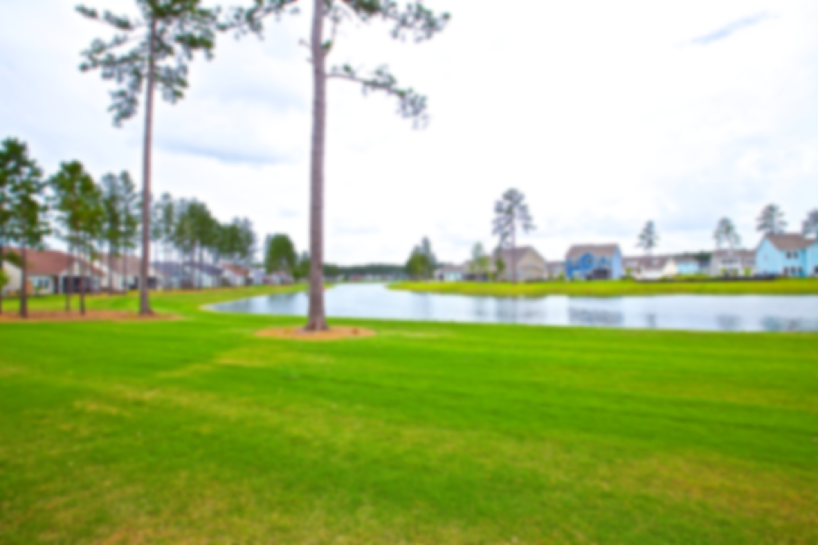
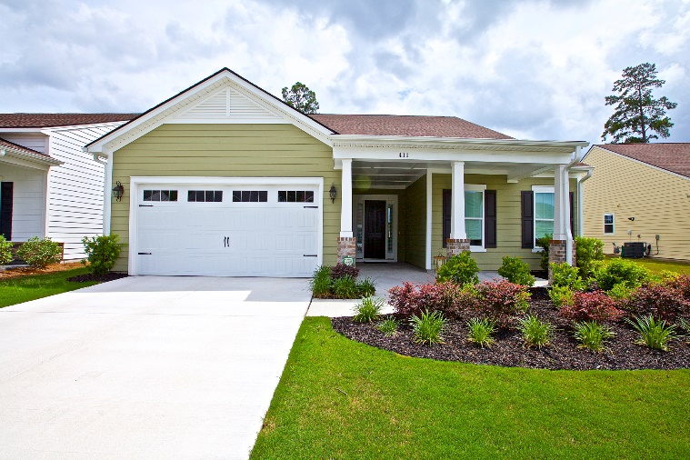
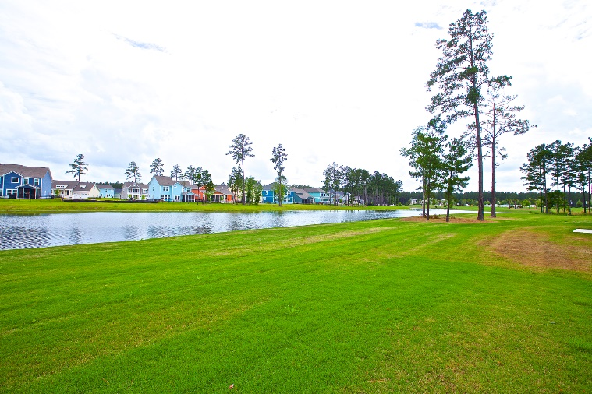
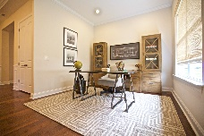
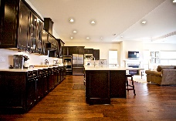
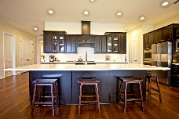
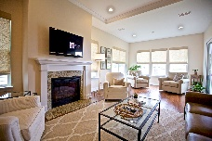
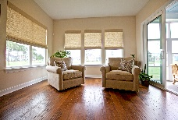
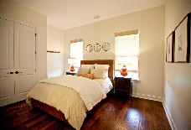
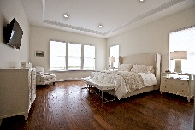
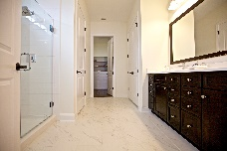
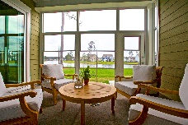
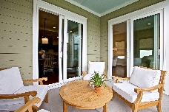
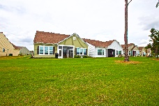
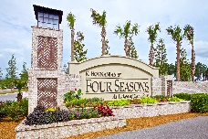

POCKET LISTING - NOT ON MLS
Four Seasons @ Cane Bay Plantation
411 FOUR SEASONS BLVD
SUMMERVILLE, SC 29486 - $475,000
2778 HSF MONT BLANC HOME - ONE STORY, BUILT IN 2016 ON LAKE LOT
Enter this gorgeous home in the spacious and welcoming foyer. Just off the foyer you’ll find your guest bedroom, guest bath and an open office/den space nicely tucked away from the family room and master. Continue through the wide open foyer and find a half bath just off the kitchen and family room, with 10 foot soaring ceilings! This open home is perfect for entertaining. The gourmet kitchen is a cooks dream, dressed with an attractive farm sink and sleek white quartz countertops throughout (they are maintenance free!) High end stainless appliances, a 36” gas cooktop, upgraded expresso cabinetry and a low seamless counter for seating completes this appealing kitchen! The family room with an inviting fireplace is expanded by an added sunroom and a screened porch. This home affords the luxury of many furniture options including wall space for your buffet in the dining area and a niche just off the foyer for a grand piece of furniture or perhaps a quaint reading nook! The master bedroom and bath leave nothing to be desired including a custom closet. You’ll find 5” walnut hardwood floors and 8 foot interior doors throughout the home. As well as trey ceilings in the master, great room and foyer. Off the kitchen you’ll find a well equipped mudroom with custom cabinetry and quartz countertops that mirror the kitchen. So much storage, additional counter space and the custom drop zone area will likely make this the most used room of the home! The huge laundry room and three car garage round out this lovely home! The garage floor is coated, walls painted and clean as a pin. And if all of that is not enough, this home sites on one of the best lake lots in the community!
The community of four seasons itself has so much to offer! 21,000 sq foot clubhouse is currently under construction and scheduled to open this fall/winter. You’ll enjoy two outdoor saltwater pools overlooking the lake, an outdoor amphitheater, tennis, bocce and pickle ball courts! Too much more to mention, the amenities are second to none.
Call me to set up an appt to see this home before it’s too late. This is a pocket listing and is not advertised on MLS.
Shelley Monahan
(843) 241-0695
shelleymonahan@kw.com
Keller Williams Realty Charleston
496 Bramson Ct Ste 200
Mt. Pleasant, SC 29464

