Slide 1
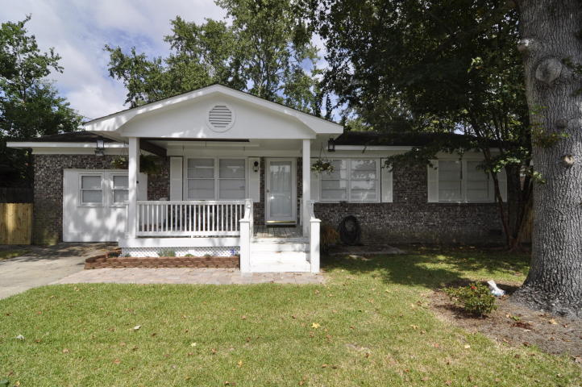
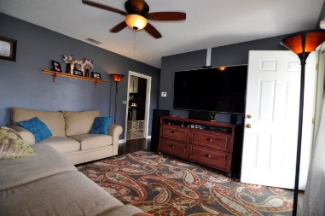
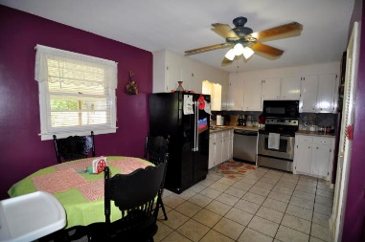
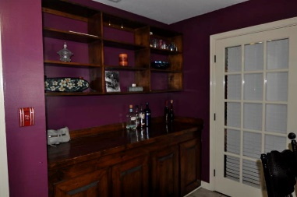
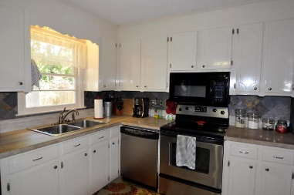
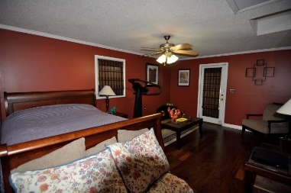
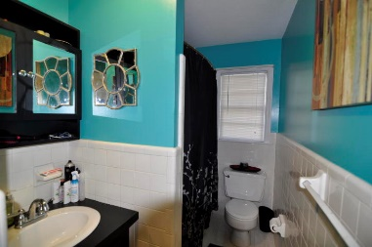
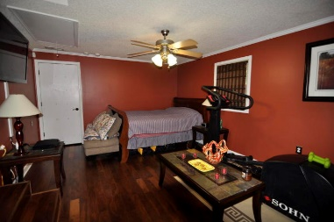
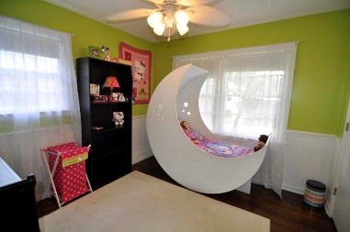
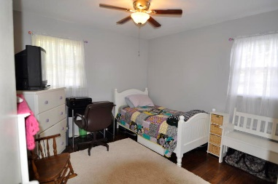
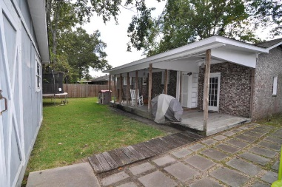
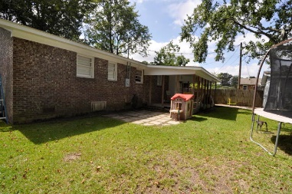
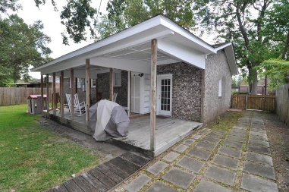
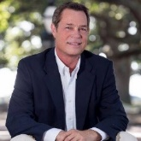

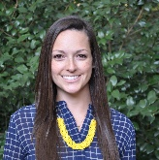
411 Judy Drive
Boulder Bluff
Goose Creek, SC 29445
MLS# 15024968
$116,900
4 Bedrooms
1 Bathrooms
1,256 Sq Ft
This well cared for home is available in Boulder Bluff. The home features four bedrooms, 1 bath, living room, eat in kitchen, and spacious back yard!
There is plentiful out door living space off the back of the home as well that can be kept open air or is ready to be screened in. This home is just minutes from shopping, dining, and entertainment!
Bobby Shealy
Office (843) 900-4000
Direct (843) 442-7373
bobby@redefy.com
Lindsay Pennell
Office (843) 900-4000
Direct (843) 830-6004
Lindsay@redefy.com
Redefy Real Estate | 12 Carriage Ln | Charleston, SC 29407 | redefy.com/Charleston

