Slide 1
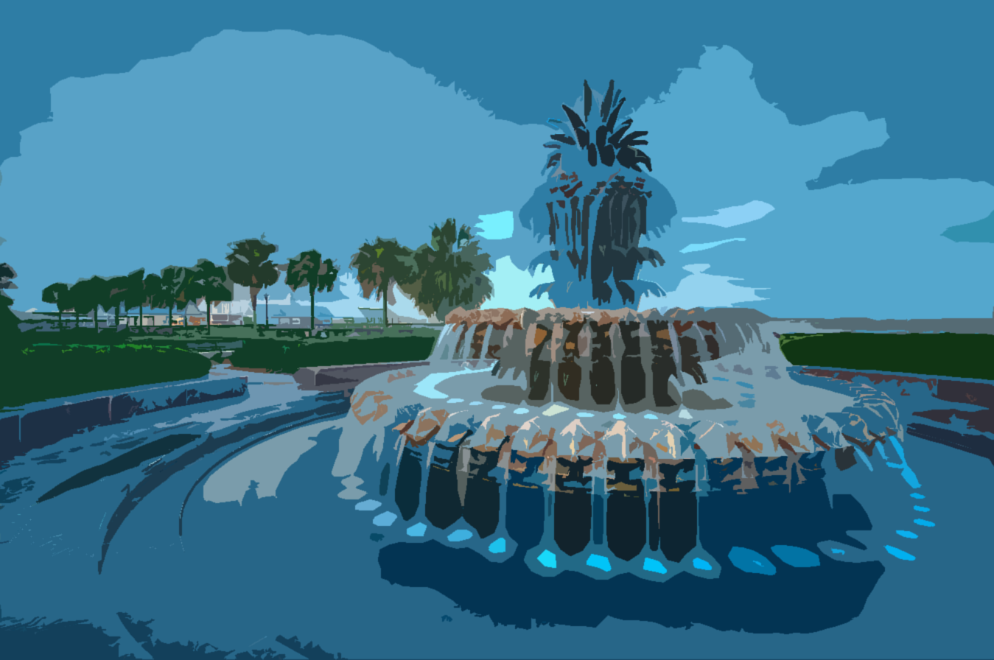
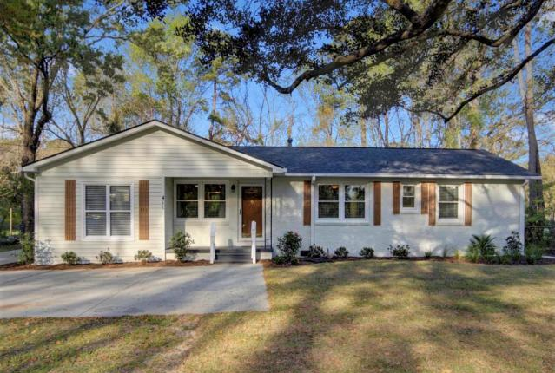
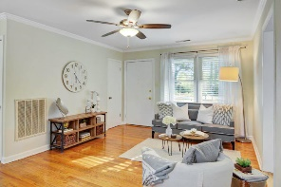
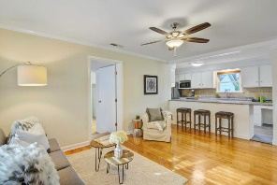
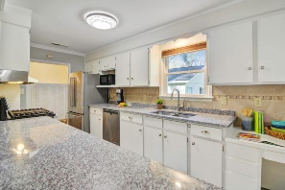
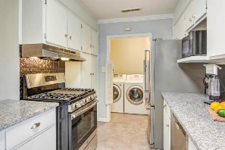
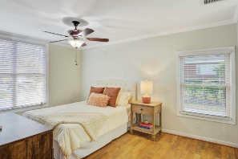
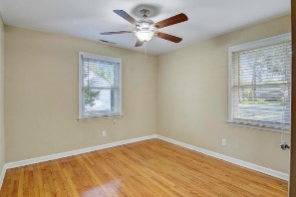
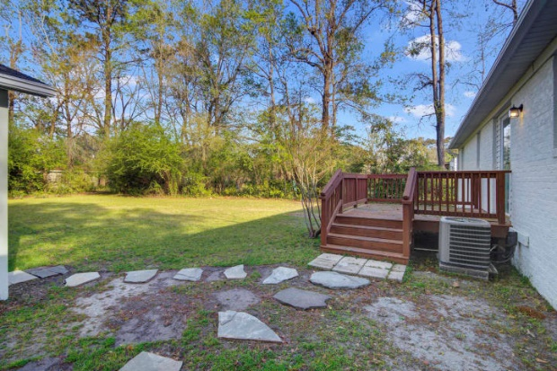
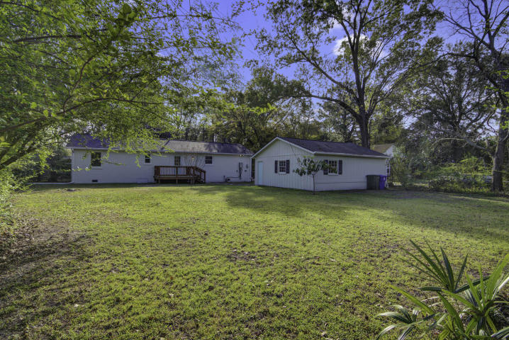


$5000 Agent Bonus! West Ashley Gem!
Price Reduced
411 Wappoo Road
Geddes Hall ~ Charleston, SC 29407
MLS# 19009259 ~ $344,900
Beautifully renovated, 4 Bed 2 ½ Bath Mid-Century Modern Brick Ranch, nearly 1/2 acre, fenced, new landscaping & Huge Garage & no HOA. You could see this home on HGTV as the "After" photos! Open & Split Floor Plan, Master Bedroom w/en-suite. Stainless Appliances & Gas Range all convey, including LG Front Loader Washer & Dryer. No Flood Insurance! In 2016 All NEW windows (except Master, new window just installed), 2016 NEW Roof, NEW Rinnai Tankless Water Heater, NEW Leaf Guard Gutters, Crawl space is encapsulated, NEW Paint throughout interior & exterior. Airport, Boeing & MUSC are less than 15 minutes & Folly Beach is only a 20 minute drive. Avondale Restaurants, Whole Foods & Costco are 5 minutes away! Come see this perfectly located, Like-New Home today! Easy to Show!
Seller will pay $5000 to Buyer's Agent at closing that presents acceptable offer & ratification by June 1st!
David Tester, ABRM
(843) 452-7337 | david@davidtester.com
www.davidtester.com
Charleston First Real Estate, Inc | 1922 Capri Dr | Charleston, SC 29407

