Slide 1
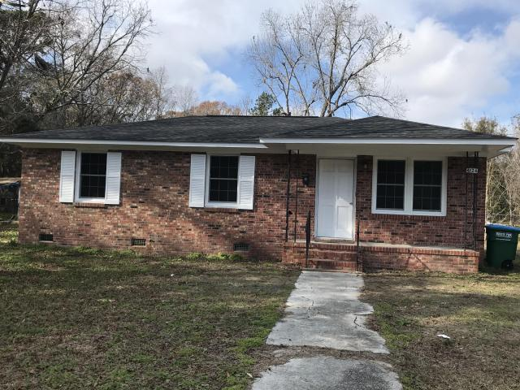
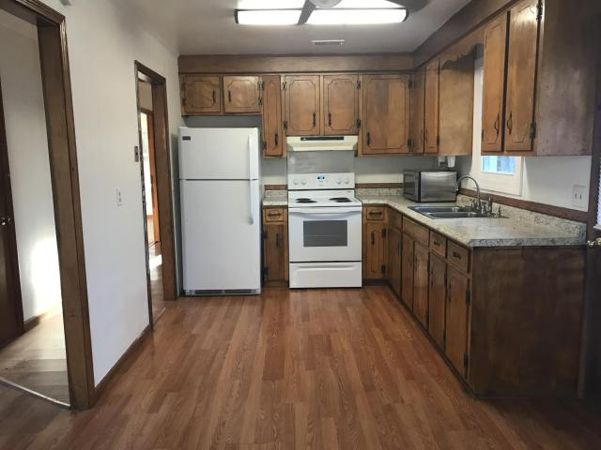
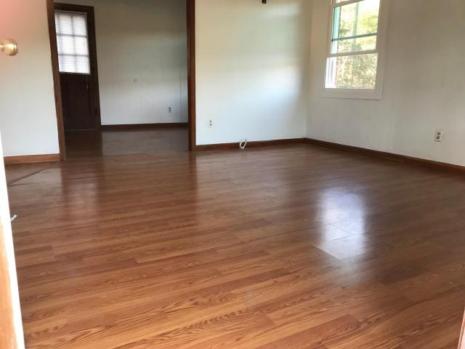
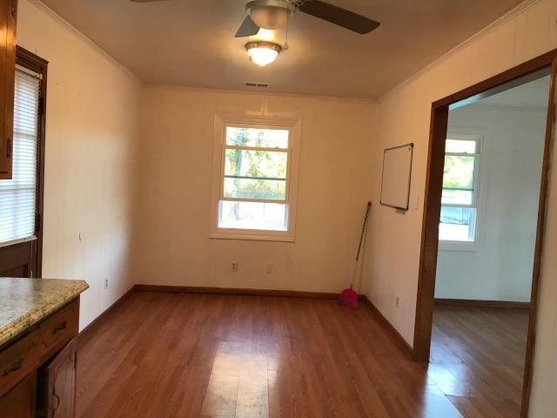
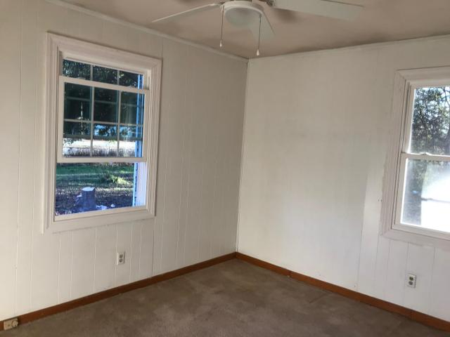
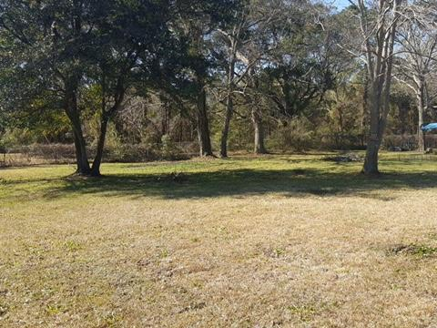


4126 N Highway 17 Chandlers ~ Awendaw, SC 29429 MLS# 17000034 ~ $269,000
GREAT LOCATION!!
ON THE CORNER OF HIGHWAY 17 N AND CHANDLER RD.
Great opportunity for investors and first time home Buyer.
Three Bedroom, One Bathroom
Totally Renovated
Eat-in Kitchen
Living Room
Large Fenced Yard
0.45 Of An Acre With Plenty Of Room To Store Your Boat Or Your RV
New Carpet In All Bedrooms
Fresh Paint
Laminate floor in kitchen and living room
New Roof Installed Dec 2017
New Windows All Over The House
The Best High School, Middle And Elementary In Charleston County, Schools Are Minutes Away
So Close To The Beaches
Was Rented In The Past For $1,400 Before Renovation
No HOA Fees
Charleston County Boat Landing Down On Chandler Rd
Please Note The Address On The Front Of The House Is 4162, The Address In Tax Record For This House Is 4126 - This Is Not A Typo Error.
Walid Ismail
M (843) 696-0061
walid@ismailrealestate.com
Ismail Real Estate LLC
2085 Terrabrook Ln
Charleston, SC 29412
www.ismailrealestate.com

