Slide 1

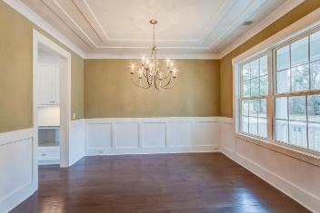
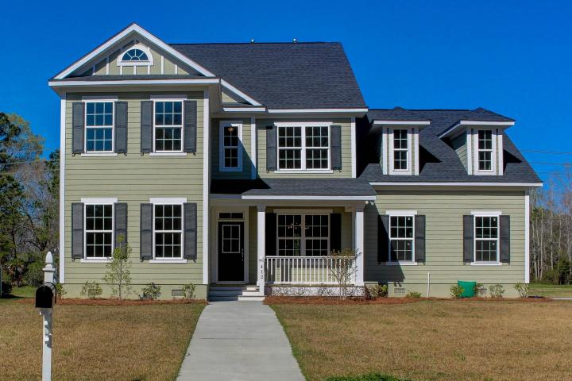
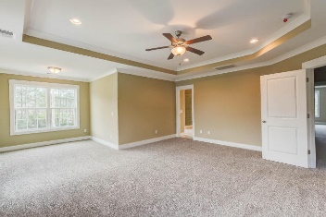
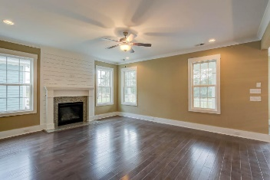
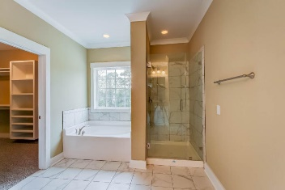
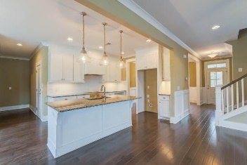
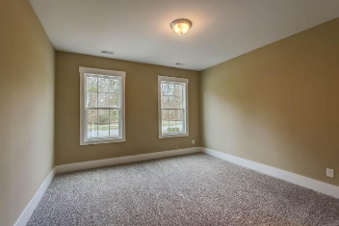
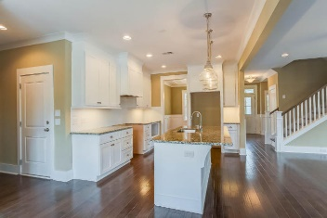
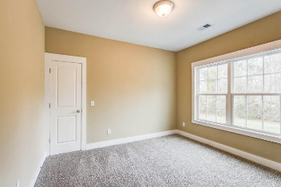
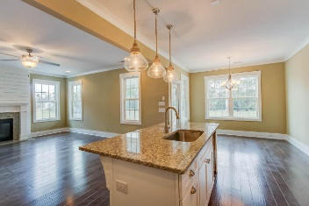
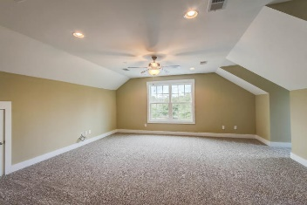

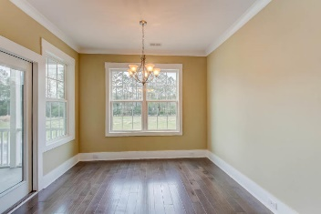
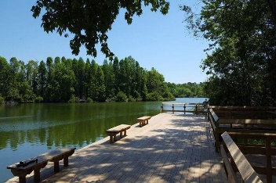
412 Hamlet Circle Crowfield Plantation :: Goose Creek, SC 29445 :: MLS# 17016009 :: $384,990
Back on the Market!
Last Available New Home @ The Hamlets!
It's a dream come true, You want an establish community but also a New Home that is a Semi-Custom and Custom Home Neighborhood. Welcome to 412 Hamlet Circle this premier home is the only New Construction side entry garage home currently available in The Hamlets featuring 5'' Hardwood Floors, Granite Countertops, Custom Fire Place Mantle with Shiplap trim accent, Smooth Ceilings, Irrigation System, and Screened Porch. The Designer Pendants in the Kitchen make the ambient light feel cozy and relaxing. The Breakfast Bay off of the kitchen is perfect for sitting around the table and entertaining. Kitchen Appliances include a Stainless Steel Gas Range with Oven, Vented Hood, Dishwasher, and Microwave. Come checkout this home in The Hamlets before it's gone!
Chris Eller
EPRO, GRN, SFR, REALTOR, CRS
(843) 343-3359
Chris@GallowayFamilyHomes.com
GFH Realty, LLC
498 Wando Park Blvd Suite 1125
Mt. Pleasant, SC 29464
www.gallowayfamilyhomes.com

