Slide 1
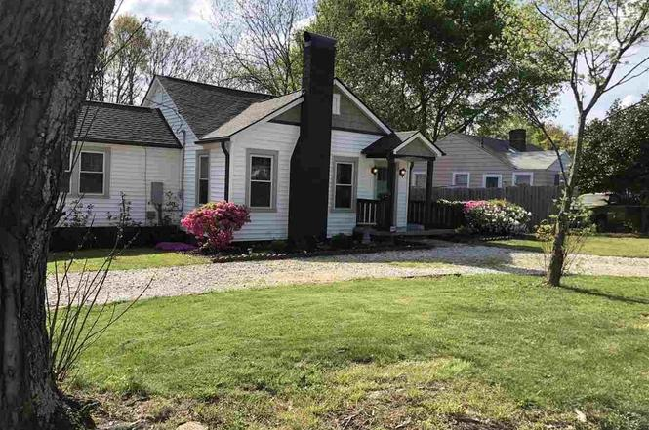
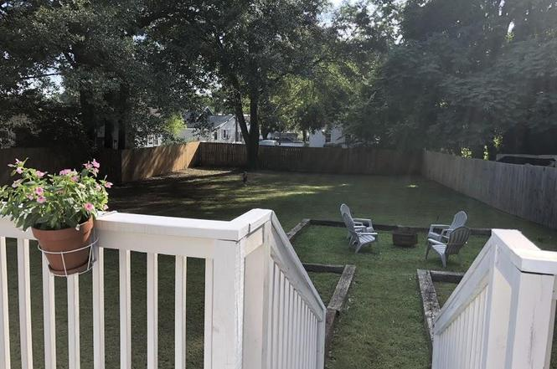
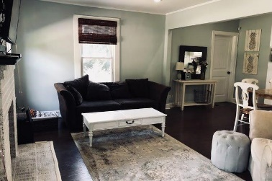
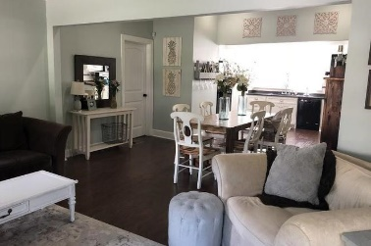
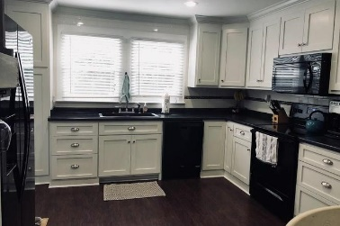
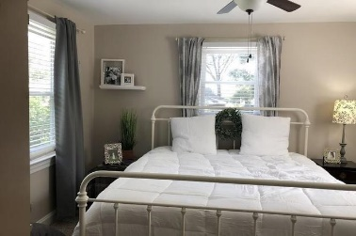
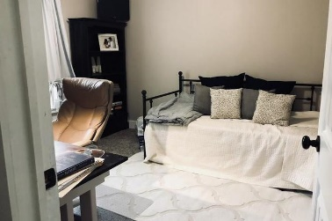
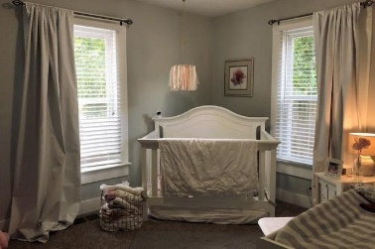
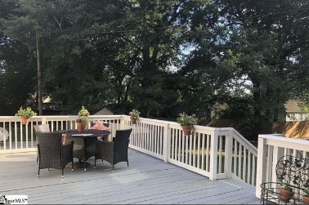
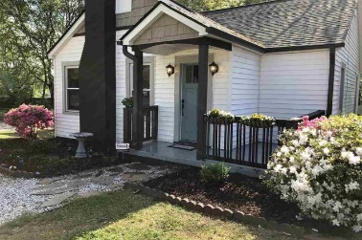


Potential Short Sale!
CLOSE TO DOWNTOWN
412 S Texas Ave
Highland ~ Greenville, SC 29611 ~ MLS# 1374519 ~ $197,000
New listing in a prime location!
Only 6 minutes to downtown Greenville and 5 minutes to Greenville Memorial Hospital and St. Francis Hospital. Updated three bedroom, two bathroom home in up and coming area! Open floor plan from the living room to the kitchen. New roof, flooring, windows, doors, kitchen and bathrooms in 2016. Step out onto the 15 ft x 30 ft deck overlooking large, private fenced backyard.
Chuck & Edy Mimms
Cell 843-224-9507
Office 843-530-8100
www.sanddollarsc.com
www.facebook.com/Sanddollarsc
Sand Dollar Real Estate Group | 2205 Middle Street | Suite 203, Mailbox 2 | Sullivans Island, SC 29482

