Slide 1
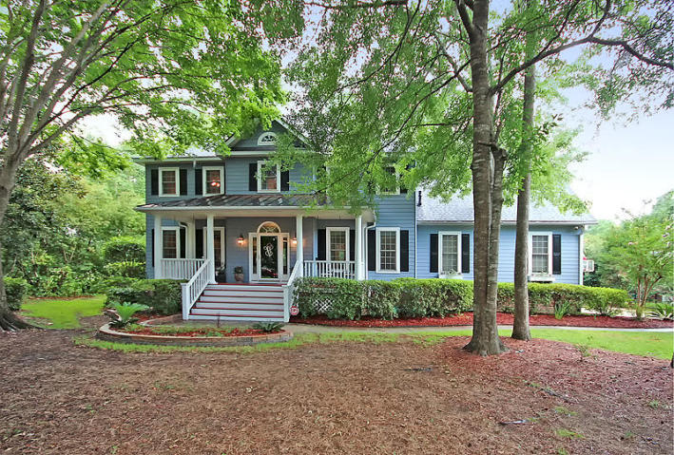
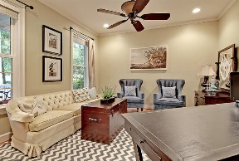
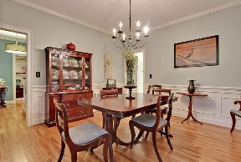
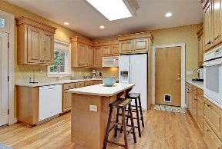
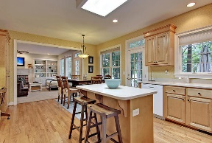
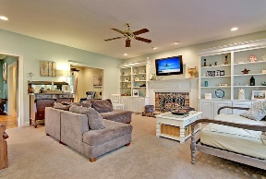
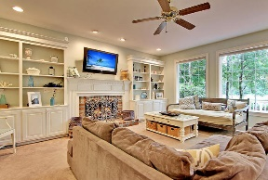
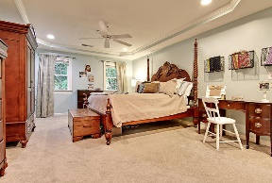
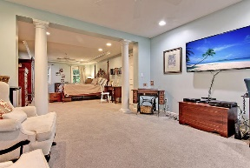
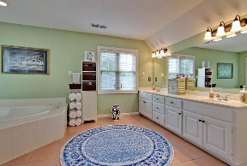
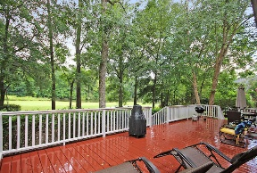
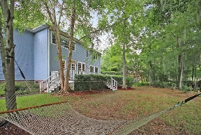
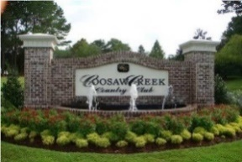


Golf Course Beauty in Gated Community!
4135 Club Course Drive
Coosaw Creek Country Club
North Charleston, SC 29420
MLS# 16019438
$378,500
4 Bedrooms | 2½ Baths | 3,148 sf
Custom built 3,148 Sq. Ft. golf course and pond view home with a new roof, new HVACs, new tankless hot water heater in a gated community under $400K! Sit on the huge back deck and enjoy the view of the golf course, pond and wildlife! This Coosaw Creek beauty has so much to offer! Wooded, private lot, this home has curb appeal galore. A full front porch welcomes you. Upon entering, you'll immediately notice the large formal living room that can be used as an office. Down the hall, you'll enter the family room with gorgeous built in cabinets and wood burning fireplace. The kitchen overlooks the family room and also offers a large eat in area, plenty of cabinet space, a built in desk space, kitchen island and great views of the golf course and pond from the kitchen sink. The dining room is a great size with plenty of room for entertaining. A large laundry room as well as a half bath complete the first floor. Upstairs, you'll find three big bedrooms with ample closet space. One bedroom has two closets! A full bath with a dual vanity is in the hall. Then comes the Master Suite! This may be one of the largest master bedrooms you have ever seen! A seating area connected to the bedroom can be used as an office, a workout room, a baby nursery, a media room...the possibilities are endless! On the way to the master bath, you'll notice his and hers walk in closets. The master bath is very large with dual vanities, jetted tub, double size shower and linen closet. This home has it all, plus, it is in walking distance to the clubhouse! Don't feel like cooking dinner? Take a short walk over to the clubhouse and enjoy all it has to offer! Coosaw Creek is a gorgeous gated golf course community conveniently located near the airport, Boeing, Mercedes, AFB. Drive to work close by, then come home to great country club living!
Larry & Kathy Mazalatis
Larry Cell 843-693-0529
Kathy Cell 843-693-0159
Office 843-871-9133
AGENTOWNED PREMIERE GROUP | 1800 TROLLEY RD | SUMMERVILLE, SC 29485

