Slide 1
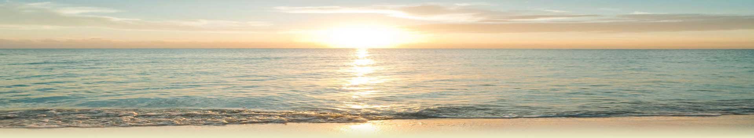

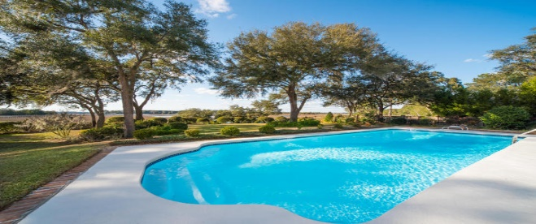
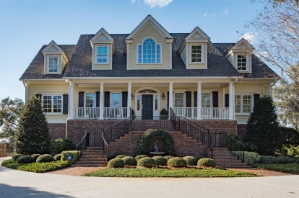
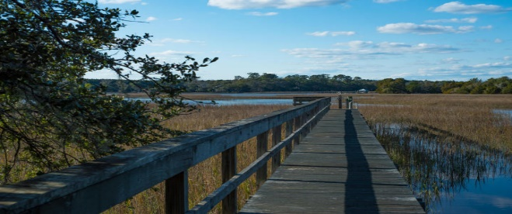
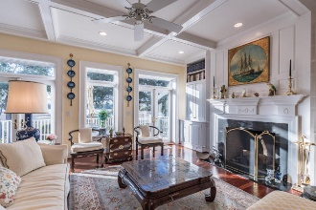
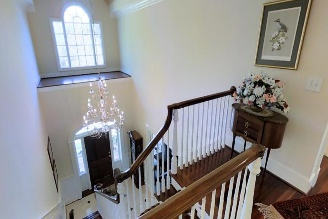
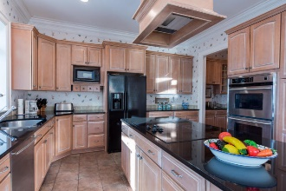
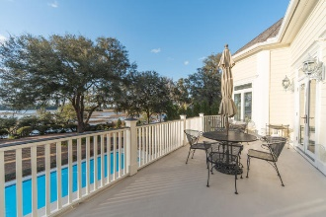
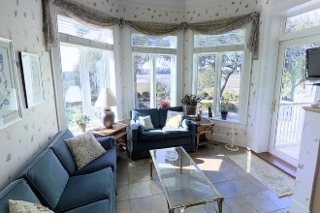
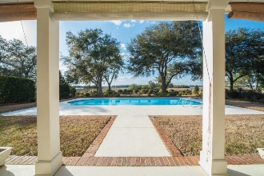
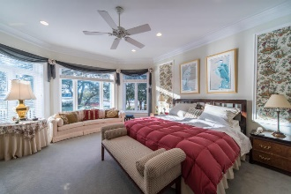
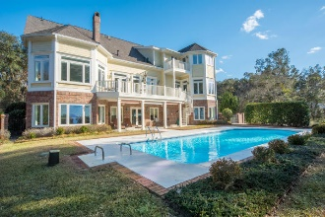
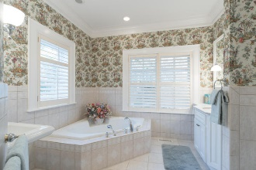
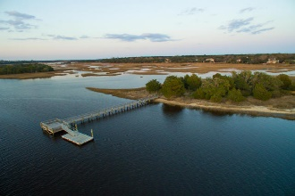


Charleston Charm on the Stono River
4138 Nature View Circle
Gift Plantation ~ Johns Island
MLS# 16004268 ~ $1,595,000
Exuding Charleston Charm on the Stono River, this Waterfront Beauty Has it All.
Built using insulated concrete forms, 4138 Nature View Circle is a formidable yet elegant home that will withstand Mother Nature's forces, and keep your power consumption amazingly low. This majestic house has 6,275 s.f. of heated and cooled space with 4+ Bedrooms, 5 full bathrooms, and a 1750 s.f. “man cave”.
Other features include panoramic river views with stately grand oaks, a swimming pool, private dock, elevator, dual master suites, lots of privacy and storage, and community deep water dock and tennis court.
This is a one-of-a-kind gem that has something for everyone. 4138 Nature View Circle is a "Solid Family Foundation" unlike any other in the Charleston area.
Bob Nitkewicz bob@goldenbearrealty.com
843-819-7754
Lee Lindler leel@goldenbearrealty.com
843-637-0803
Golden Bear Realty | 654 Coleman Blvd, Suite 100 | Mt Pleasant , SC 29464
Cell (843) 637-0803 | Office (855) 725-5890 | Fax (561) 721-3311
www.goldenbearrealty.com

