Slide 1
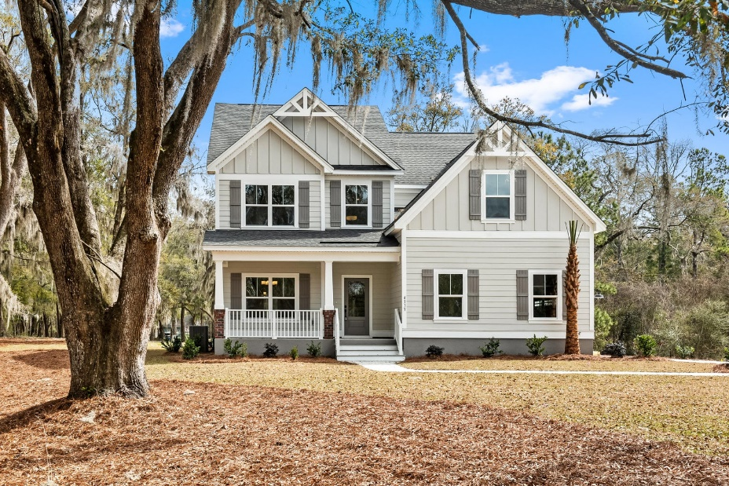
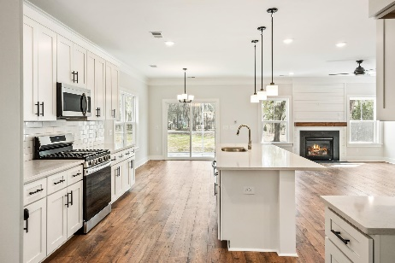
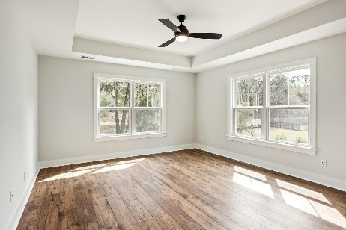
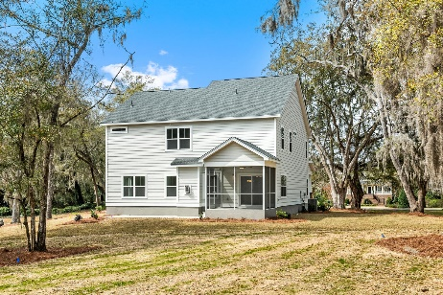
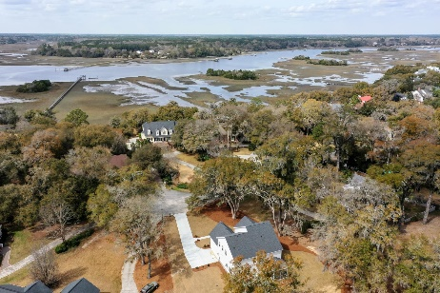



BRAND NEW HOME IN GIFT PLANTATION
4139 Nature View Circle
Gift Plantation
Johns Island, SC 29455
MLS# 24005949
$1,150,000
5 Bedrooms :: 3½ Baths :: 3,282 sf
Welcome to 4139 Nature View Circle, a captivating new construction residence nestled within the prestigious Gift Plantation community of Johns Island, SC. This impeccably designed home offers 3,282 square feet with 5 bedrooms and 3.5 bathrooms, exuding modern elegance. The desirable Gift Plantation is situated on Johns Island and features a community deepwater dock, a clubhouse, pool, tennis/pickleball courts, a picnic area, and walking trails with exclusive access to two private islands - convenient to area beaches and Downtown Charleston. Step into the heart of the home and discover a beautiful kitchen adorned with luxurious finishes, 42'' crown moulded cabinets, upgraded hood enclosure, and a massive island, providing ample space for culinary endeavors and gatherings with loved ones.
This inviting space is anchored by a beautifully adorned fireplace in the main living area providing a warming vibe to this great space. The master bedroom suite, conveniently located on the main floor, offers a serene retreat with its spacious layout and thoughtful design. Enjoy a large walk in closet with custom built wooden shelves designed for peak functionality and storage. Indulge in the blissful outdoor living space, complete with a screened porch & paver porch for your grill or outdoor fireplace, where you can unwind and soak in the Grand Oaks and natural beauty of the of this large .73 acre lot. With its seamless blend of style, functionality, and tranquility, 4139 Nature View Circle presents an unparalleled opportunity to embrace the quintessential Lowcountry lifestyle. Take part in a vibrant community feel & clubhouse with numerous social events, holiday celebrations, and gatherings. Don't miss your chance to make this extraordinary property your own sanctuary in Johns Island. Schedule a showing today and experience the epitome of Southern living.
Finishing touches are being added to this gorgeous home, to include an upgraded, craftsman hood vent enclosure. A shaker cabinet addition to the mudroom, and upgraded shelving system in the master closet!
Jon Moore
(843) 732-3365
jon@charlestonrealestategroup.com
www.charlestonrealestategroup.com
Charleston Real Estate Group | 443 Folly Road | Charleston, SC 29412

