Slide 1
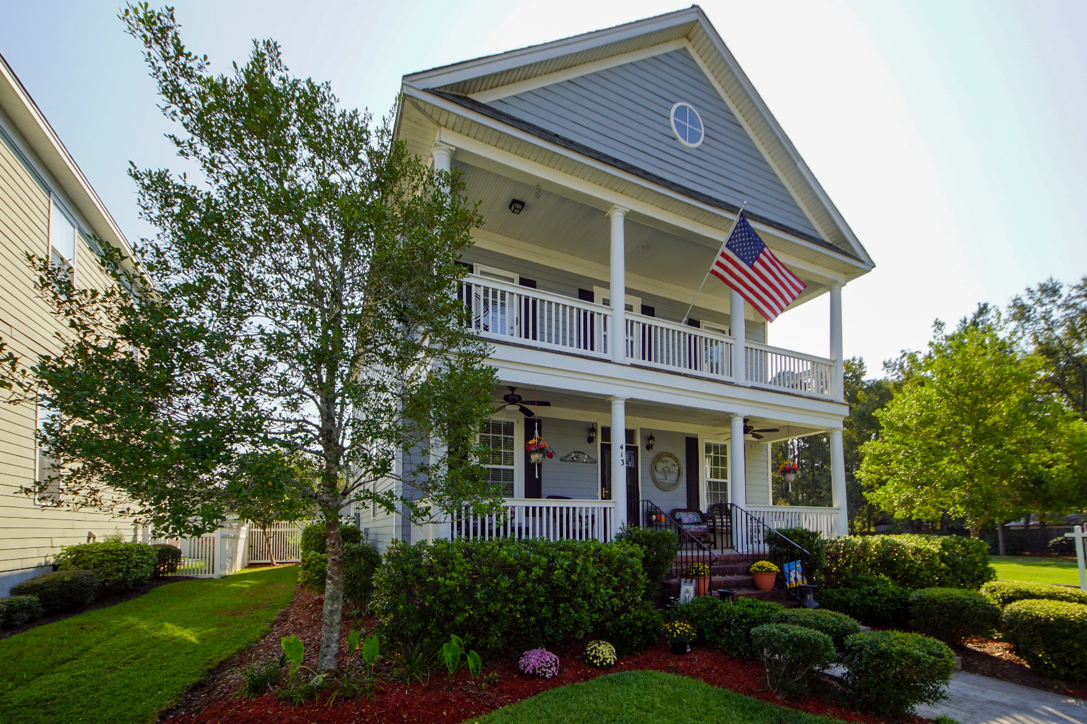
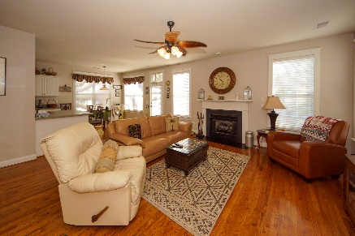
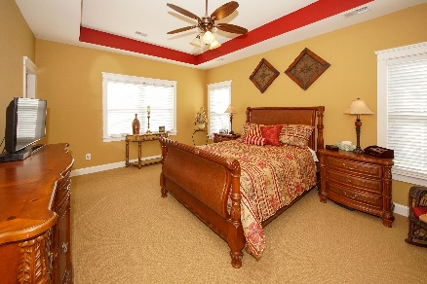
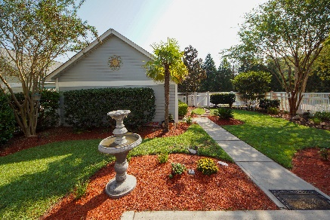


413 Hydrangea Street
White Gables :: Summerville, SC 29483
MLS# 19027576 :: $289,000
3 Bed / 3½ Bath
Just Listed!
Great Cube Appeal!
Stunning Charleston Single! Double front porch, professionally landscaped yard and corner lot are just the beginning of this gorgeous home. Well maintained by the seller, this home features formal living and dining, family room, each in kitchen, hard wood floors, crown molding and decorative casing around windows and doors. Spacious master bedroom is upstairs with an oversized master bath and walk in closets. Secondary bedrooms have a jack and jill bathroom with separate powder rooms for extra privacy. Sellers have created a tropical paradise in the back yard and this lot is walking distance to the pool! No need to wait for new construction. This home is turnkey and seller pride shows throughout!!!
Connie White, Broker
843-532-3356
connie@chrepros.com · conniewhiterealestate.com
Charleston Homes · 597 Old Mt. Holly Road · Suite 301 · Goose Creek, SC 29445

