Slide 1
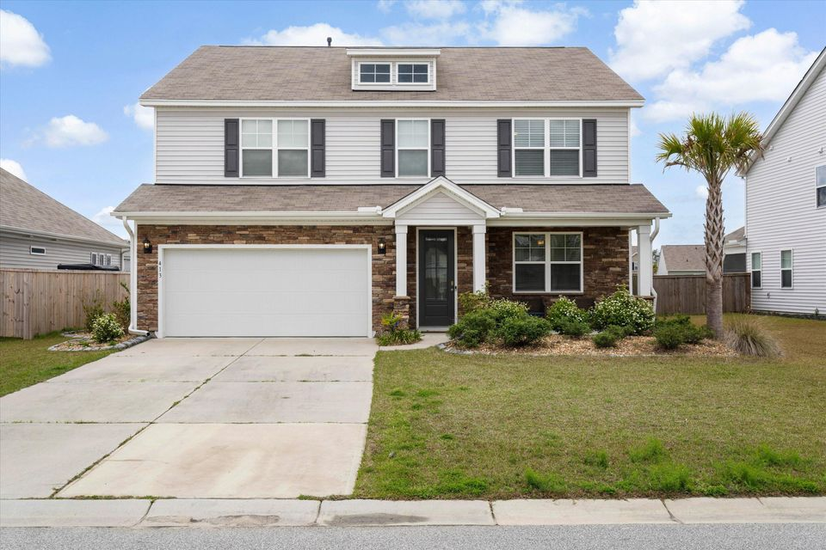
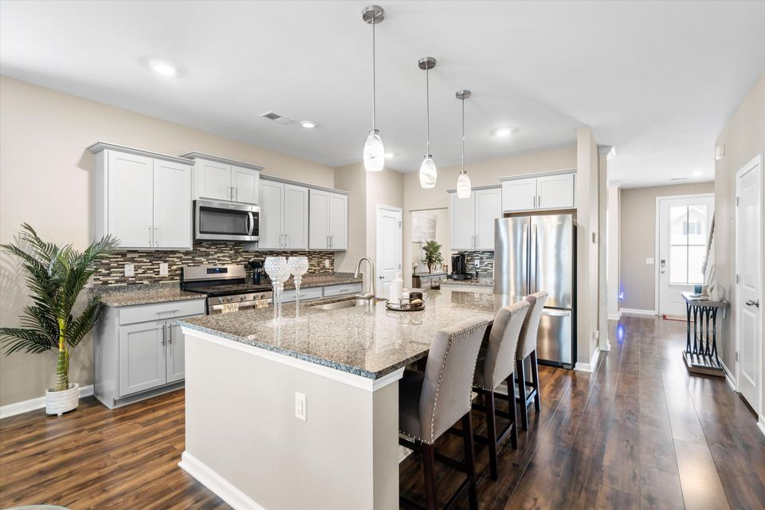
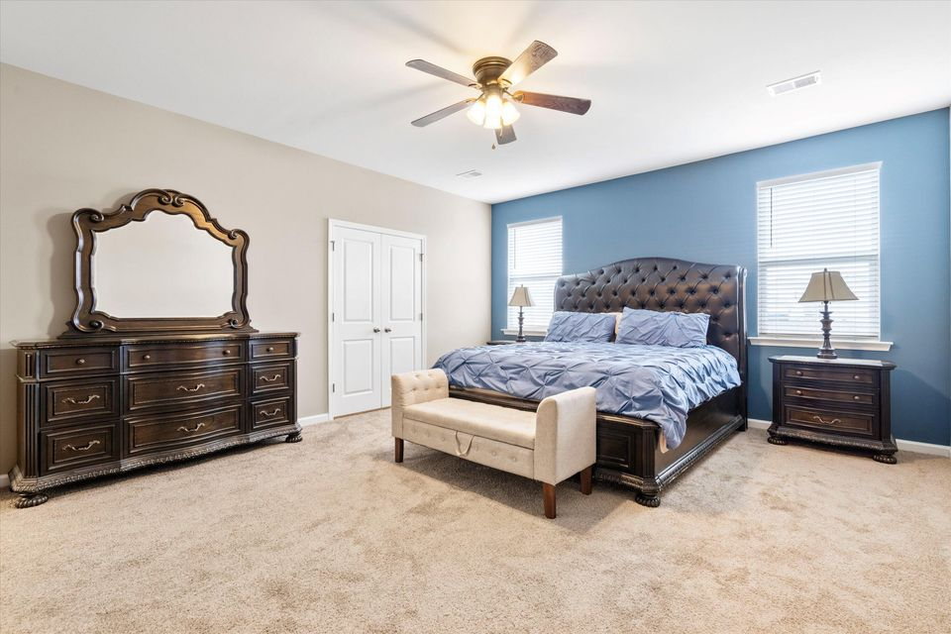
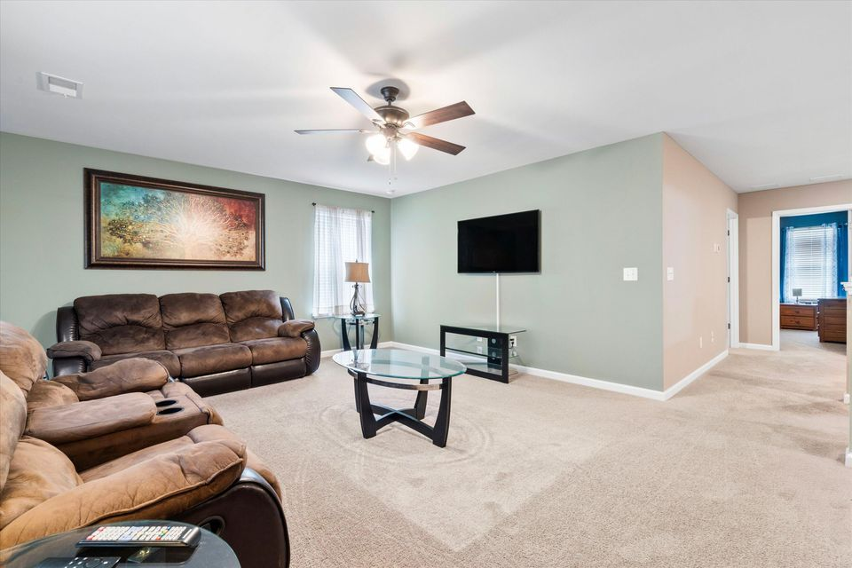



413 RIBIERO DRIVE
11/
5 BEDROOMS
3.5 BATHS
3,036 SF
� 1753
piiq 2
MAIN-FLOOR PRIMARY SUITE + 2 FULL BATHS UPSTAIRS!
CANE BAY PLANTATION | MLS# 25012416 | $465,000
ENJOY A VIDEO TOUR!
CHARLESTON
WEST ASHLE
KELLERWILLIAMS.

