Slide 1
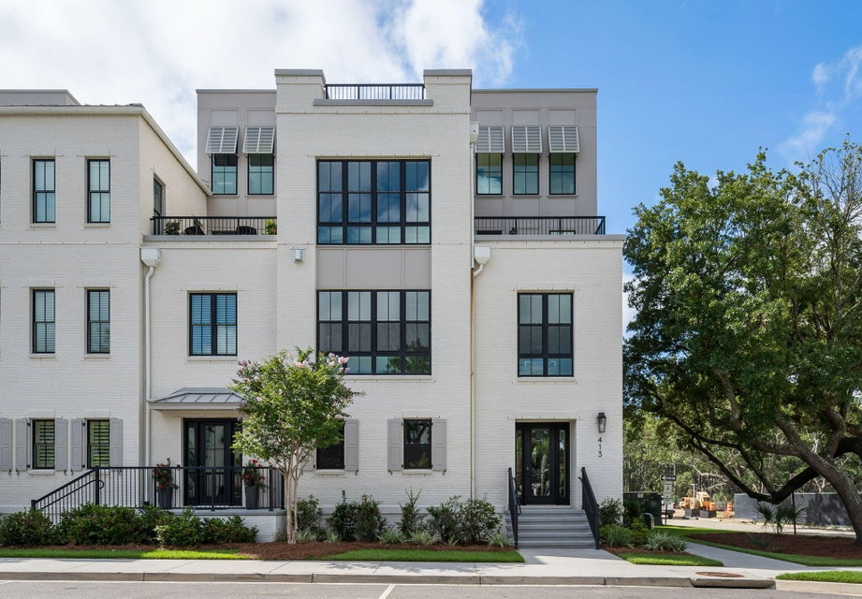
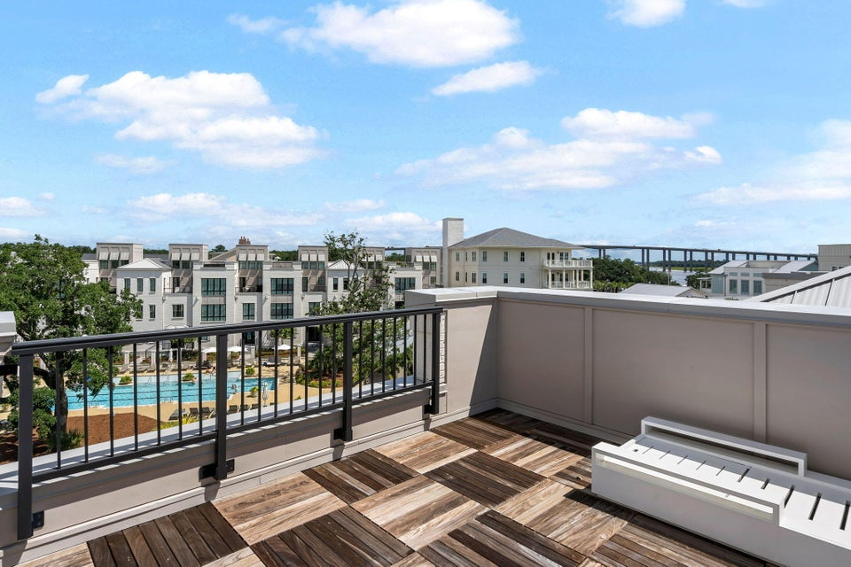
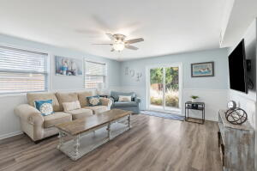
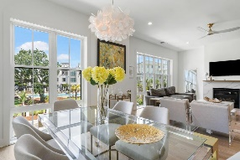
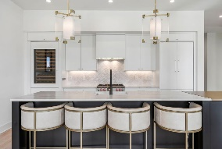
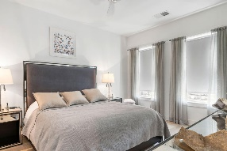
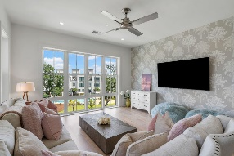
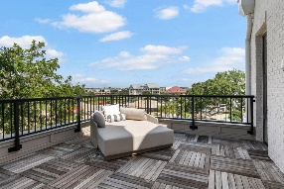

413 Spartina Lane
Daniel Island | Charleston, SC 29492 | MLS# 25018704 | $2,400,000
Daniel Island Townhome, High-end Contemporary Finishes
This stunning, corner unit, 3 bedroom, 3.5 bath townhome is located in the heart of Daniel Island's waterfront district, within walking distance of restaurants, shops, offices, and Waterfront Park. Built in 2021, the unit has been used as a second home and is in ''like new'' condition. The owners had the original custom interior professionally redesigned with classic contemporary, elegant finishes. Enter the first level of the home into the foyer. To the left you'll find a flex room that can be used as office space, a den, or a rec room. Continue straight to access the stairs or elevator. Up one floor you'll find the open-concept kitchen/living/dining areas. Large windows, here and throughout, provide an abundance of natural light and views of the beautiful community courtyard and pool.
The kitchen features stone countertops; white textured tile backsplash; 4-seat breakfast bar; BlueStar gas range; and white modern cabinetry with built-in appliances that include refrigerator/freezer, wine cooler, dishwasher, and drawer microwave. The primary suite, laundry room, and a guest powder room are also on the 2nd level of the home. The third level features two bedrooms -- each with an en suite bath -- as well as a den/flex room with a large wall of windows and a terrace, both overlooking the courtyard and pool and views of Daniel Island beyond. The fourth level is a rooftop terrace that runs the entire depth of the building and overlooks Daniel Island with glimpses of the Wando River. Home is on whole-home wireless smart lighting system by Lutron. Items that were added or replaced at the finishing stage of construction or post-construction include the following: Hardwood flooring throughout; 3-stop elevator; Custom modern handrails and glass panels in stairwells that allow for views; Designer lighting and fans and upgraded switches -- all compatible with and established on Lutron remote control smart home system; Nest thermostats; Upgraded plumbing fixtures; Emtek crystal doorknobs with black back plates and hinges; Custom-designed and built kitchen cabinetry and upgraded kitchen hardware, countertops, backsplash, dishwasher, and range; Built-in ice maker in kitchen island; Upgraded towel bars, robe hooks, and mirrors in all bathrooms; Designer tile accent wall in powder room; Custom frameless glass doors/walls in all full baths; Redesigned and rebuilt primary suite closet and hall closet shelving systems; Custom closets for other two bedrooms; Motorized shades in primary bedroom; Designer wallpaper; Custom-designed and built cabinets and shelves and custom countertops in laundry room; Ring cameras.
HOA fees cover everything except electricity and H-6 insurance (contents). Opportunity to purchase the home furnished, subject to certain exclusions.
VIEW LISTING
Andrea Rogers
843-532-3010 | andrearogers1@gmail.com | www.andrearogersrealtor.com
AgentOwned Preferred Group | 1400-G Palm Blvd | Isle Of Palms, SC 29451

