Slide 1
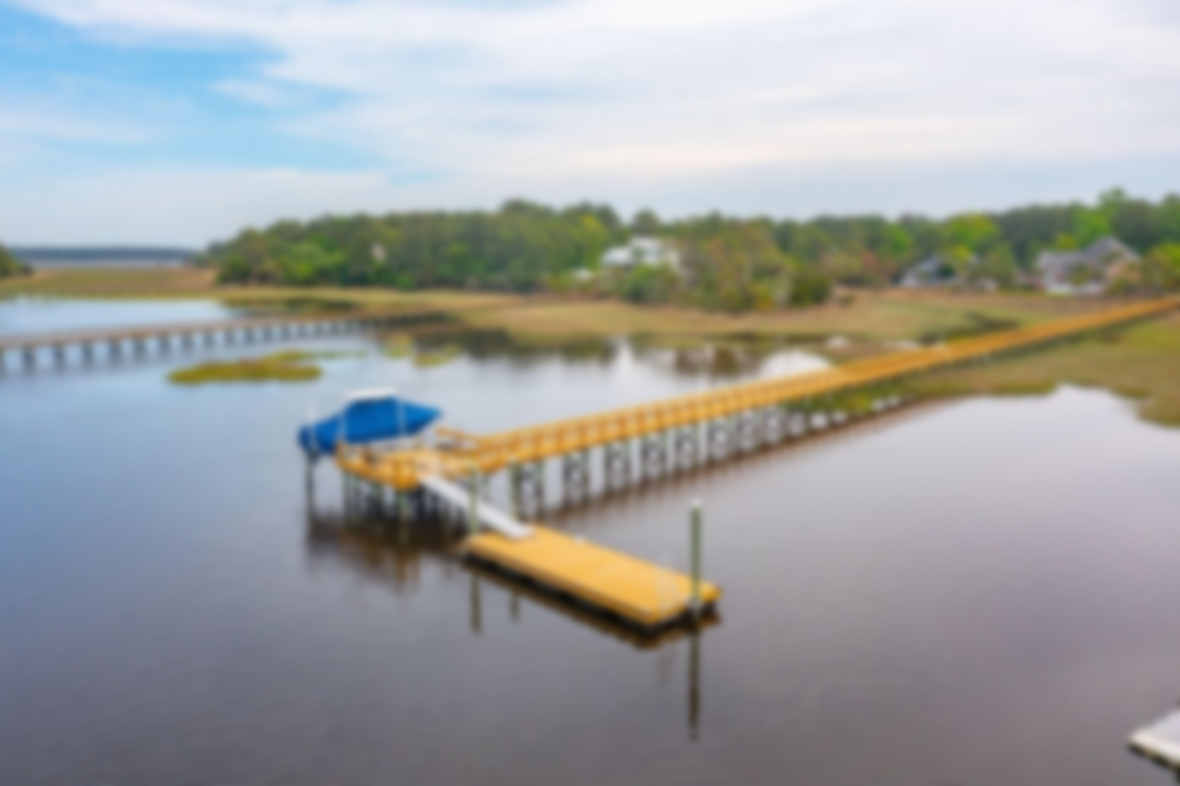
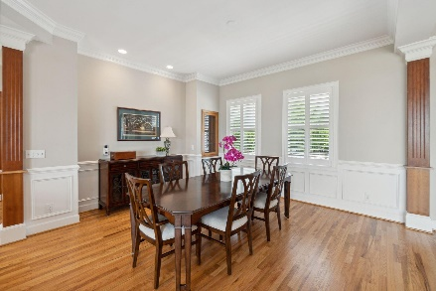
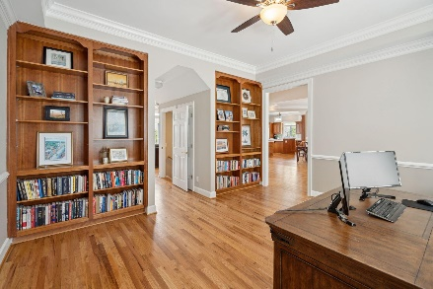
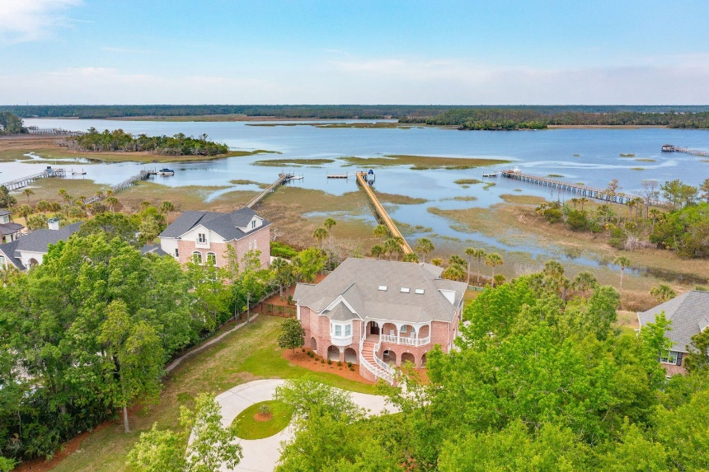
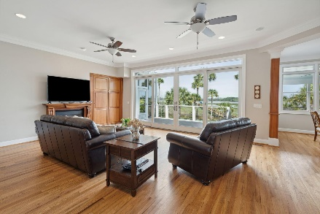
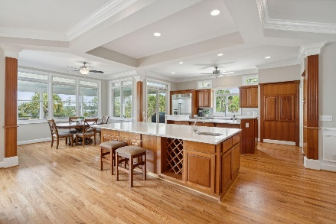
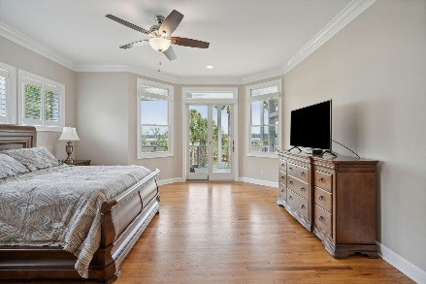
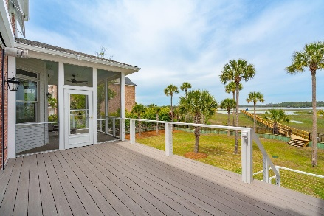
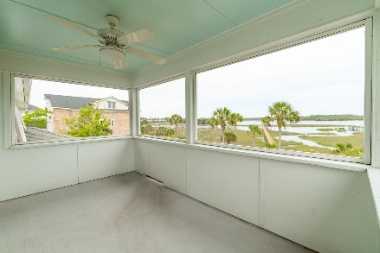
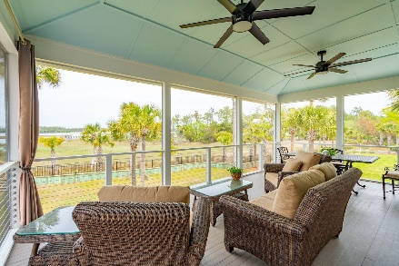
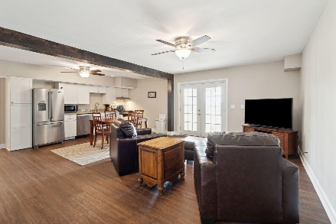
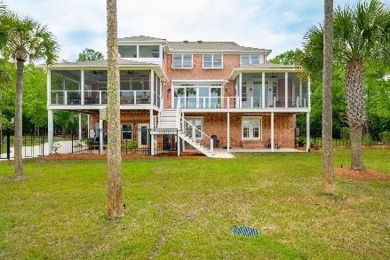
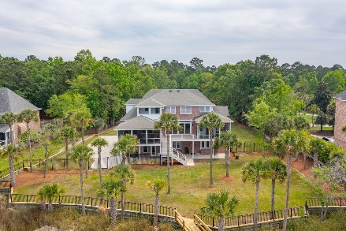
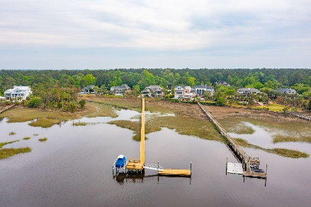


4141 Colonel Vanderhorst Cir Dunes West Mount Pleasant, SC 29466 MLS# 24009762 | $2,775,000
Riverfront Estate
Behind the gates of Dunes West, in prestigious Wagner Point, this grand southern plantation style home is nestled into an estate size lot of lush landscaping and sits on the banks of Wagner Creek. The exterior of the home is impressive, designed with a nod to the distinctive architecture of Downtown Charleston's historic 2 Meeting Street Inn and built in a timeless fashion. An imposing front staircase welcomes guests onto the rocking-chair ready front porch. Once inside, you'll find the lavish details are everywhere. Gorgeous millwork, including hardwood floors, multi-piece crown moulding, five inch baseboards, coffered ceilings, board-and-batten walls and hardwood floors are found throughout. Most awe inspiring are the expansive and breathtaking views visible from nearly every room in the home. This impressive custom residence offers its owners and their guests true luxury and comfort. A wide open floor plan is as ideal for daily living as it is for entertaining. A huge, custom crafted chef's kitchen is sure to delight even the most discerning of home cooks.
A much desired main floor owner's suite offers everything you could want, including gorgeous water views and access to a private screened-in porch. Just imagine waking to the sight of shore birds hunting for breakfast or enjoying your morning coffee while taking in the serene creek views. Automatic room darkening blinds are remote controlled for when it's time to get your beauty sleep. A luxury en-suite bath offers dual vanities, a make-up and dressing vanity, oversized jetted soaker tub, separate shower with dual shower heads and body jets, private water closet, and a large custom system walk-in closet (second closet located inside the bedroom).
While a home of this stature is certainly impressive on the interior, the outdoor living is what truly sets it apart. Located on beautiful Wagner Creek, this property showcases a newly constructed deep water dock with a 10,000 lb boat lift, floater, and an oversized pier head which is possible due to there being no homes directly across the water. The current owners have fished right off of the dock and caught large redfish behind the home. The yard is fully fenced and offers a full yard irrigation system on a well with new pump. A brand new landscape lighting project was recently completed and extends down the dock. A retaining wall was also recently constructed. Hurricane shutters are installed on all doors on the rear of home plus on top floor windows on the rear to offer piece of mind and ease of installation.
An all brick masterpiece on deep water does not come available often so don't miss your opportunity to make this dream home yours! Located in one of Mount Pleasant's premier gated communities, Dunes West offers an award winning golf course and club house, pools, tennis club, and neighborhood walking paths. Dunes West is conveniently located close to the beaches, shopping, dining, minutes from the new Roper St. Francis hospital and a short drive to the world class dining and shopping of historic downtown Charleston.
3D Virtual Tour! | Video Tour
Don Dawson 843-514-0452 ddawson@carolinaone.com Carolina One Real Estate • 2713 Highway 17 North • Mount Pleasant, SC 29466
www.TeamDawsonSC.com

