Slide 1
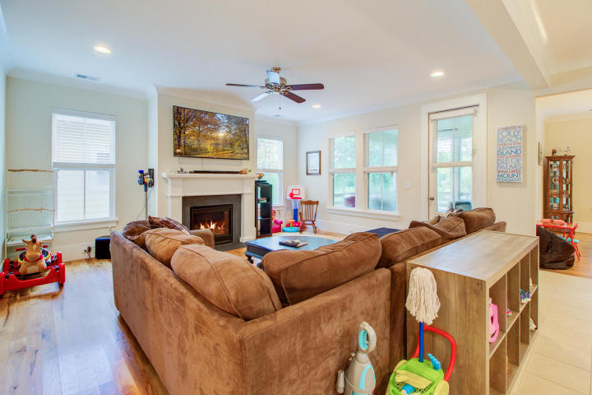
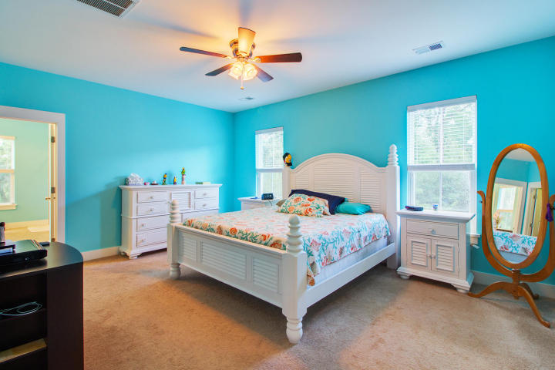
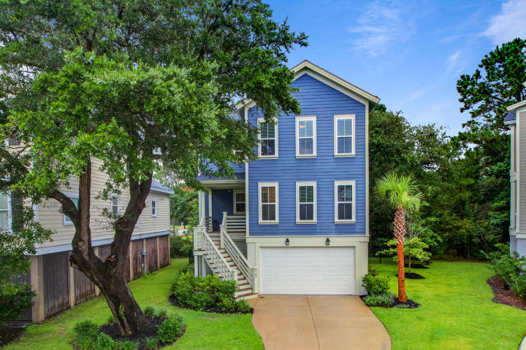
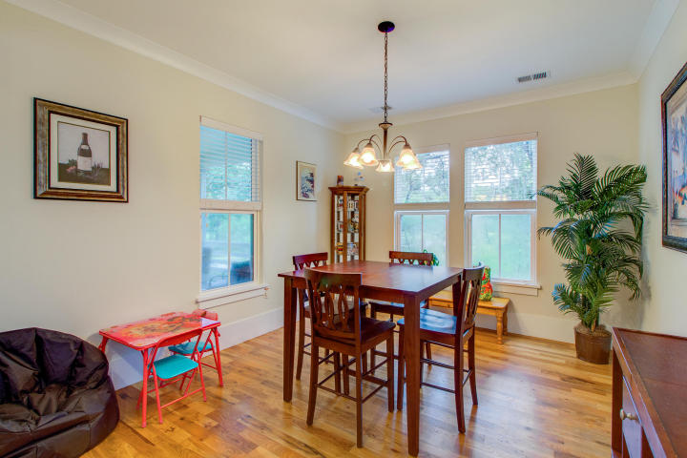
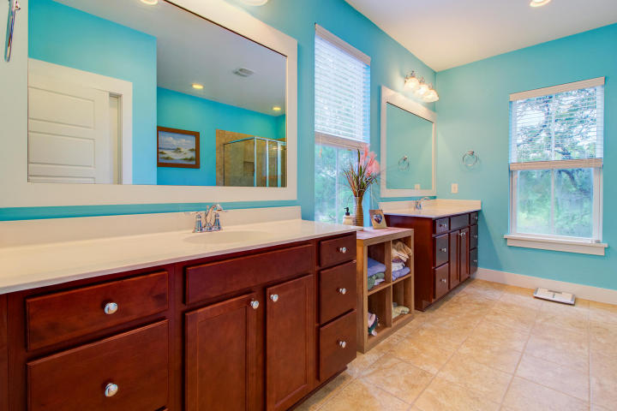
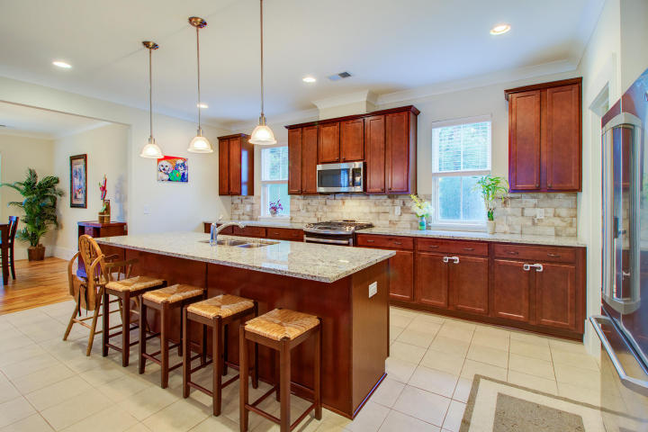
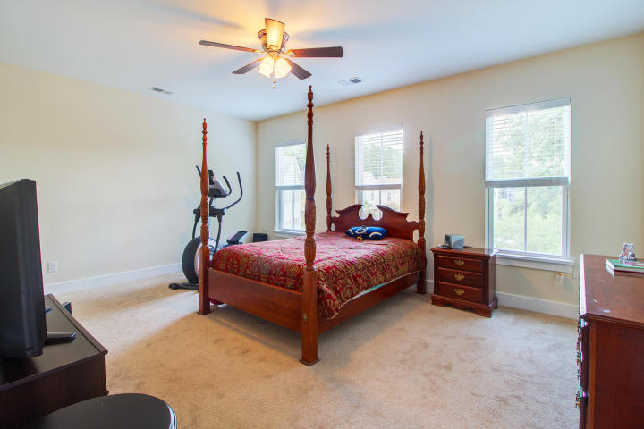
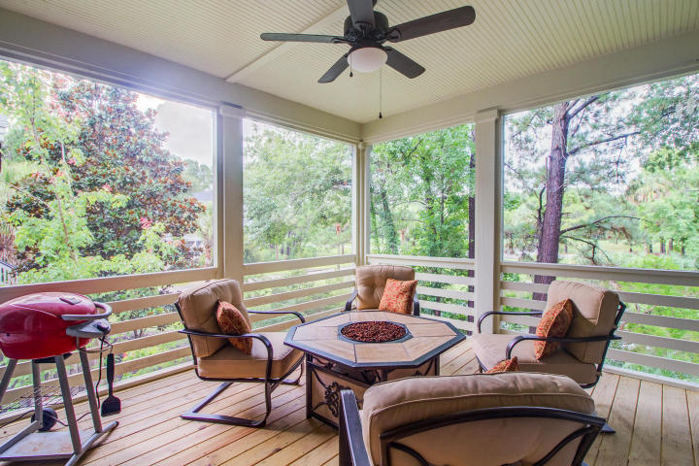
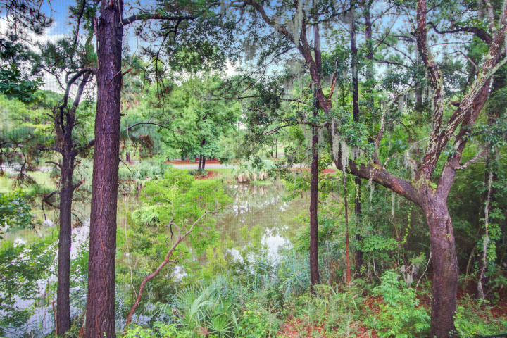


HOME PRICE REDUCED! Now Listed Under $500,000
4144 Egrets Pointe Dr
Charleston National
Mount Pleasant, SC 29466
MLS# 18021523
Beautiful 2 Story Southern Charm Home that features over 2,500 SqFt with 4 bedrooms and 2.5 baths. It's located in the Charleston National neighborhood of desirable Mount Pleasant, South Carolina.
Egrets Pointe Drive is not a through street, and therefore it is ideal for walking and biking with neighbors in this quaint community. Charleston National is a golf course community and the residents enjoy wonderful amenities including pools, a play park and tennis courts. Golf club memberships are available if interested.
The location of 4144 Egrets Pointe can't be beat! Ideally situated within Charleston National it is an easy walk or bike ride to the amenities and close to the driving range as well. Residents can easily access the entrance/exit on Rifle Range Rd. which makes the ride to nearby beaches at Isle of Palms a snap! This alternative to bustling Rt. 17 is a true bonus! Children in this neighborhood attend sought after award winning schools in Mt. Pleasant making this wonderful home a great option for everyone! You will live like you are on vacation.
Located only 15 minutes to beautiful beaches and historic downtown Charleston. This home has it all…DON’T MISS OUT ON THIS INCREDIBLE OPPORTUNITY!!
Offered at just $499,000
Call me TODAY to arrange your tour. 843-300-8530
3D Walk thru tour on MLS or go to https://my.matterport.com/show/?m=ETW9QauengJ
Ellen O'Neil
Broker/Owner, ABR, e-PRO, CNE
Charleston Realtor of Distinction
(843) 300-8530
www.EllenONeilProperties.com

