Slide 1
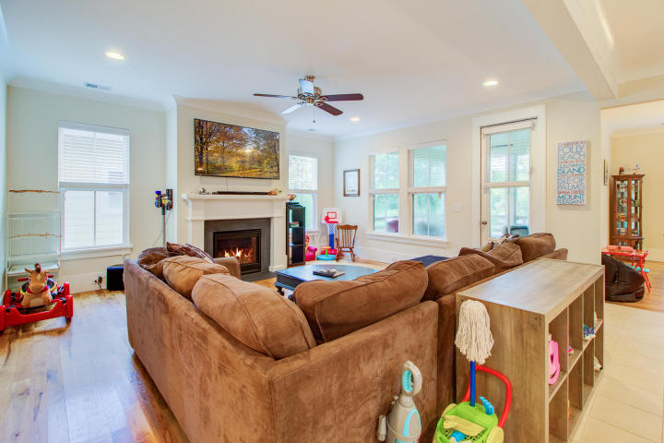
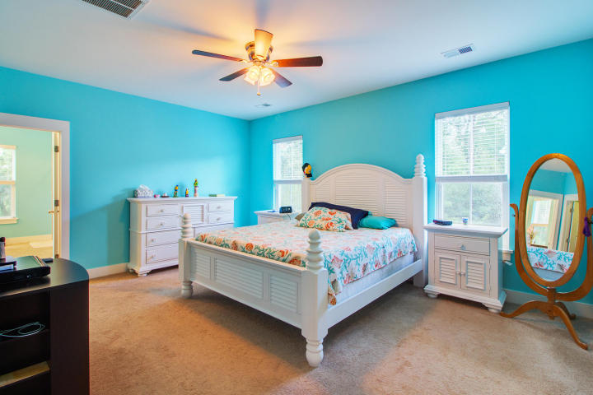
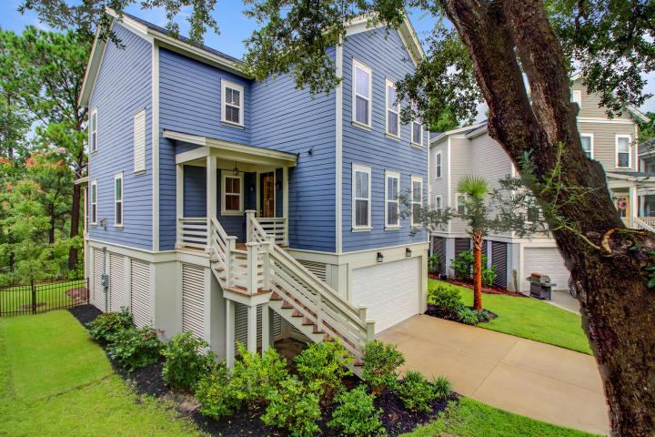
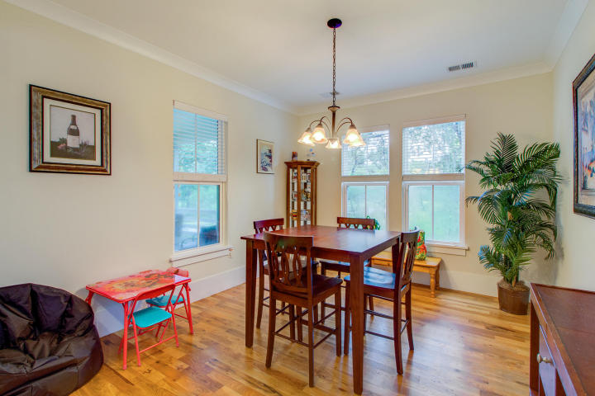
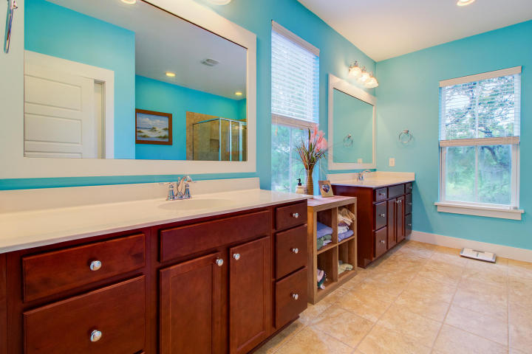
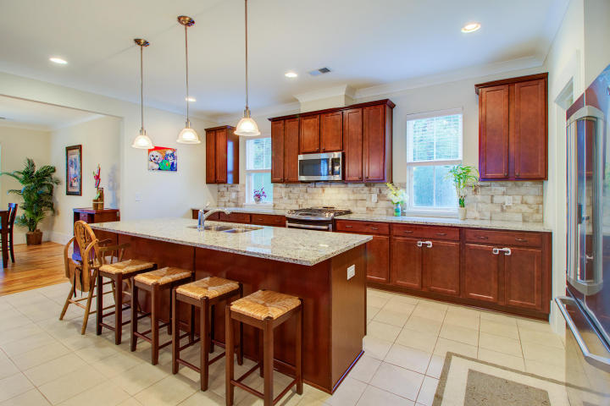
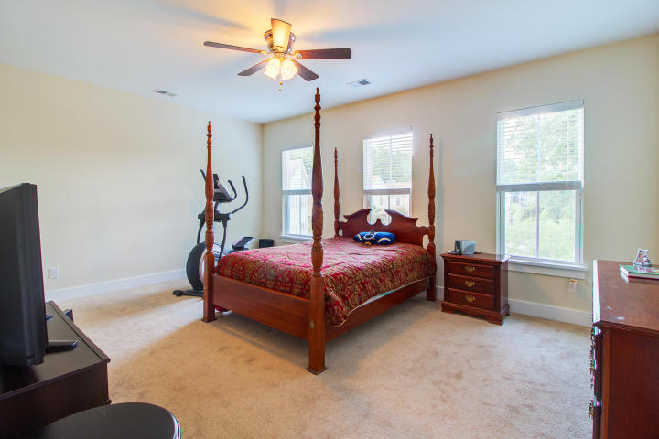
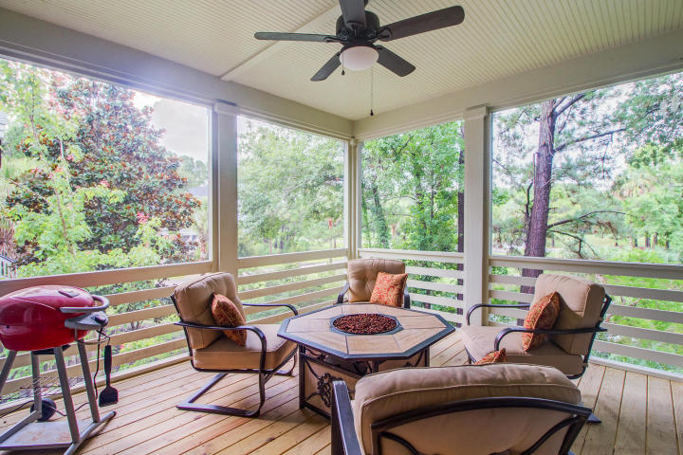
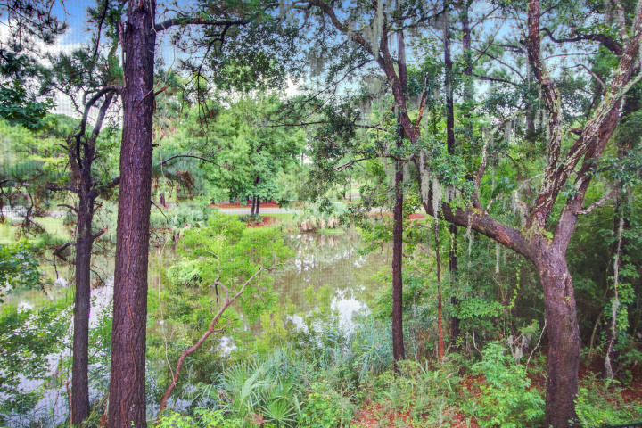


HOME PRICE REDUCED!
Now Listed Under $490,000
4144 Egrets Pointe Dr
Charleston National
Mount Pleasant, SC 29466
MLS# 18021523
This house has it all! No need to look any further - 4144 Egrets Pointe Drive is a charming Charleston style home with a fantastic floor plan and finishes that are sure to please. Entering the home you will immediately appreciate the wonderful open concept design of this home! The home is airy and bright with light wood floors and tons of natural light flooding the living area. The kitchen is huge with an abundance of cabinets and beautiful granite counters. The large kitchen island seats four comfortably and the cook in your house will love the gas range! A huge pantry comes in handy despite the fact that there are tons of cabinets making this the ideal kitchen which overlooks the family room. This layout is absolutely perfect for families and also for entertaining. There is a nice sized dining area off the kitchen with views of the beautiful back yard, which happens to be a pond lot graced with mature trees. A perfect sized screened porch is located off the family room as an added extension to the everyday living space offered in this awesome home! Also located on the main level is the laundry room and fourth bedroom which is currently being used as a home office. This is a versatile floor plan easy to adapt to your lifestyle. Venture upstairs and you will find the large master suite and two additional bedrooms. The master suite has his and her walk in closets. Dual sinks and vanities are a bonus in the huge master bath which is graced with a tiled shower and separate garden tub. The guest bedrooms are generous in size and share a full bath located off the hallway. Living in a raised home such as this offers numerous benefits. The entire lower level of the home is available to park multiple cars, provide much needed storage, and can even accommodate a boat if needed! This lovely home is situated on a beautiful lot, which overlooks a pond and is surrounded by mature trees and plants. The yard is fenced and is ideal for families with children and pets. Egrets Pointe Drive is not a through street, and therefore it is ideal for walking and biking with neighbors in this quaint community. Charleston National is a golf course community and the residents enjoy wonderful amenities including pools, a play park and tennis courts. Golf club memberships are available if interested. The location of 4144 Egrets Pointe can't be beat! Ideally situated within Charleston National it is an easy walk or bike ride to the amenities and close to the driving range as well. Residents can easily access the entrance/exit on Rifle Range Rd. which makes the ride to nearby beaches at Isle of Palms a snap! This alternative to bustling Rt. 17 is a true bonus! Children in this neighborhood attend sought after award winning schools in Mt. Pleasant making this wonderful home a great option for everyone! You will live like you are on vacation. Come tour 4144 Egrets Pointe Drive today to see for yourself why this home truly has it all!
Offered at just $489,000
Call me TODAY to arrange your tour. 843-300-8530
3D Walk thru tour on MLS or go to https://my.matterport.com/show/?m=ETW9QauengJ
Ellen O'Neil
Broker/Owner, ABR, e-PRO, CNE
Charleston Realtor of Distinction
(843) 300-8530
www.EllenONeilProperties.com

