Slide 1

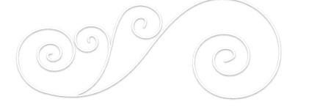
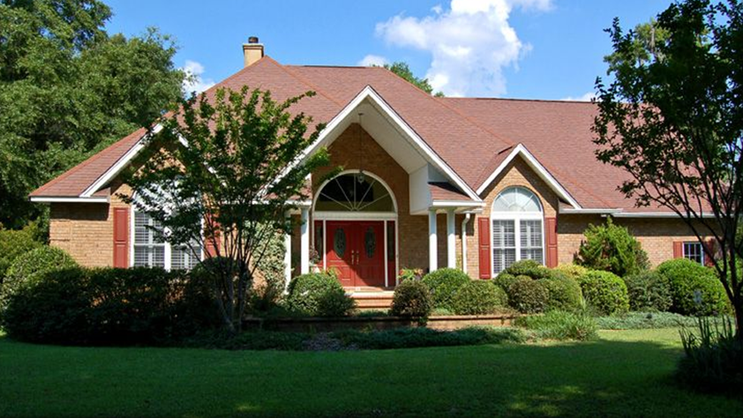
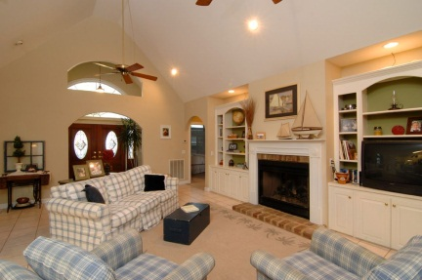
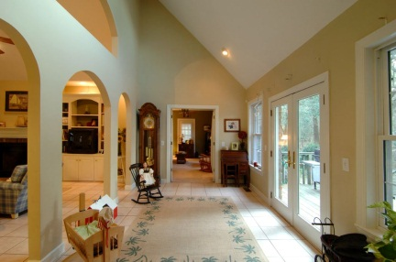
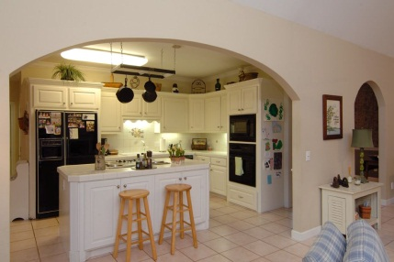
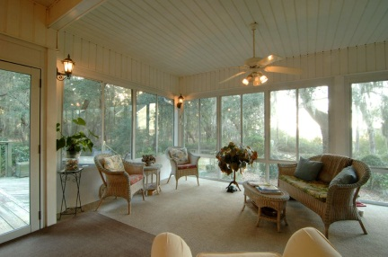
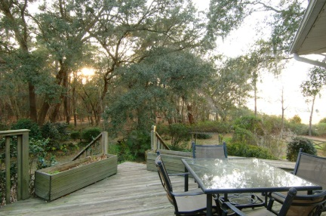
JUST LISTED
4144 Nature View Circle
Gift Plantation John’s Island Offered at $575,000
4 Bedrooms & 2 Baths
3,400 Square Feet
Approx 1.3 Acres
Marshfront Tidal Creek
Neighborhood Amenities
MLS 1301719
LUXURY LAND AND HOMES INC
95 Broad Street
Charleston SC 29401
TERRI SEIGNIOUS
Mobile 843 670 1444
Terri@LuxuryLandandHomes.com

