Slide 1
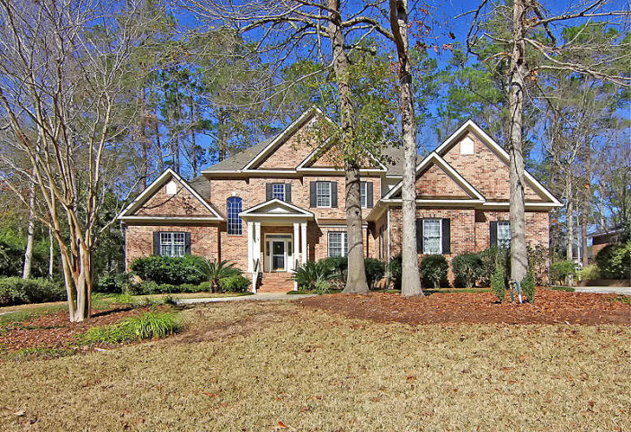
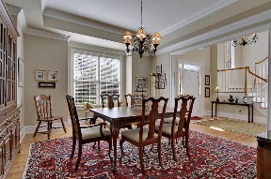
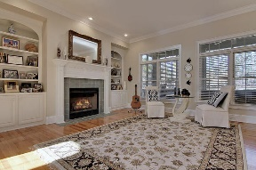
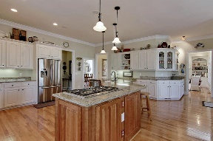
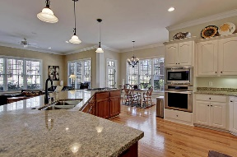
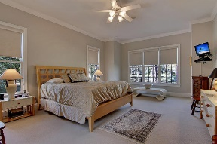
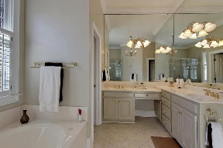
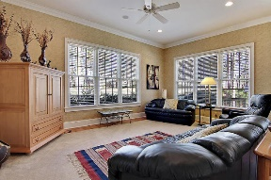
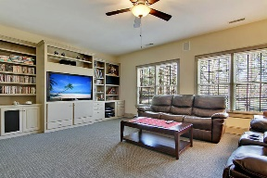
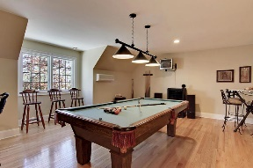
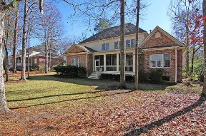
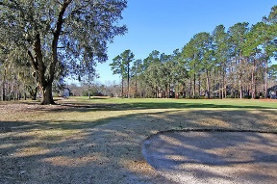



Gorgeous Golf Course Home!
4146 Club Course Drive
Coosaw Creek Country Club
North Charleston, SC 29420
MLS# 17002041
$584,900
4 Bedrooms | 3½ Baths | 4,500 sf
Get ready to be Wowed by this gorgeous home located on the golf course in the stunning community of Coosaw Creek! This home has been completely updated! Newer roof, newer HVAC, renovated kitchen, master bath...just move right in!! Curb appeal galore, this home has plenty of parking with a great circular drive. Upon entering the home, you'll be welcomed by a grand foyer with vaulted ceilings and you'll immediately notice the gorgeous wood flooring. To your right is a large dining room, perfect for entertaining. Straight ahead, you'll see the formal living room with built in cabinets and shelves, gas fireplace, and golf course views. The kitchen is a cooks delight! Granite countertops, stainless steel appliances, gas cooktop, pantry, breakfast bar, eat in area, wet bar and tons of cabinet space! No struggle finding room to store things in this kitchen! Off the kitchen is a family room, so you can be cooking and still be a part of what's happening! Off the eat in area is a small deck perfect for grilling~ then off the other side of the kitchen is a large screened in porch with ceiling fans and surround sound. The master bedroom is also located on the first floor. Great golf course views right from your bed! The master bath has been renovated and offers a whirlpool tub, large tiled shower, two large walk in closets and dual vanities. Upstairs you'll find some flex space that can be used as an office, an at home gym or for storage. There are storage areas and a closet off this space. Next is the media room. Get ready to watch your favorite shows with surround sound, built in bookshelves and more amazing golf course views! Down the hall, you have three bedrooms! One, with its own bath, perfect for out of town guests and two that share a full bath that offers dual vanities! Then, step down in to the huge FROG. This is another multi-functional room that can be used as a game room, media room, office, you name it! This home has it all! Surround sound, central vacuum, dehumidifier under the home, new hot water heater, oversized two car garage, it's a must see! The neighborhood has 24 hour 7 day a week gated security, unlimited golf for all household members, and the location, wow...close to it all! Boeing, Bosch, AFB, Mercedes are all a short drive away. Come live the good life in a golf course community that has tons of activities and events, great food in the restaurant, great community pool with an award winning swim team, and the most beautiful golf course you'll every play on!
Larry & Kathy Mazalatis
Larry Cell 843-693-0529
Kathy Cell 843-693-0159
Office 843-871-9133
AGENTOWNED PREMIERE GROUP | 1800 TROLLEY RD | SUMMERVILLE, SC 29485

