Slide 1
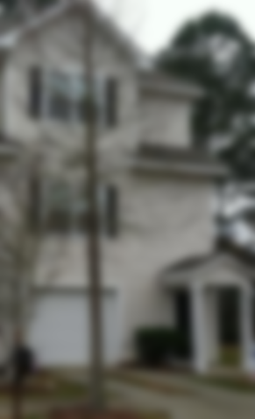
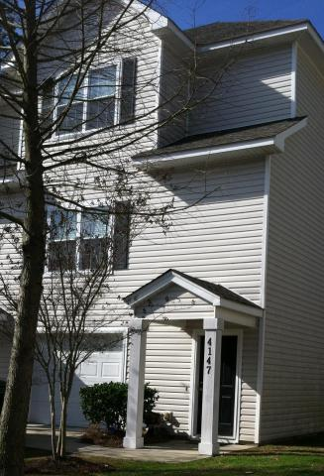
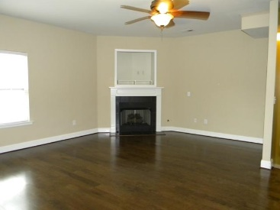
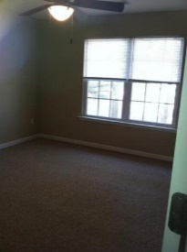
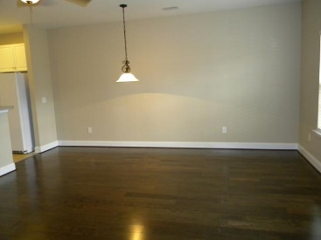
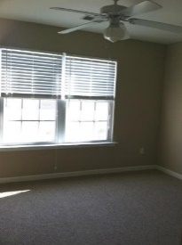
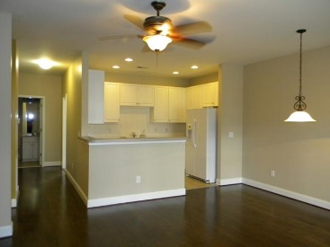
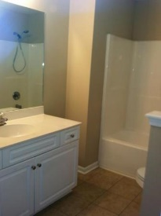
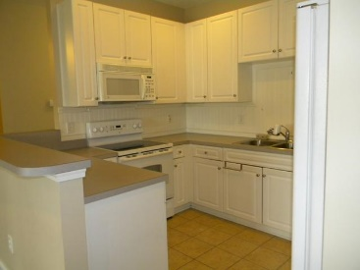
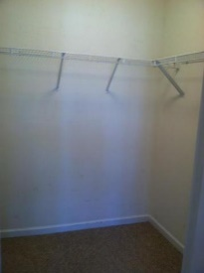


Well maintained and convenient townhome
4147 Perrine Street
Ashley Park • Charleston, SC 29414 • MLS# 17014808 • $220,000
Very nice well kept end unit townhome in convenient West Ashley. Less than 5 min to I526, shopping, dining and hospital. Close to downtown, beaches and I26. Dual master bedrooms each with full baths. Privacy fenced backyard patio area great for entertaining and grilling out. Garage fits 2 cars tandem parking with plenty of storage area.
Christina Garvin
(843) 270-7667 | cgarvin63@gmail.com
Elaine Brabham and Associates, LLC • 1890 Sam Rittenberg Boulevard, Suite 217 • Charleston, SC 29407

