Slide 1

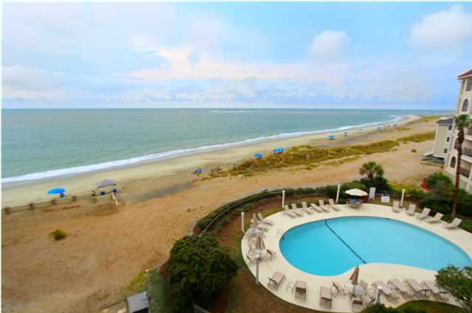
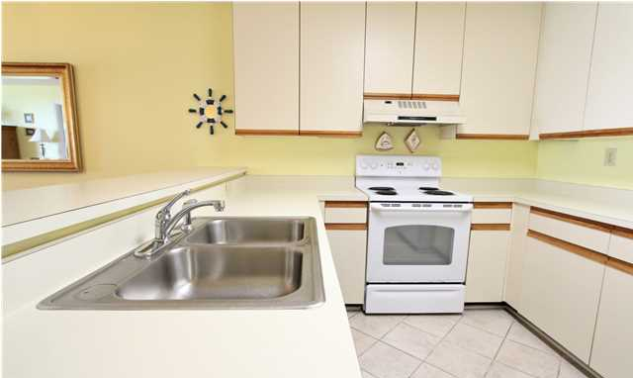
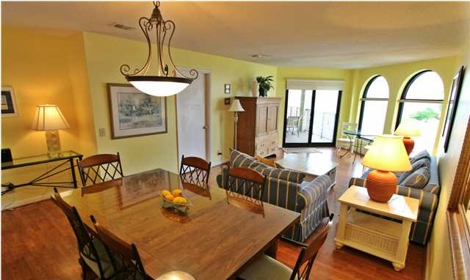
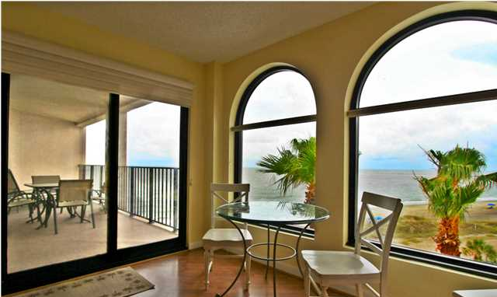
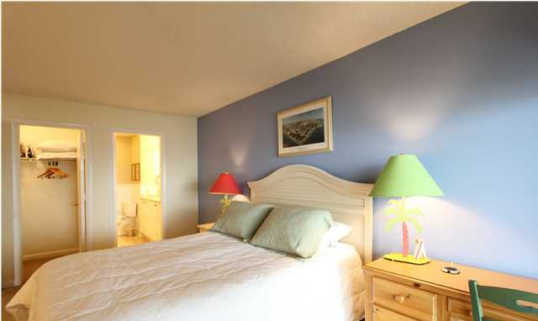
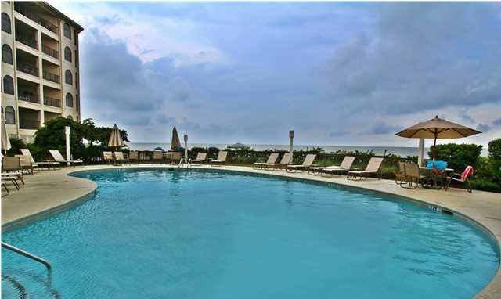
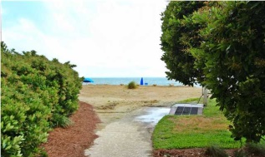



Get Paid to Live at the beach
414 Seascape Villa ~ Wild Dunes ~ Isle of Palms
MLS# 1414815 ~ $585,000
CERTIFIED PRE OWNED CONDO - Rest assured when purchasing this home, a full home inspection has been done, and necessary repairs remedied. This home is priced to sell, based on a recent appraisal. Just to wrap the deal up with a bow, the seller is offering a full coverage American Home Shield 1 year warranty. Located in the Wild Dunes resort - a prestigious, highly sought after, gated community. Enjoy golfing(less than 500 yards away), tennis, swimming, spa-services, the fitness center, clubs, socializing and island adventures! Not to mention the Isle of Palms full-service marina just a short drive away! This incredible fourth floor condo has elevator access for your convenience. This condo has been very well maintained, and is loved by repeat renters. Annual rental income exceeds $50,000 per year and the unit has a long history of being rented to many of the same guests year after year. Some highlights include a wide open floor plan that allows you to entertain all of your family and friends. No one will want to leave! The prime oceanfront location impresses with views of the Atlantic ocean seen from the entire main living area as well as from the master bedroom. Wake up to a beautiful sunrise and fall asleep listening to the waves. The large, private ocean view deck has plenty of seating. It overlooks the beach and the pool and is accessible from either set of sliding doors located in the living area and the master suite. Both GORGEOUS updated baths are sure to impress. The living area has easy to maintain, beautiful flooring. Kitchens, baths and the entry are tiled, ideal for easy cleaning and durability. The HVAC was replaced in 2009, and the water heater replaced 6/21/2012. BRAND NEW WINDOWS AND DOORS! Being sold fully furnished with a short list of what the owners will keep. Just bring your swimsuit! Check out the competition and we think you will agree that this is the best value out there! Enjoy the salty ocean air, soak up the sunshine and admire the sunrise from the comfort of your own slice of paradise! Escape to 414 Seascape Villa. The Seascape monthly fee for this condo is $1050 and includes INSURANCE, flood, sewer, water and cable, grounds and exterior building maintenance, pool and elevator maintenance.
Norm Cooper
ABR, GRI, Charleston Top Producer
normcooper@kw.com
843-460-0319
www.charlestonwaterfrontnewhomes.com

