Slide 1



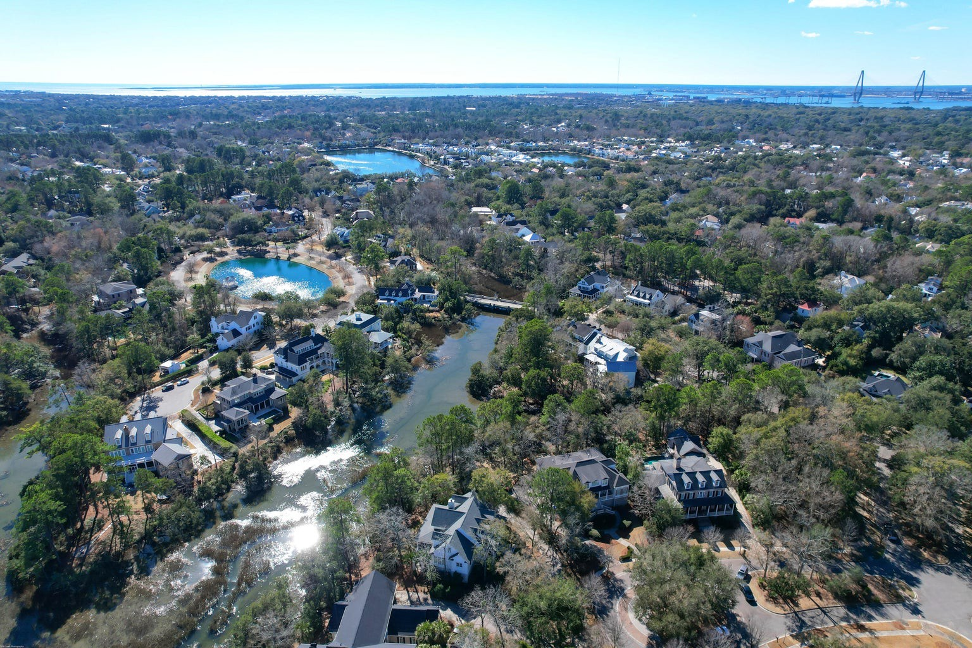
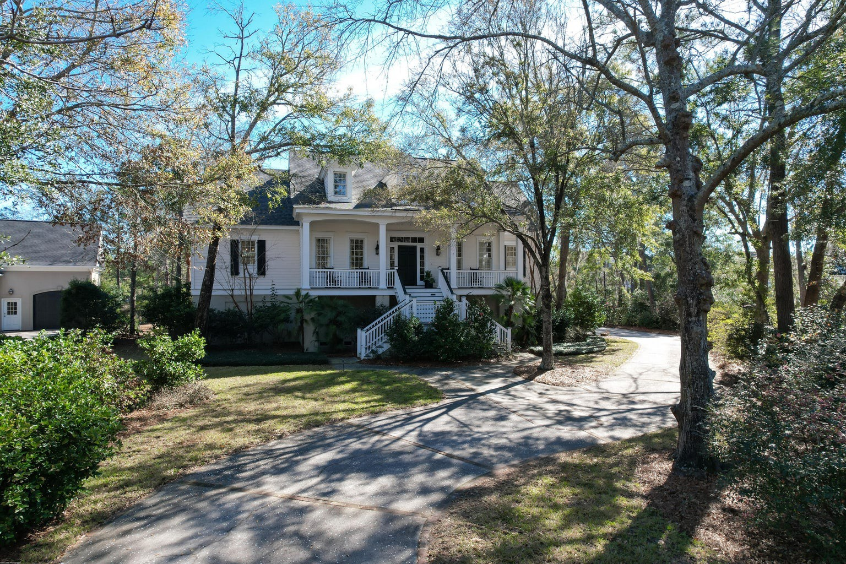
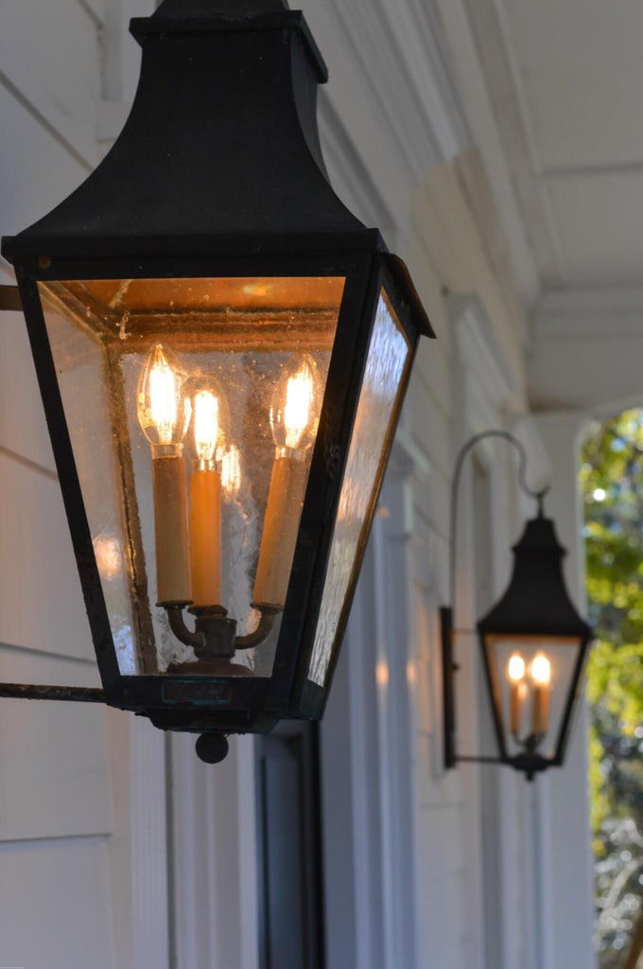
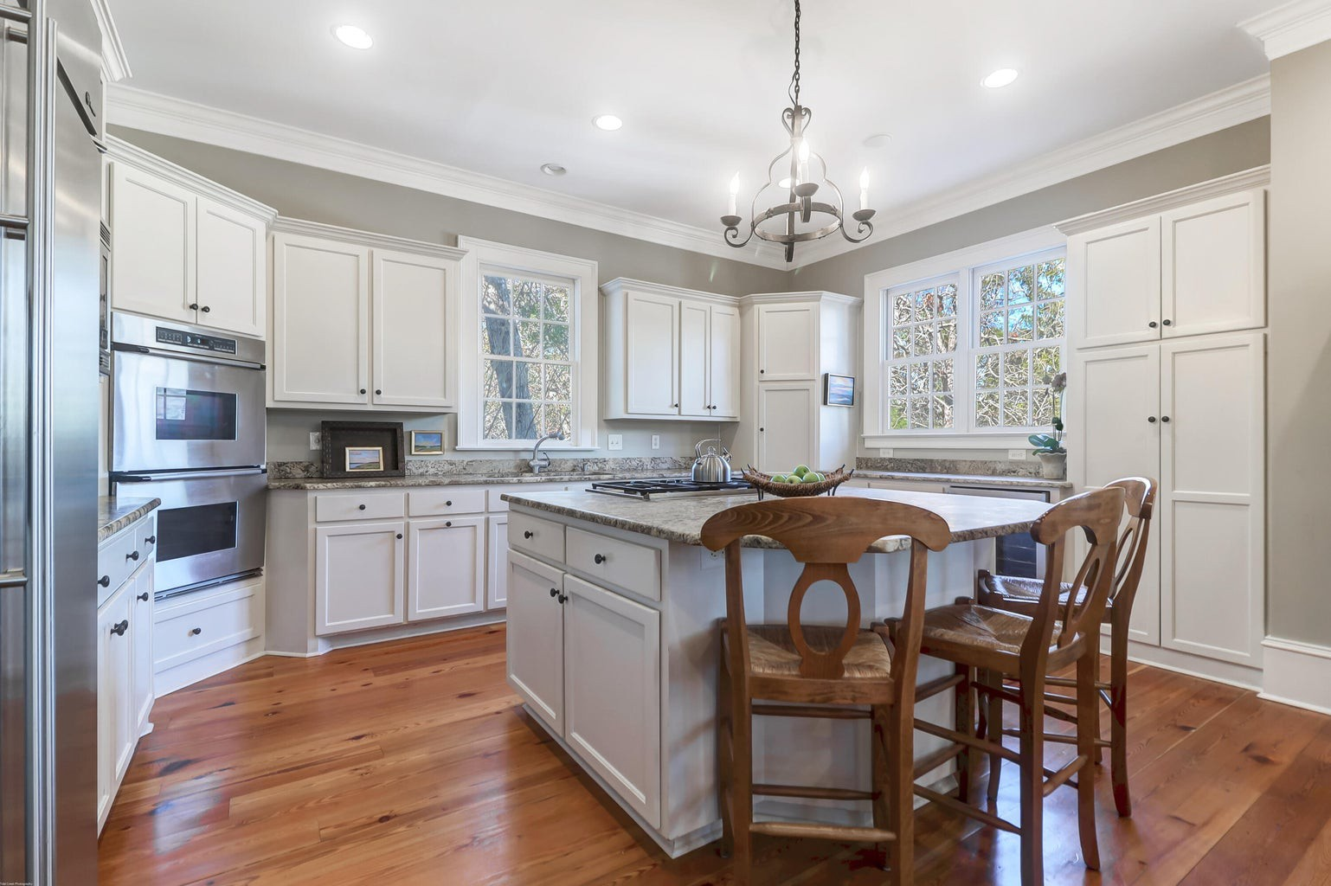
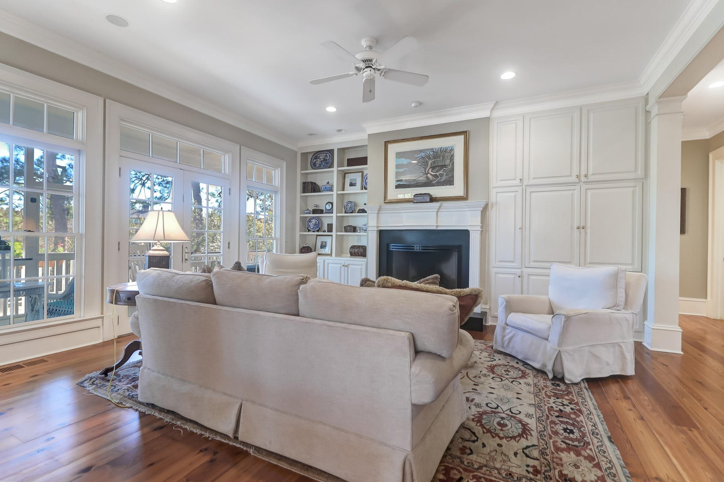
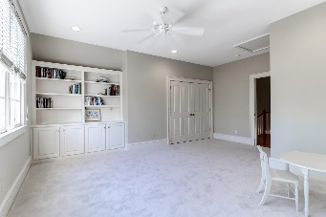
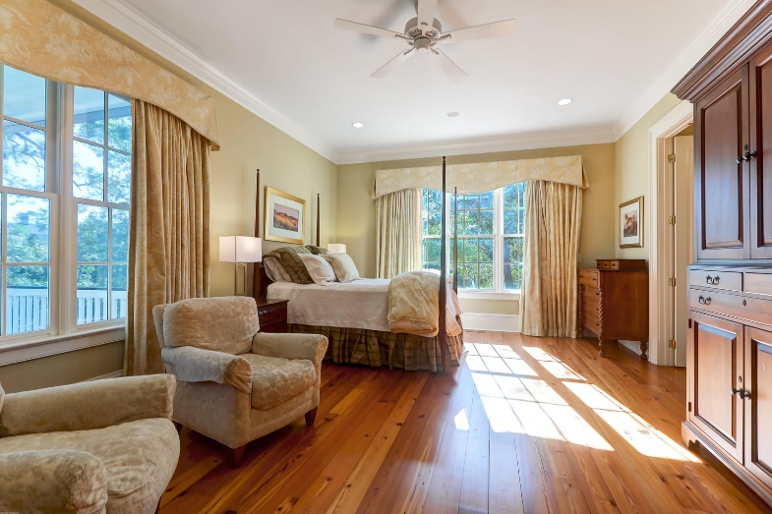
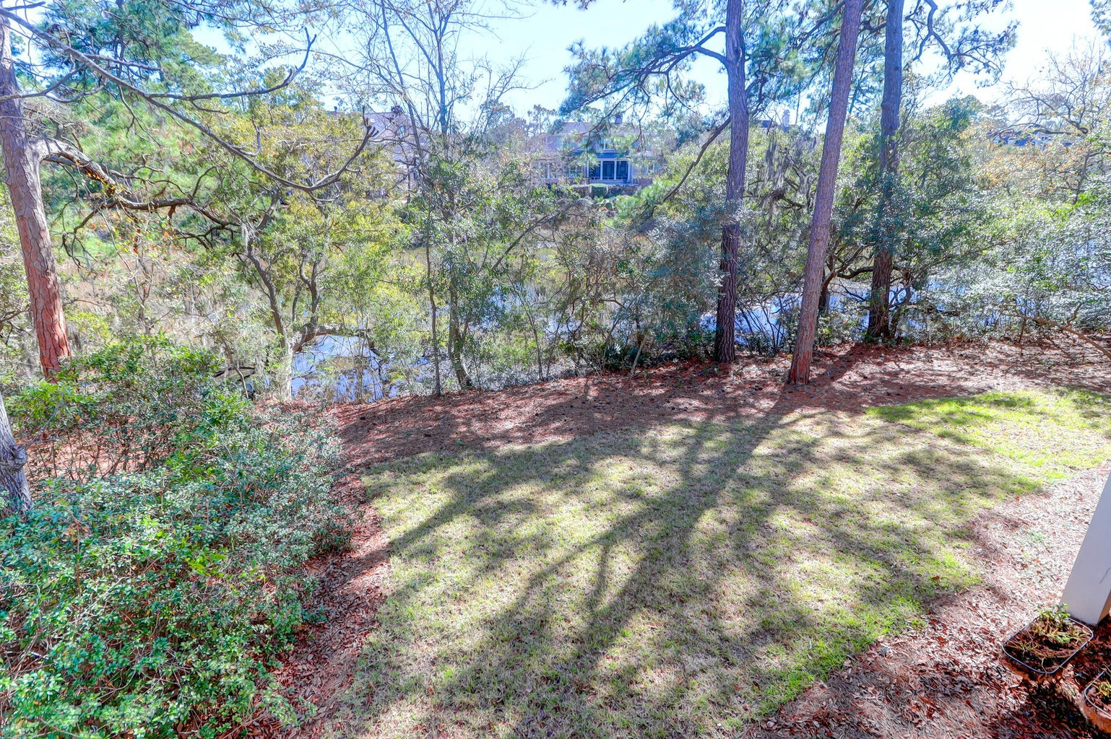
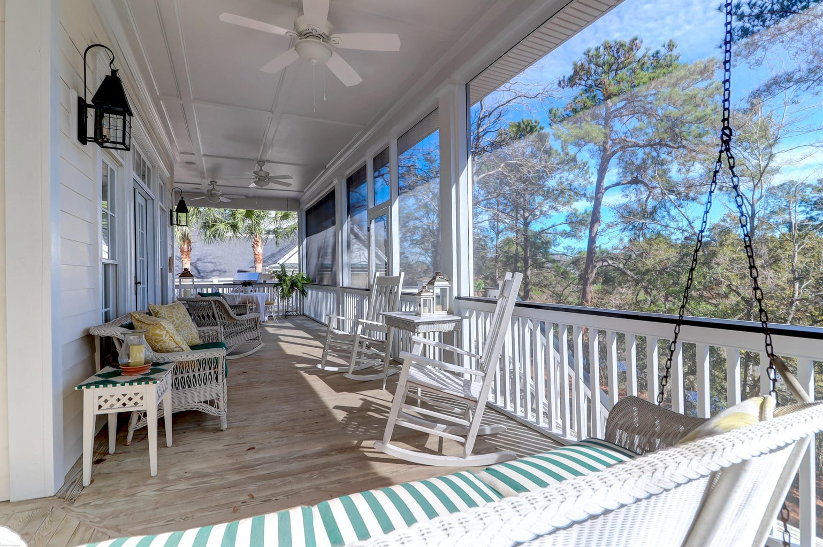
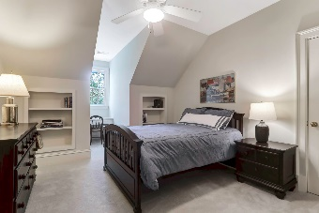
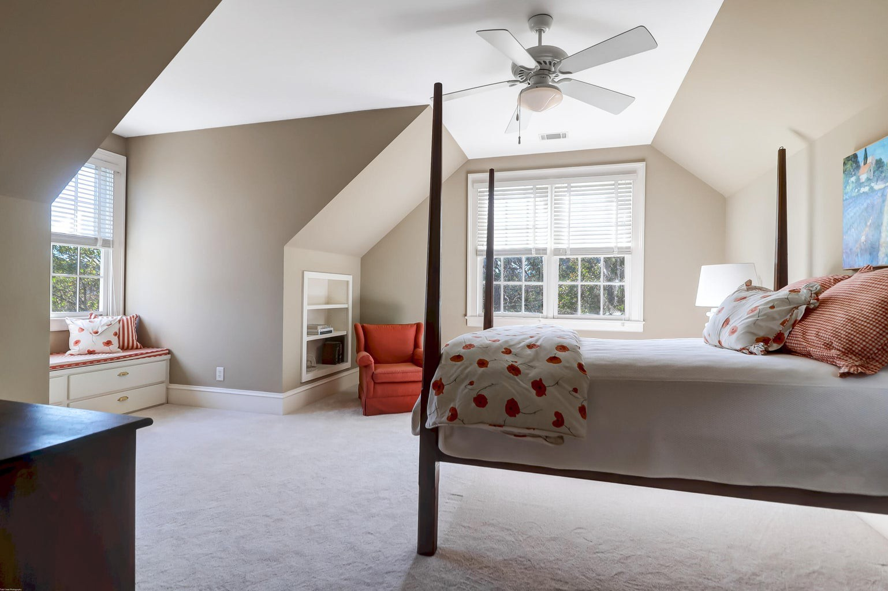
Leesa Northrup
Carolina One Real Estate 628 Long Point Road Mount Pleasant SC 29464 Office: 843.884.1622
Mobile: 843.442.0987
Fax: 843.746.4994
lnorthrup@carolinaone.com
414 Creek Bend Wharf
Olde Park | Mount Pleasant, SC 29464
Welcome to a captivating haven of refined elegance, where luxury meets the tranquility of marshfront living. Nestled in the heart of a prestigious neighborhood, this extraordinary residence embodies sophistication Southern charm. As you approach the full front porch with its welcome arm staircase, a sense of peace envelops you. The mature landscaped grounds showcase the lovely plantings including many large camellias. Step inside and be greeted by a foyer that sets the tone for the entire residence. Gleaming reclaimed heart pine floors and the handcrafted foyer light guide you through to the expansive living spaces, where large windows frame breathtaking views of the marsh, bringing the outdoors in. The living room is a symphony of comfort and style, with a fireplace with a custom-made wrought iron screen, as its centerpiece, inviting you to unwind and enjoy! The eat in kitchen and the sunroom lead you to the gourmet kitchen, featuring top-of- the-line appliances, custom cabinetry, and a center island that doubles as a gathering point for friends and family. Adjacent is the formal dining room, large enough to seat all your guests with a lovely Venetian Fortuny Chandelier. The owner's suite is a sanctuary, boasting panoramic marsh views, a private sitting area, and a spa-like ensuite bathroom with exquisite finishes. Four additional bedrooms and two more bathrooms offer ample space for family or guests, each designed with a commitment to elegance and comfort. The seamless integration of indoor and outdoor living spaces is showcased by the expansive back screened in porch, providing a perfect vantage point to enjoy early morning coffee while listening to the birds. This home is not just a residence; it is a testament to the art of living well. The attention to detail is evident in every square inch, from the crown molding to the custom-built bookshelves to the antique newel post in the foyer. With a dedication to quality and craftsmanship, this marshfront estate stands as a paragon of elegance in a highly sought-after neighborhood.
Enjoy a video tour!
Now Offering at $3,400,000
MLS 23023257
Bedrooms: 5
Bathrooms: 3.5
Square Feet: 3,968

