Slide 1
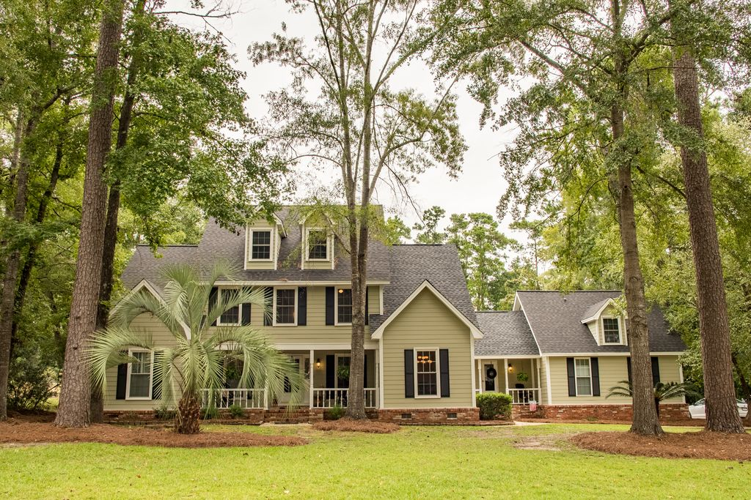
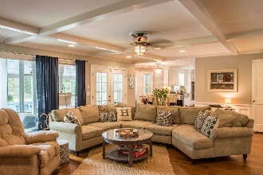
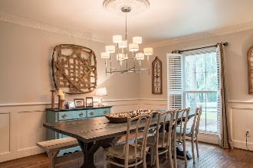
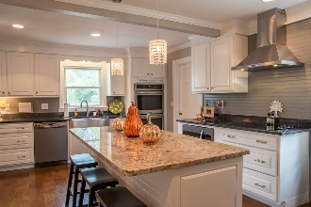
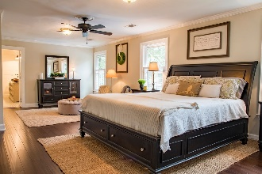
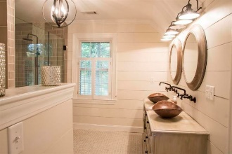
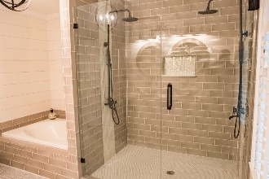
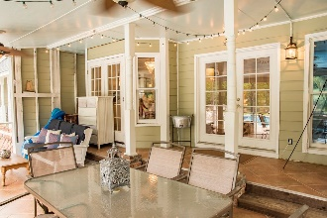
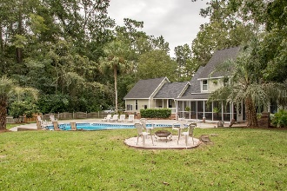
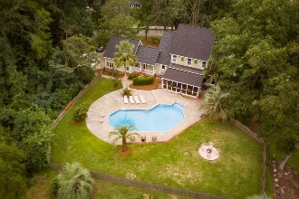



Spring - Move in at Best Time of Year!
Back on the Market!
SWIMMING POOL...ON THE GOLF COURSE… NO HOA!
415 Country Club Blvd Country Club Estates · Summerville, SC 29483 · MLS# 19003361 · $539,000 5 Bedrooms | 5 Baths | 4,290 Sq Ft
SPRINGTIME, AZALEAS... ON THE GOLF COURSE AND NO HOA...OVERSIZED SWIMMING POOL....! Between Miler Country Club and Tea Farm, a Golf Course Lot situated on HOLE #4.
This stunning home is perfect for hosting parties and large family gatherings. Starting with the UPGRADES; New hardwood flooring, new architectural shingled roof, 2 new HVAC units and duct replacement, new Hardiplank siding, total KITCHEN REMODEL/EXPANSION with double ovens, new appliances, GRANITE counter tops, a beautifully crafted functional Island with four deep drawers for larger items. The kitchen has drawers and cabinets galore including DOUBLE TRASH CAN PULL-OUT DRAWERS at each end of the kitchen. And a must-have HUGE PANTRY and added WINE/BEVERAGE NOOK.
This kitchen was designed with love for style and convenience. The Family Room features a large Charleston Brick Fireplace, French Doors and a Showcase Window for lots of lighting.
The Master Bedroom offers all you could ask for with a Large Sitting Area, a Huge WALK-IN CLOSET and an additional closet with shelving and hang-ups. The 2017 UPGRADE of the MASTER BATH accents the DUAL SHOWER SYSTEMS, separate oversized garden tub and double sinks for him and her. All upstairs bedrooms have WALK-IN CLOSETS with their own attic door access for plenty of STORAGE. The Mother-in-Law Suite includes kitchen, bedroom, full bath and living area. Not to leave out the ample space in the FROG that includes another FULL BATH. The third story could be used as office space, a playroom, a media room, MORE STORAGE or a bedroom complete with more attic space. This magnificent home with its established natural landscape features a LARGE IN-GROUND POOL for fun at home. To top it off, you have a getaway area on quiet nights sitting out on your Large Screened-in Back Porch by the Pool. The location is perfect for walking/running and bike rides with access to the Sawmill Branch Trail. This unique home is located on a quite street with no thru traffic. Tight-knit community and caring neighbors. Convenient location and has everything you could possibly desire.
SOUTHERN CHARM!
JACKIE LAWSON, REALTOR®
(843) 568-1250 · jlawsonhomes@gmail.com · CharlestonHomesByJackie.com
AgentOwned Realty Co. Premier Group, Inc. · 141 A N. Main Street · Summerville, SC 29483

