Slide 1
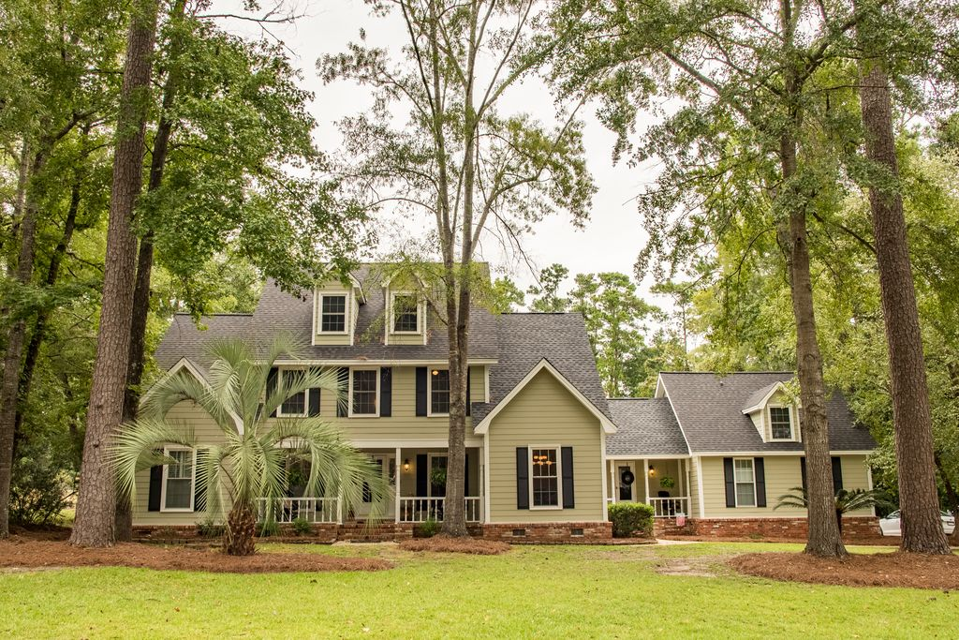
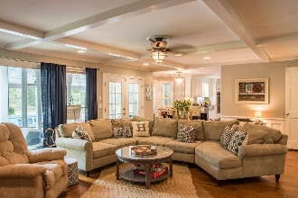
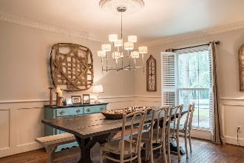
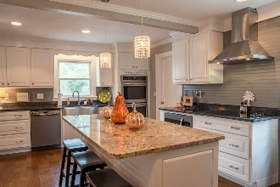
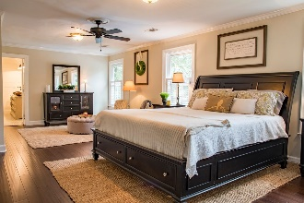
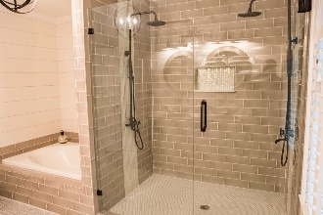
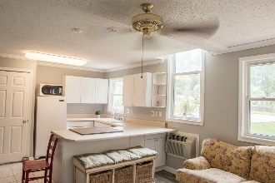
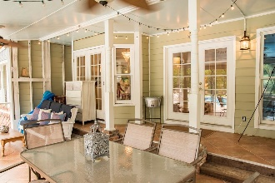
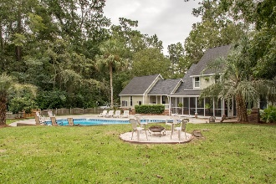
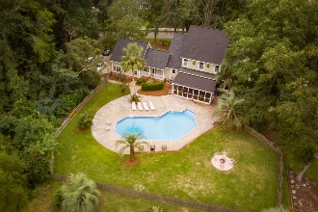
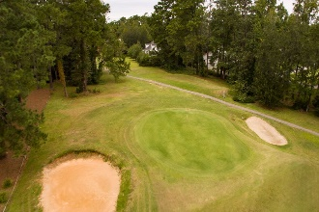


17 Timmerman
Byrnes Downs
Charleston, SC 29407
MLS# 16022572 · $2,500/mo
3 Bedrooms | 2 Full Baths | 1,233 Sq Dt
Timeless Character And Modern Upgrades!
415 Country Club Blvd
Country Club Estates · Summerville, SC 29483 · MLS# 18017510 · $554,900
5 Bedrooms | 5 Baths | 4,290 Sq Ft
BACK ON THE MARKET!
Between Miler Country Club and Tea Farm, a Golf Course Lot situated on hole #4. The perfect balance that will make you feel right at home and awesome for hosting parties. Starting with the upgrades; new hardwood flooring, new architectural shingled roof, 2 new HVAC units and duct replacement, new hardiplank siding, total kitchen expansion/remodel with double ovens that every kitchen desires, new appliances, granite counter tops, beautiful island, drawers and cabinets galore, not to forget the huge pantry and added wine/beverage nook. This kitchen was designed with love for style and convenience. The family room features a large Charleston Brick Fireplace, French doors and a showcase window for lots of lighting. The master bedroom is considerably large with a sitting area, huge walk-in closet and an additional closet with shelving and hang-ups. The 2017 upgrade of the master bathroom accents the dual shower systems, separate oversized garden tub and double sinks for him and her. All upstairs bedrooms have walk-in closets with their own attic door access for plenty of storage. The mother-in-law suite includes the kitchen, bedroom, full bath and living area. Not to leave out the large finished room over the mother-in-law suite with another full bath. Third story could be used as office space, a playroom, more storage or a bedroom complete with more attic space. This magnificent home with its established natural landscape features a large in-ground pool for fun and exercise at home. To top it off, you have that area for quiet nights sitting on a large screened-in back porch. The location is perfect for walking and bike rides with access to the Sawmill Branch Trail. House is located on a dead end street with no thru traffic. It's convenient to what you need and has everything you could possibly want.
CHARM!
JACKIE LAWSON, REALTOR®
(843) 568-1250 · jlawsonhomes@gmail.com · jackielawsonrealty.com
AgentOwned Realty Co. Premier Group, Inc. · 141 A N. Main Street · Summerville, SC 29483

