Slide 1
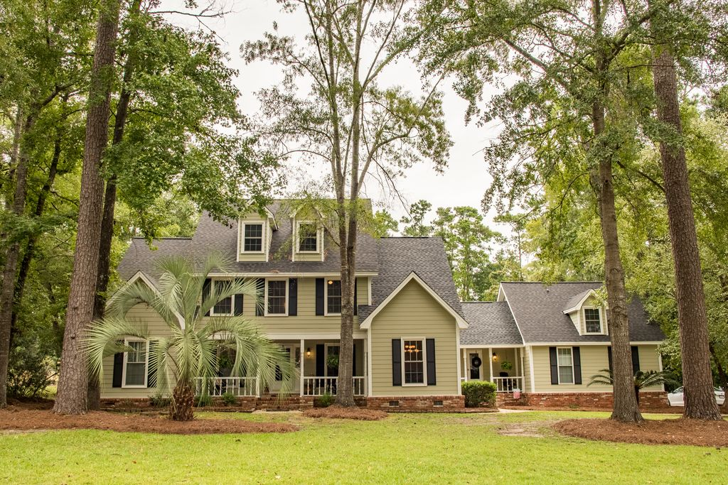
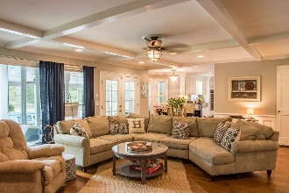
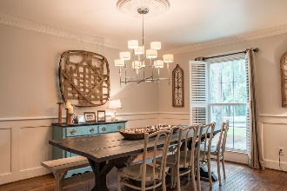
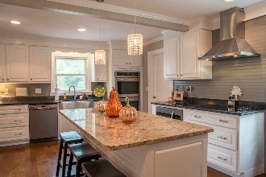
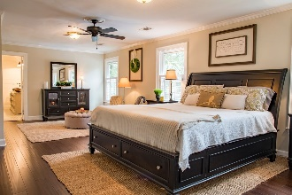
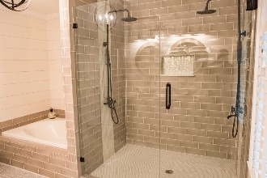
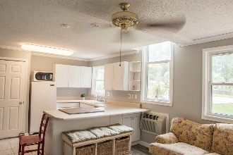
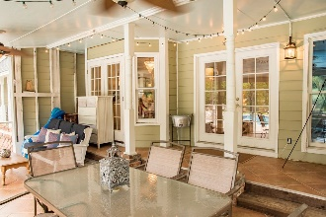
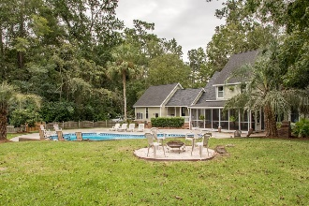
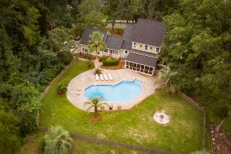
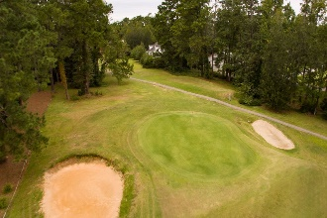


17 Timmerman Byrnes Downs Charleston, SC 29407 MLS# 16022572 · $2,500/mo 3 Bedrooms | 2 Full Baths | 1,233 Sq Dt
KICKOUT CLAUSE IN PLACE!
BUYERS CAN STILL VIEW AND SUBMIT OFFERS!
415 Country Club Blvd Country Club Estates · Summerville, SC 29483 · MLS# 18017510 · $554,900 5 Bedrooms | 5 Baths | 4,290 Sq Ft
BUYERS CAN STILL VIEW AND SUBMIT OFFERS ON THIS PROPERTY.
THE CONTINGENT Buyers have not been able to sell their home to close on this one.
There is NO HOA! SWIMMING POOL! ON THE GOLF COURSE! Between Miler Country Club and Tea Farm, a Golf Course Lot situated on hole #4. The perfect balance that will make you feel right at home and awesome for hosting parties. Starting with the upgrades; new hardwood flooring, new architectural shingled roof, 2 new HVAC units and duct replacement, new hardiplank siding, total kitchen expansion/remodel with double ovens that every kitchen desires, new appliances, granite counter tops, beautiful island, drawers and cabinets galore, not to forget the huge pantry and added wine/beverage nook. This kitchen was designed with love for style and convenience. The master bedroom is considerably large with a sitting area, one huge walk-in closet and an additional smaller closet with shelving and hang-ups. The 2017 upgrade of the master bathroom accents the dual shower systems, separate oversized garden tub and double sinks for him and her. All upstairs bedrooms have walk-in closets with their own attic door access for plenty of storage. The mother-in-law suite includes the kitchen, bedroom, full bath and living area. Not to leave out the large finished room over the mother-in-law suite with another full bath. Third story could be used as office space, a playroom, more storage or a bedroom complete with more attic space. This magnificent home with its established natural landscape features a large in-ground pool for fun and exercise at home. To top it off, you have that area for quiet nights sitting on a large screened-in back porch. The location is perfect for walking and bike rides with access to the Sawmill Branch Trail. House is located on a dead end street with no thru traffic. It's convenient to what you need and has everything you could possibly want. CHARM!
JACKIE LAWSON, REALTOR®
(843) 568-1250 · jlawsonhomes@gmail.com · CharlestonHomesByJackie.com
AgentOwned Realty Co. Premier Group, Inc. · 141 A N. Main Street · Summerville, SC 29483

